Slide 1
ASA NJ Chapter Spring Symposium – 40th Anniversary: A Brief History
June 28th, 2019
Steve Ascher, PhD
Secretary – ASA NJ Chapter

Slide 2
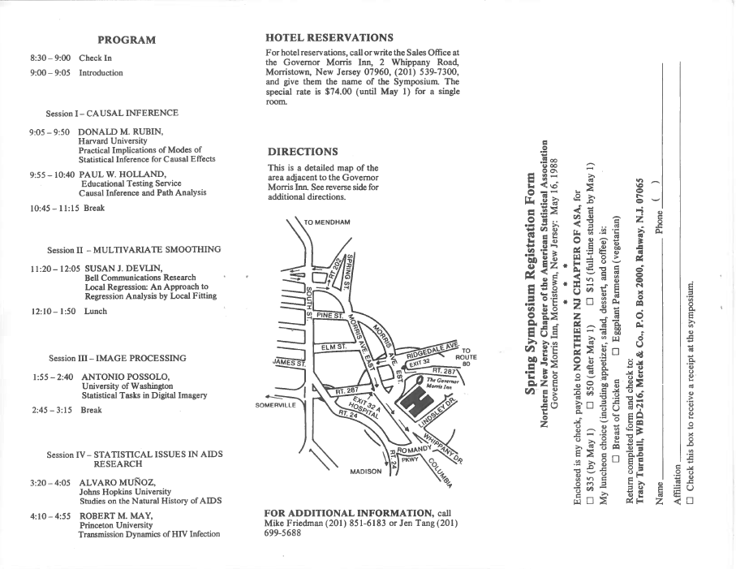
The Northern New Jersey Chapter of the American Statistical Association
presents its 10th Annual Spring Symposium: New Perspectives in Statistics.
May 16, 1988. Governor Morris Inn; Morristown, New Jersey.

Slide 3
23rd Spring Symposium - New Jersey Chapter - American Statistical Association
Interim Analyses and Sample Size Modification
June 4, 2002
Flexible Sample Size: Is There a Free Lunch?, Chris Jennison and Bruce Turnbull
Symposium on Group Sequential Inference, Cyrus R. Mehta
Problems and issues in adaptive clinical trial design, Gordon Lan
Inference and Operational Conduct Issues with Sample Size Adjustment Based On Interim Observed Effect Size, James Hung et. Al
Self-Designing Trials: Further Thoughts and Advances, Lloyd D. Fisher
Gordon Lan, Pfizer Inc.
Lloyd Fisher, Univ. of Washington
Chris Jennison, Univ. of Bath, U.K.
H. M. James Hung, CDER/FDA
Cyrus Mehta, Cytel Software and Harvard

Slide 4
26th SPRING SYMPOSIUM
STATISTICAL DATA MINING
June 7, 2005
8:30-9:00 | Registration and Continental Breakfast
9:00-9:10 | Opening Remarks Pamela Ohman Strickland
9:10-9:55 | Data Mining in the Real World: Lessons Learned from the Pit Richard D. DeVeaux
9:55-10:05 | Floor Discussion
10:05-10:50 | Empirical Bayes Estimation of Adverse Event Odds Ratios in Clinical Trials William DuMouchel
10:50-11:00 | Floor Discussion
11:00-11:20 | Coffee Break
11:20-12:05 | Use of Advanced Computer Methods to Simplify the Analysis of Complex Clinical Drug Safety Data Ana Szarfman
12:05-12:15 | Floor Discussion
12:15-1:15 | Lunch
1:15-2:00 | Data Mining for Genomics Lyle Ungar
2:00-2:10 | Floor Discussion
2:10-2:25 | Coffee Break
2:25-3:00 | Future Directions of Statistical Data Mining– Panel Discussion All Speakers
Richard D. DeVeaux
Department of Mathematics and Statistics
Williams College
William DuMouchel
Lincoln Technologies, Inc.
Ana Szarfman
Office of Pharmacoepidemiology and Statistical Science, U.S. Food and Drug Administration
Lyle H. Ungar
Department of Computer and Information Science, University of Pennsylvania

Slide 5
28th SPRING SYMPOSIUM
Practical and Methodological Issues in Analysis of Time-to-Event Data: Emphasis on Pharmaceutical Application
May 31, 2007
8:00-8:50 | Registration and Continental Breakfast
8:50-9:00 | Opening Remarks C.V. Damaraju
9:00-10:00 | Sensitivity to MAR assumption in missing data: case studies using model-based multiple imputation Jose Pinheiro
10:00-10:15 | Floor Discussion
10:15-10:30 | Coffee Break
10:30-11:30 | Parametric modeling of time-to-event data with possibly non-proportional hazards Keaven Anderson
11:30-11:45 | Floor Discussion
11:45-12:15 | Software Demo
12:15-1:30 | Lunch
1.30-2:30 | Sensitivity Analysis Paradigm for the Analysis of Randomized Trials with Informative Drop-out Daniel O. Scharfstein
2:30-2:45 | Floor Discussion
2:45-3:00 | Coffee Break
3:00-4:00 | Non-inferiority Methodology in Drug Clinical Trial H.M. James Hung
4:00-4:15 | Floor Discussion
4:15 | Concluding Remarks
Jose Pinheiro
Novartis Pharmaceuticals
Keaven Anderson
Merck
Daniel O. Scharfstein
Dept of Biostatistics
Johns Hopkins University
H.M. James Hung
Division of Biometrics I, OB/OTS/CDER, FDA

Slide 6
32nd ANNUAL SPRING SYMPOSIUM
BAYESIAN AND FREQUENTIST ADAPTIVE
DESIGNS IN CLINICAL TRIALS
June 3, 2011
Program
8:00-8:55 Registration and Breakfast
8:55-9:00 Opening Remarks
Prof. Dirk Moore, President,
ASA-NJ Chapter
9:00-10:15 Adapting traditional adaptive
designs: new methods and
procedures
Scott Evans, Senior Research
Scientist, Department of
Biostatistics, Harvard School of
Public Health
10:15-10:30 Break
10:30-11:45 Bayesian Goldilocks Designs:
Getting the Sample Size Just Right
Scott Berry, President, Berry
Consultants
11:45-12:15 Software Demo
Ram Kamath, VP, Vsoft Infoware
Inc.
12:15-1:30 Lunch
1:30-2:45 Bayesian and Frequentist Adaptive
Designs for Studies of Medical
Devices
Gene Pennello, Team Leader,
Diagnostics Devices Branch, FDA
2:45-3:00 Break
3:00-4:15 On Efficient Two-Stage
Adaptive Designs for Clinical
Trials with Sample Size
Adjustment
Qing Liu, Senior Research
Fellow, Johnson and Johnson
4:15-4:30 Panel Discussion
4:30-4:35 Closing Remarks
Steve Ascher, Vice-President,
ASA-NJ Chapter
Scott Evans, Ph.D.
Senior Research Scientist, Department of
Biostatistics, Harvard School of Public Health, MA
Scott Berry, Ph.D.
President and Senior Statistical Scientist
Berry Consultants, TX
Gene Pennello, Ph.D.
Team Leader, Diagnostics Devices Branch
FDA/CDRH/OSB/Division of Biostatistics, MD
Qing Liu, Ph.D.
Senior Research Fellow, Johnson and Johnson, NJ

Slide 7
The 33rd ANNUAL SPRING SYMPOSIUM
NEW JERSEY CHAPTER OF ASA
CAUSAL INFERENCE IN CLINICAL TRIALS,
EPIDEMIOLOGY, AND SOCIAL SCIENCE
8:00-8:55 Registration and Breakfast
8:55-9:00
Opening Remarks
Prof. Dirk Moore, President,
ASA-NJ Chapter
9:00-10:05
Exploring New Statistical
Methods for Causal Inference in
Longitudinal Studies
Zhiqiang Tan, Ph.D.
10:05-11:10 Covariate Balancing Propensity
Score
Kosuke Imai, Ph.D.
11:10-11:25 Break
11:25-12:30 Compliance Mixture Modeling
with a Zero Effect Complier Class
and Missing Data
Michael Sobel, Ph.D.
12:30-1:45
Lunch
1:45-2:50
Strategies for Using Partially Valid
Instrumental Variables
Dylan Small, Ph.D.
2:50-3:05 Break
3:05-4:10 Comparative Effectiveness of
Dynamic Treatment Regimes: An
Application of the Parametric g-
Formula
Miguel Hernan, Dr. P.H.
4:10-4:55 Questions and Answers
4:55-5:00 Closing Remarks
Steve Ascher, Vice-President,
ASA-NJ Chapter
June 8, 2012
Zhiqiang Tan, Ph.D., Associate Professor, Department of
Statistics, Rutgers, The State University of New Jersey.
Kosuke Imai, Ph.D., Assistant Professor, Department of
Politics, Princeton University.
Michael Sobel, Ph.D., Professor, Department of Sociology,
Columbia University.
Dylan Small, Ph.D., Associate Professor, Department of Statistics, The Wharton School, University of Pennsylvania.
Miguel Hernan, Dr.P.H., Professor of Epidemiology,
Department of Epidemiology, Harvard School of Public
Health.

Slide 8
8:30-9:00 | Registration and Breakfast
9:00 – 9:05 | Opening Remarks Steve Ascher, President, ASA-NJ Chapter
9:05 -10:00 | A Split-and-Conquer Approach for Analysis of Extraordinarily Large Data Minge Xie, Ph.D.
10:00-10:55 | Modeling Millions Robert Stine, Ph.D.
10:55– 11:15 | Break
11:15 -12:10 | Principal Component Analysis for High Dimensional NonGaussian Data Han Liu, Ph.D.
12:10 – 1:30 | Lunch
1:30-2:25 | Observational studies in healthcare: are they any good? David Madigan, Ph.D.
2:25-2:45 | Break
2:45 – 3:40 | Shaping Cities of the Future using Mobile Data Chris Volinsky, Ph.D.
3:40 – 3:55 | Floor Discussion
3:55 -4:00 | Closing Remarks Vatsala Karwe, Vice-President, ASA-NJ Chapter
34th ANNUAL SPRING SYMPOSIUM
Big Data, Data Mining, and Data Visualization in the 21st Century: Evolution of Statistical Approaches
June 7, 2013
Minge Xie, Ph.D., Professor, Department of Statistics, Rutgers University
Robert Stine, Ph.D., Professor of Statistics, Wharton School at the University of Pennsylvania.
David Madigan, Ph.D., Professor and Chair, Department of Statistics, Columbia University
Han Liu, Ph.D., Assistant Professor of Operations Research and Financial Engineering, Princeton University
Chris Volinsky, Ph.D., Executive Director of the Statistics Research Department, AT&T Research-Labs

Slide 9
35th ANNUAL SPRING SYMPOSIUM
MODEL BASED DRUG DEVELOPMENT
June 6, 2014
Program
8:30-9:00 | Registration and Breakfast
9:00 – 9:05 | Opening Remarks Steve Ascher, President, ASA-NJ Chapter
9:05 -10:00 | Generalizing the MCPMod dose finding methodology beyond normal, independent data, Jose Pinheiro, Ph.D
10:00-10:55 | Meta-analysis of clinical dose response in a large drug development portfolio, Neal Thomas, Ph.D
10:55–11:15 | Break
11:15 -12:10 | Integration of knowledge from late phase trials to support regulatory decisions, Yaning Wang, Ph.D
12:10 – 1:30 | Lunch
1:30-2:25 | Title being finalized Gary Rosner, Sc.D.
2:25-3.20 | Bayesian evidence synthesis in drug development and comparative effectiveness research, David Ohlssen Ph.D
3:20-4:00 | Break
3:40 – 3:55 | Floor Discussion
3:55 -4:00 | Closing Remarks Peng-Liang Zhao, Vice-President, ASA-NJ Chapter
Jose Pinheiro, Ph.D., Senior Director, Head of Statistical Modeling in Model Based Drug Development, Janssen Research and Development
Neal Thomas , Ph.D., Senior Director, Statistical Consulting and Research Center, Pfizer
Yaning Wang, Ph.D., Deputy Director, Division of Pharmacometrics in the Office of Clinical Pharmacology at FDA
Gary Rosner, Sc.D., Director of the Biostatistics Shared Resource in the Sidney Kimmel Comprehensive Cancer Center at Johns Hopkins
David Ohlssen , Ph.D., Senior expert statistical methodologist and Bayesian team lead, Statistical methodology group, Novartis Pharmaceuticals Corporation

Slide 10
Program
8:30 - 9:00 | Registration and Breakfast
9:00 - 9:05 | Opening Remarks Zhaoling Meng, President, ASA-NJ Chapter
9:05 - 9:55 | Reflections on the Opportunities and Challenges of Big Data, Demissie Alemayehu
9:55 - 10:45 | On High Dimensionality in Multivariate Regression Problems, Alan J. Izenman
10:45 - 11:00 | Break
11:00 - 11:50 | Likelihood Ratio-based Tests for Longitudinal Safety Data, Ram Tiwari
11:50 - 12:00 | Questions
12:00 - 1:15 | Lunch
1:15 - 2:05 | Analytical Approaches for Characterizing the Diffusion of New Medical Technologies, Sharon-Lise Normand
2:05 - 2:55 | Taking Biostatistics to New Dimensions, Dhammika Amaratunga
2:55 - 3:00 | Questions
3:00 - 3:15 | Break
3:15 - 4:05 | The ‘Big Data’ Revolution in Healthcare, Myoung Kim & Andrew Yoo
4:05 - 4:25 | Panel Discussion
4:25 - 4:30 | Closing Remarks Peng-Liang Zhao, Vice-President, ASA-NJ Chapter
36th ANNUAL SPRING SYMPOSIUM
THE ROLE OF BIG DATA IN PHARMA
May 29, 2015
Demissie Alemayehu, Ph.D., VP, Statistics Department, Pfizer
Alan J. Izenman, Ph.D., Professor, Department of Statistics, Temple University
Ram Tiwari, Ph.D., Associate Director, Office of Biostatistics Center for Drug Evaluation & Research, FDA
Sharon-Lise Normand, Ph.D., Professor, Department of Health Care Policy, Harvard Medical School & Department of Biostatistics, Harvard T.H. Chan School of Public Health, Harvard
Dhammika Amaratunga, Ph.D., Independent Statistical Consultant, ASA Fellow
Myoung Kim, Ph.D., Exec. Director, Medical Devices & Diagnostics, J & J
Andrew Yoo, M.D. & M.S., Director, Epidemiology, Medical Devices & Diagnostics, J & J

Slide 11
37th ANNUAL SPRING SYMPOSIUM
ONCOLOGY DRUG DEVELOPMENT: The DISEASE, The DRUG and The COSTs
June 17, 2016
Program
8:00 - 8:30 | Registration and Breakfast
8:30 - 8:35 | Opening Remarks Steve Ascher, President, ASA-NJ Chapter
8:35 - 9:35 | The Role of the Cancer Institute in Drug Development Joseph Aisner, Rutgers Cancer Institute of New Jersey
9:35 - 10:35 | Efficient Basket Trial Design for Single-Arm Phase II Trials Mithat Gönen, Memorial Sloan Kettering Cancer Center
10:35 - 10:50 | Break
10:50 - 11:50 | Basket Design of Phase III Confirmatory Trials Cong Chen, Merck & Co. Inc.
11:50 - 12:00 | Questions
12:00 - 1:15 | Lunch
1:15 - 2:15 | Regulatory Challenges in Reviewing Oncology Product Applications Kun He, FDA
2:15 - 2:30 | Break
2:30 - 3:30 | Value to Outcomes (V2O) in Oncology Drug Development John Doyle, Quintiles, Columbia University
3:30 - 4:00 | Panel Discussion
4:00 - 4:05 | Closing Remarks Jing Gong, Vice President, ASA-NJ Chapter
Joseph Aisner, MD, Co-Director, Thoracic Oncology Program, Medical Oncologist, Rutgers Cancer Institute of New Jersey
Cong Chen D, Ph.D., Director of Oncology Biostatistics, Merck & Co.
John Doyle, Dr. P.H., SVP and Managing Director, Quintiles Advisory Services; Adjunct Assistant Professor, Epidemiology, Columbia University, Mailman School of Public Health
Mithat Gönen, Ph.D., Chief, Biostatistics Service, Memorial Sloan Kettering Cancer Center
Kun He, Ph.D., Team Leader, Mathematical Statistician, Division of Biometrics V, Office of Biostatistics Center for Drug Evaluation & Research, FDA

Slide 12
38th ANNUAL SPRING SYMPOSIUM
STATISTICAL INFERENCE BEYOND P-VALUES: ARE WE ALL ALIGNED?
May 25th, 2017
Program
8:30 - 9:00 | Registration and Breakfast
9:00 - 9:05 | Opening Remarks Steve Ascher, President, ASA-NJ Chapter
9:05 - 10:00 | Examining Intuitions about Statistical Inference in Applied Research Eric Loken, Ph.D
10:05 - 11:00 | New perspectives of p-value as strength of evidence measured by confidence distribution Minge Xie, Ph.D
11:00 - 11:30 | Break/Posters
11:30 - 12:30 | The use of Rejection Odds and Rejection Ratios in Testing Hypotheses Jim Berger, Ph.D
12:30 - 1:30 | Lunch
1:30 - 2:25 | Doctor, It Hurts When I p Ron Wasserstein, Ph.D
2:25 - 2:40 | Break
2:40 – 3:30 | Panel Discussion
3:30 -3:35 | Closing Remarks Jing Gong, Vice President, ASA-NJ Chapter
Eric Loken, Ph.D., Associate Professor, Department of Educational Psychology, University of Connecticut
Jim Berger, Ph.D., Professor, Department of Statistics, Duke University
Minge Xie, Ph.D., Professor, Department of Statistics and Biostatistics, Rutgers
Ron Wasserstein, Ph.D., Executive Director, ASA

Slide 13
39th ANNUAL SPRING SYMPOSIUM
Advances in Data Visualization and Exploration Techniques
Friday, June 29th, 2018
Mark Hansen, Professor, Data Science Institute, Director, Columbia University
Douglas Robinson, Global Head Biomarkers and Diagnostic Biometrics, Novartis
Sanjay Matange, R&D Director, Data Visualization Division, SAS Institute
Naomi Robbins, Principal of NBR
Zhiheng Xu, Mathematician Statistician, FDA/CDRH

Slide 14
Program
8:00 - 8:45 | Registration and Breakfast
8:45 | Opening Remarks Jing Gong, President, ASA-NJ Chapter
8:55 - 9:50 | Meta-Analysis of Rare Adverse Events in Randomized Clinical Trials: Bayesian and Frequentist Methods, Gary Rosner
9:50 - 10:45 | A Case Study of Phase II/III Seamless Adaptive Design in a Rare Disease Area, Hui Quan
10:45 - 11:00 | Break
11:00 - 11:55 | Statistical Considerations on Early-to-Late Transition of Oncology Projects, Cong Chen
12:00 - 1:00 | Lunch/Poster Session
1:00 - 1:55 | Innovation in Pediatric Trial Design in Rare Autoimmune Diseases, Peter Mesenbrink
1:55 - 2:50 | Incorporating Adult Clinical Data into Pediatric Clinical Trials: A Robust Bayesian Approach , Satrajit Roychoudhury
2:50 - 3:05 | Break
3:05 – 4:00 | Pediatric Drug Development – a Regulatory Perspective, James Travis
4:00 - 4:30 | Panel Discussion
4:30 | Closing Remarks Shiling Ruan, Vice President, ASA-NJ Chapter
40th ANNUAL SPRING SYMPOSIUM
Clinical Trials for Rare Diseases and Pediatric Populations – Challenges in Design and Analysis
Friday, June 28th, 2019
Gary Rosner, Eli Kennerly Marshall Jr. Professor of Oncology and Professor of Biostatistics, Johns Hopkins University
Hui Quan, Associate VP and Global Head of the methodology group, Sanofi
Cong Chen, Executive Director, Merck
Peter Mesenbrink, Executive Director, Novartis
Satrajit Roychoudhury, Senior Director, Pfizer
James Travis, Mathematical Statistician, FDA

Slide 15
Happy 40th!!!
Thank you to all past and present chapter officers, volunteers, and speakers for making this happen!

