Slide 1
Pediatric Drug Development
A Regulatory Perspective
James Travis

Slide 2
Disclaimer
This speech reflects the views of the author and should not be construed to represent FDA’s views or policies.

Slide 3
Overview
Pediatric regulations
Common issues with pediatric drug development
Options for control arms
Overview of some recent legislation

Slide 4
Regulatory Objectives
“Substantial evidence that the drug will have the effect it purports or is represented to have under the conditions of use prescribed, recommended, or suggested in the proposed labeling thereof” - (21 U.S.C 355 (d))

Slide 5
Pediatric Regulations

Slide 6
Pediatric Research Equity Act (PREA)
PREA gives FDA the authority to require pediatric studies in certain drugs and biological products. The goal of the studies is to obtain pediatric labeling for the product.
Can only require studies in the pediatric equivalent of the indication being sought in adults.
There is a penalty for non-compliance.

Slide 7
PREA Requirements
PREA applies to a product whenever the following is applicable:
  New indication
  New dosage form
  New dosing regimen
  New route of administration
  New active ingredient

Slide 8
PREA Process
Submit an initial Pediatric Study Plan (iPSP) no later than 60 days after the End of Phase 2 meeting.
  Contains an outline of the pediatric studies that the sponsor plans to conduct and any planned deferral or waiver.
  Objective is to reach agreement with the Agency on the plan
  The plan will be used to determine the post-marketing requirements.

Slide 9
Best Pharmaceuticals for Children Act (BPCA)
Provides a six-month exclusivity extension for conducting studies agreed to under a Written Request.
Can be requested by submitting a proposed pediatric study request
Written request will include all pediatric indications for which there will be an expected public health benefit.

Slide 10
Common Issues

Slide 11
Common Issues
Hard to recruit pediatric patients
Extra ethical requirements
Differences in endpoints
Different causes for disease

Slide 12
Causes of Recruitment Issues
Smaller population
Logistical issues
Study palatability issues

Slide 13
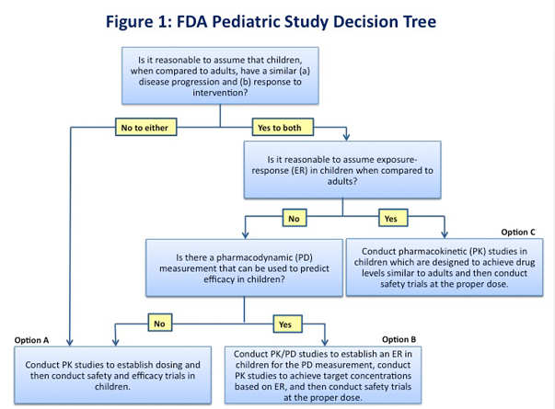
Extrapolation

Slide 14
Borrowing
Historically, extrapolation has been a binary decision - either we can extrapolate or we can’t.
Methods that borrow efficacy data from adults have been proposed as a method of improving decision making in a non-binary fashion.
Requires a subjective decision on how much data to borrow.

Slide 15
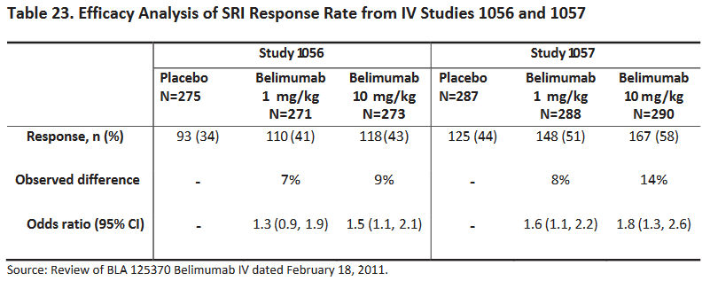
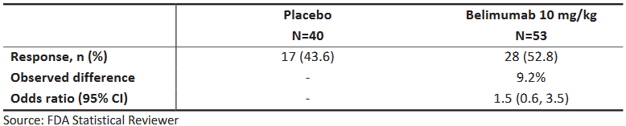
Example - Belimumab

Slide 16
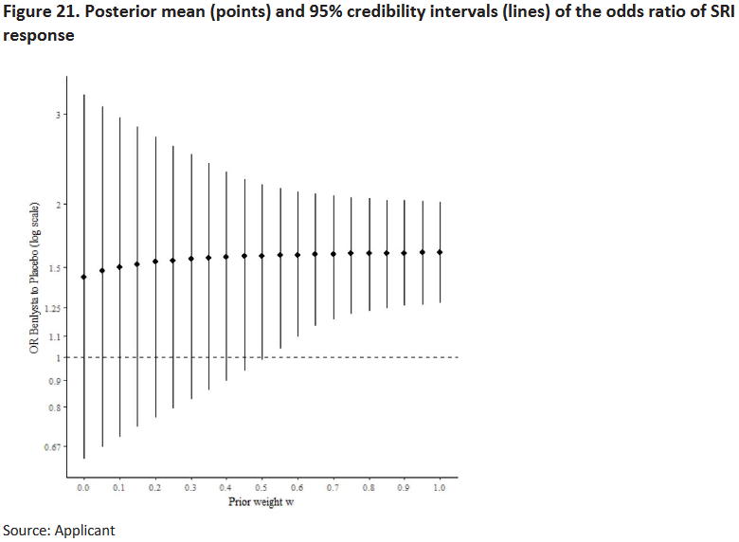

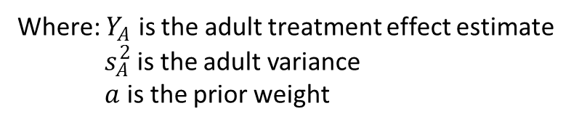
Example – Belimumab Cont’d
Treatment effect prior:
Where: $Y_{A}$ is the adult treatment effect estimate
$s_{A}^{2}$ is the adult variance
$a$ is the prior weight

Slide 17
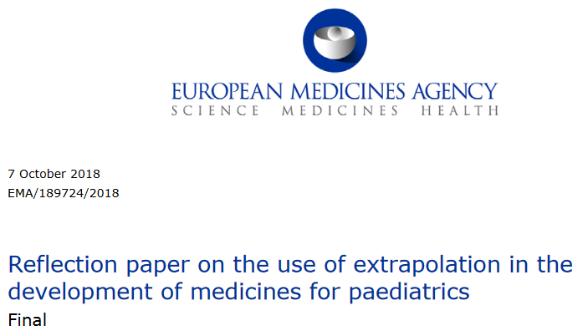
EMA Reflection Paper

Slide 18
ICH E11A – Paediatric Extrapolation
Address and align terminology related to pediatric extrapolation
Provide information on various approaches that can be utilized to support the use of pediatric extrapolation
Discuss a systematic approach to use of pediatric extrapolation
Discuss study designs, statistical analysis, M&S analyses and respective methods

Slide 19
Basic Ethical Framework in Pediatrics
1. Children should only be enrolled in research if the scientific and/or public health objective(s) cannot be met through enrolling subjects who can consent personally (i.e., adults).
2. Absent a prospect of direct therapeutic benefit, the research risks to which children are exposed must be “low.”
3. Children should not be placed at a disadvantage by being enrolled in a clinical trial, either through exposure to excessive risks or by failing to get necessary health care.
4. Vulnerable populations unable to consent (including children) should have a suitable proxy to consent for them.
Ethical Challenges in Clinical Trial Design Lessons Learned from DMD November 29, 2016

Slide 20
“Low” Risk
21 CFR 50.50-56 describe the additional safeguards for children in clinical investigations.
Frequently, the collection of endpoints does not represent a prospect of direct therapeutic benefit to the patient.
21 CFR 50.53 requires that The Minor increase over minimal risk

Slide 21
Ethical Issues with Endpoints
E.g. Muscle biopsies as a biomarker in muscular dystrophies:
  “Other than to establish the initial diagnosis, muscle biopsies are not clinically indicated for disease management and do not offer a prospect of direct clinical benefit to the enrolled child”

Slide 22
Control Arms

Slide 23
Placebo Controls
Placebo controls may not be acceptable for several reasons:
  Ethically problematic if there is an approved treatment and there is morbidity/mortality associated with delaying treatment.
  Even if it is ethical, it may not be acceptable to the patient or parent if there is an effective treatment.

Slide 24
Non-inferiority/Active Controls
We often don’t have enough data to specify a reliable non-inferiority margin for pediatrics.
When we do, we usually need a substantially larger number of patients to establish non-inferiority, which can exacerbate enrollment issues.

Slide 25
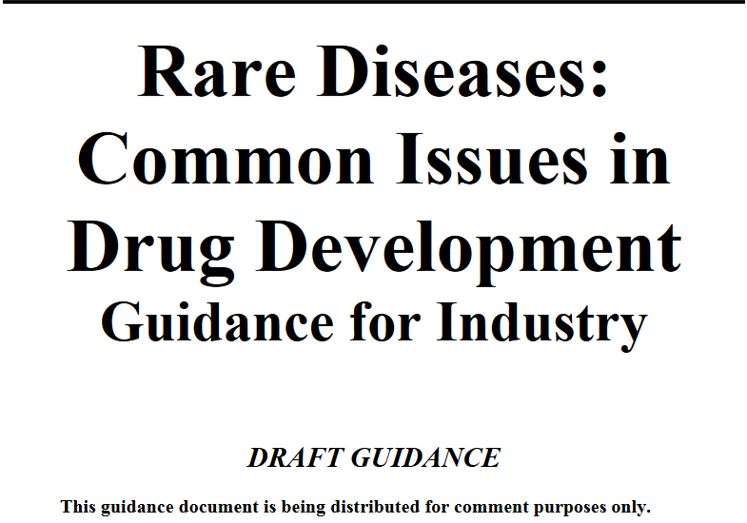
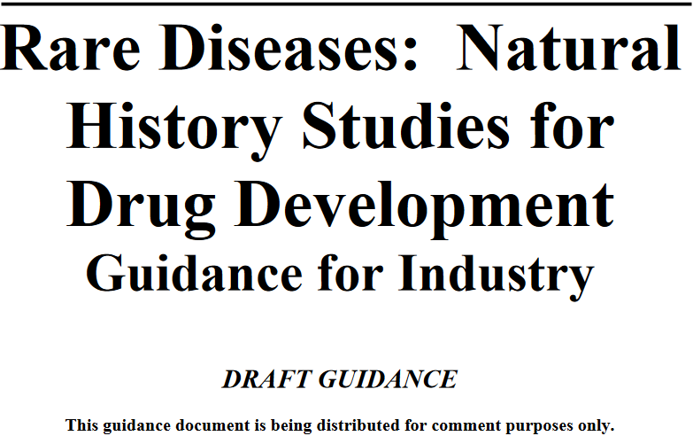
Natural History Controls

Slide 26
Historical (External) Controls
“The inability to eliminate systematic differences between nonconcurrent treatment groups, however, is a major problem with that design”
  There is an unmet medical need;
  There is a well-documented, highly predictable disease course that can be objectively measured and verified, such as high and temporally predictable mortality;
  There is an expected drug effect that is large, self-evident, and temporally closely associated with the intervention.

Slide 27
Recent FDA Legislation

Slide 28

21st Century Cures Act
The 21st Century Cures Act (Cures Act), signed into law on December 13, 2016, is designed to help accelerate
medical product development and bring new innovations and advances to patients who need them faster and more efficiently

Slide 29
Cures Act
Section 3022
Real World Evidence
Section 3001
Patient experience data
Section 3002
Patient-focused drug development
Section 3021
Novel clinical trial designs

Slide 30
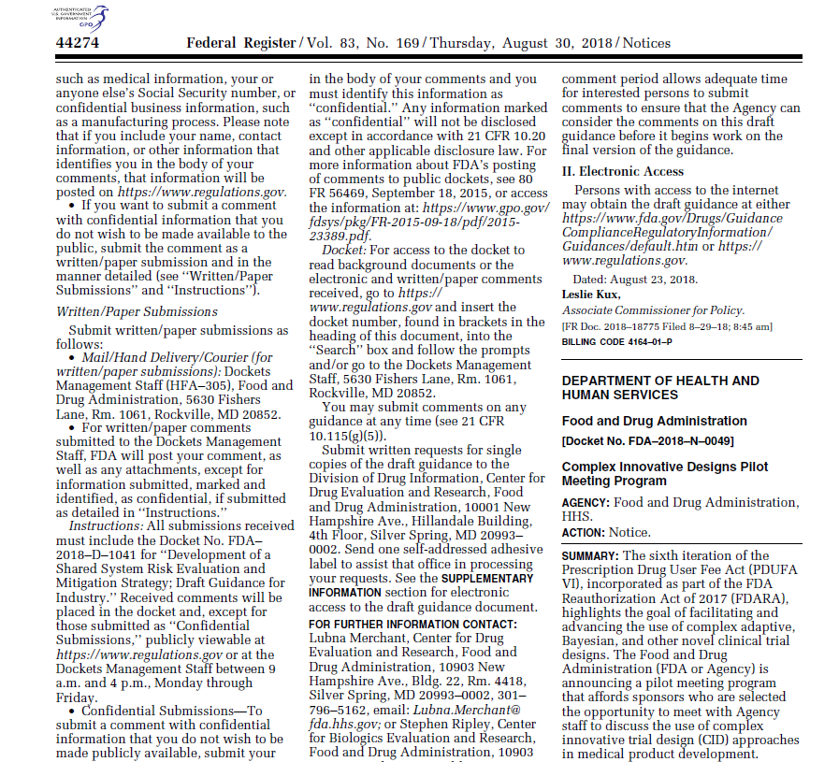
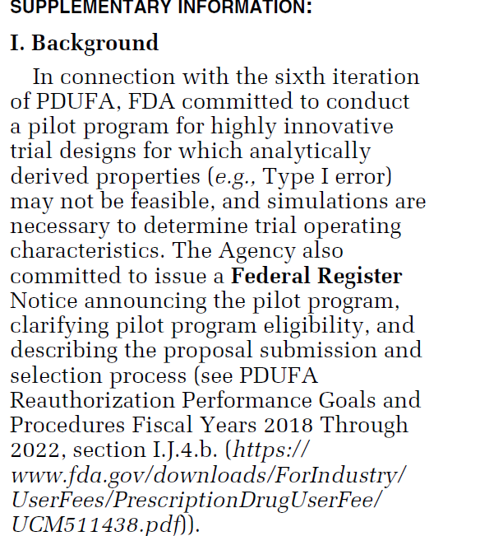














Federal Register Notice
…highlights the goal of facilitating and advancing the use of complex adaptive, Bayesian, and other novel clinical trial designs

Slide 31
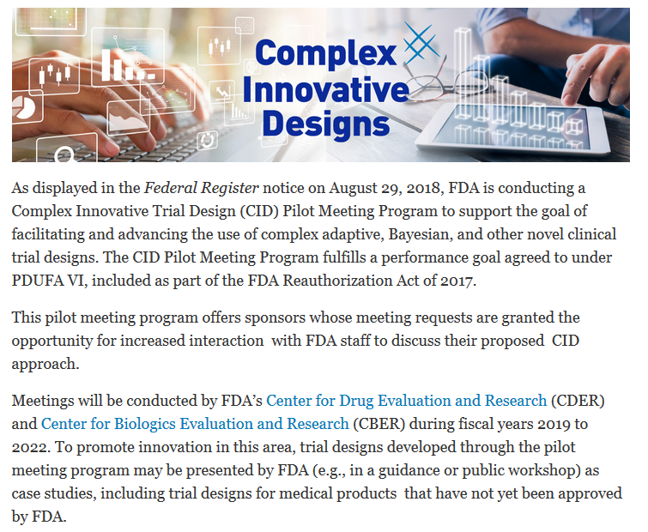
Complex Innovative Trial Designs Pilot Program

Slide 32
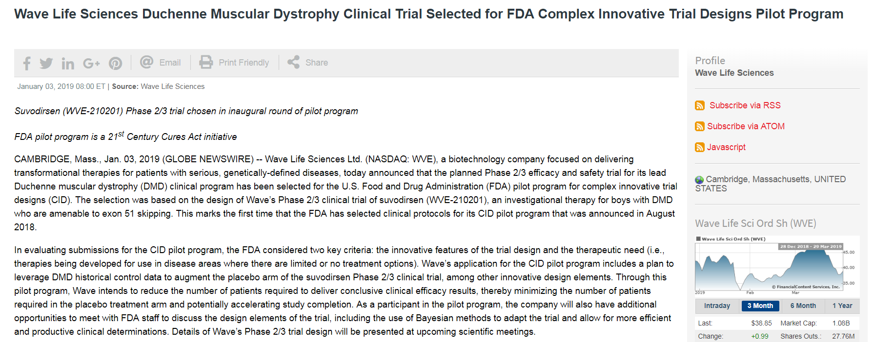





Wave Life Sciences submission
Placebo augmentation using a Bayesian modeling strategy

Slide 33
FDARA
FDA published a list of molecular targets that are
  1) molecular targets for which existing evidence and/or biologic rationale exist to determine their potential relevance to the growth or progression of one or more pediatric cancers and
  2) those targets for which there is evidence that they are not associated with the growth or progression of pediatric tumors for which requirement for early pediatric evaluation of drugs and biologics which are directed at these targets would be waived.

Slide 34
References
https://www.fda.gov/drugs/development-resources/complex-innovative-trial-designs-pilot-program
https://www.fda.gov/science-research/pediatrics/pediatric-ethics
https://www.ecfr.gov/cgi-bin/text-idx?SID=dc5b7c64a99fb69d90f21404a5c64633&mc=true&node=sp21.1.50.d
https://www.fda.gov/about-fda/oncology-center-excellence/pediatric-oncology
https://www.fda.gov/media/127912/download

