Slide 1
A case study of Phase II/III seamless adaptive design in a rare disease area
Hui Quan, Yi Xu, Yixin Chen,
Lei Gao and Xun Chen
Sanofi
June 28, 2019

Slide 2
Outline
Background
A seamless phase II/III design and procedure
Sample size adaptation
Estimation of treatment effect
Simulation
Example
Discussion

Slide 3
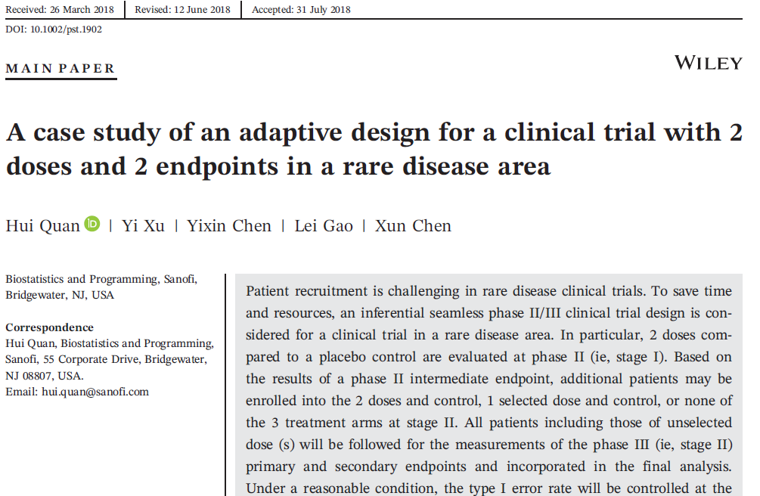

Slide 4
Background (1/3)
Traditionally, we use separate phase II and phase III studies in a new drug development program
We select doses for phase III based on data of phase II
  8/9-month white gap between phases II and III
To streamline, we have interest in phase II/III seamless design –- with one protocol to eliminate the white gap.
Two types of phase II/III seamless designs:
  Inferential: include phase II pats in phase III analysis: need multiplicity adjustment to control Type I error rate
  Operational: phase II pats excluded from phase III analysis

Slide 5
Background (2/3)
It is challenging to recruit patients in rare disease areas.
  The application of an inferential seamless design will save time and resources.
  Sample size adaptation will ensure desired conditional power (CP) with fixed design as a special case

Slide 6
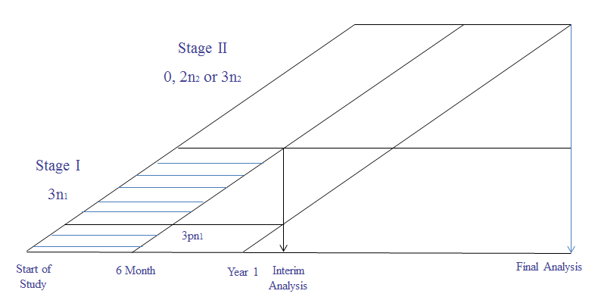

An adaptive design in a rare disease area
Two doses and placebo control, $n_{1}$/arm patients for phase II/stage I ($n_{2}^{′}$ /arm for stage II and fixed design)
Interim analysis on an intermediate endpoint X (month 6)
Dose i is selected for stage II if ${\hat{δ}}_{X_{i}}≥C$, sample size $n_{2}$/arm for CP
Patients are followed for Phase III endpoints(primary & secondary)

Slide 7

Type I error rate control (1/2)
Graphical procedure for Type I error rate control ($α_{1}+α_{2}=α)$

Slide 8

Type I error rate control (2/2)
To focus more on the primary endpoint, a step-down Hochberg procedure: primary endpoint then secondary endpoint at $α$

Slide 9
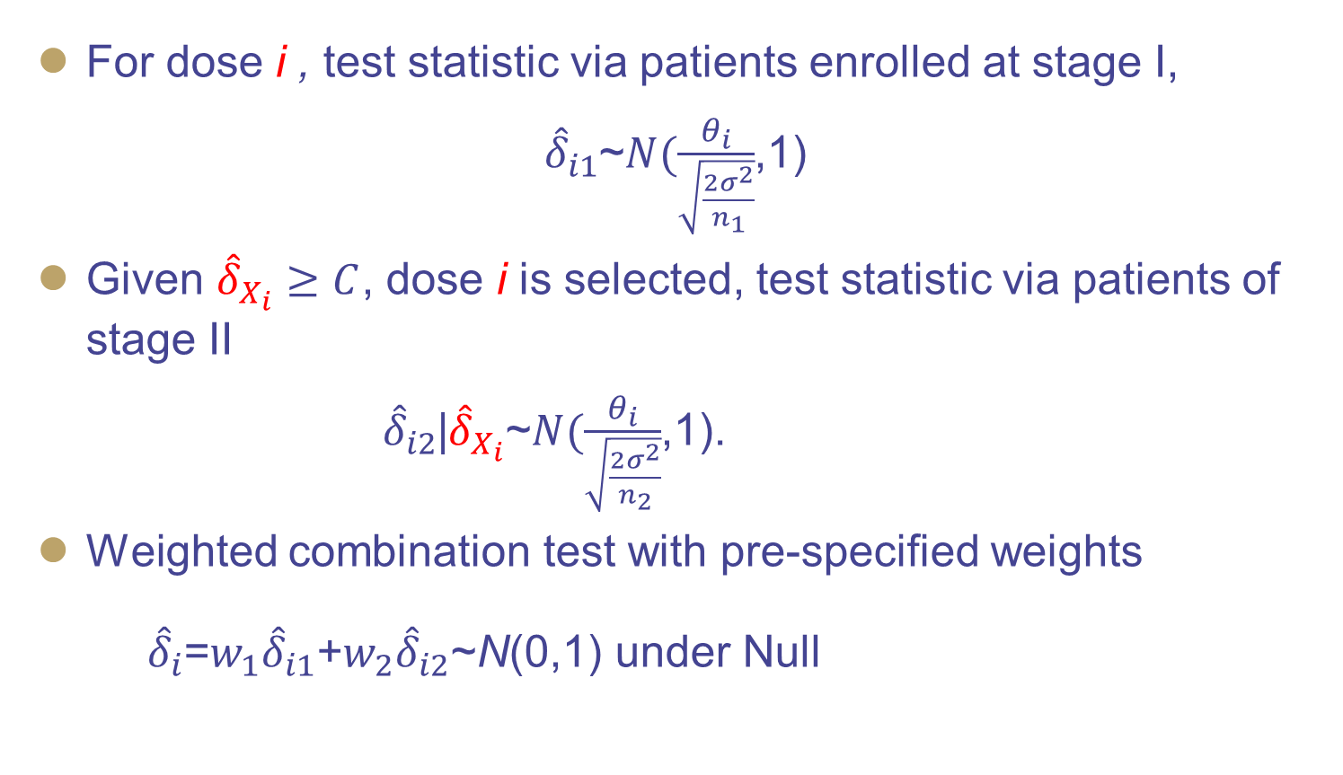
Test statistics (1/2)
For dose i , test statistic via patients enrolled at stage I,
${\hat{δ}}_{i1}$~$N(\frac{θ_{i}}{\sqrt{\frac{2σ^{2}}{n_{1}}}}$,1)
Given ${\hat{δ}}_{X_{i}}≥C$, dose i is selected, test statistic via patients of stage II
${\hat{δ}}_{i2}$|${\hat{δ}}_{X_{i}}$~$N(\frac{θ_{i}}{\sqrt{\frac{2σ^{2}}{n_{2}}}}$,1).
Weighted combination test with pre-specified weights
${\hat{δ}}_{i}$=$w_{1}{\hat{δ}}_{i1}$+$w_{2}{\hat{δ}}_{i2}$~N(0,1) under Null

Slide 10
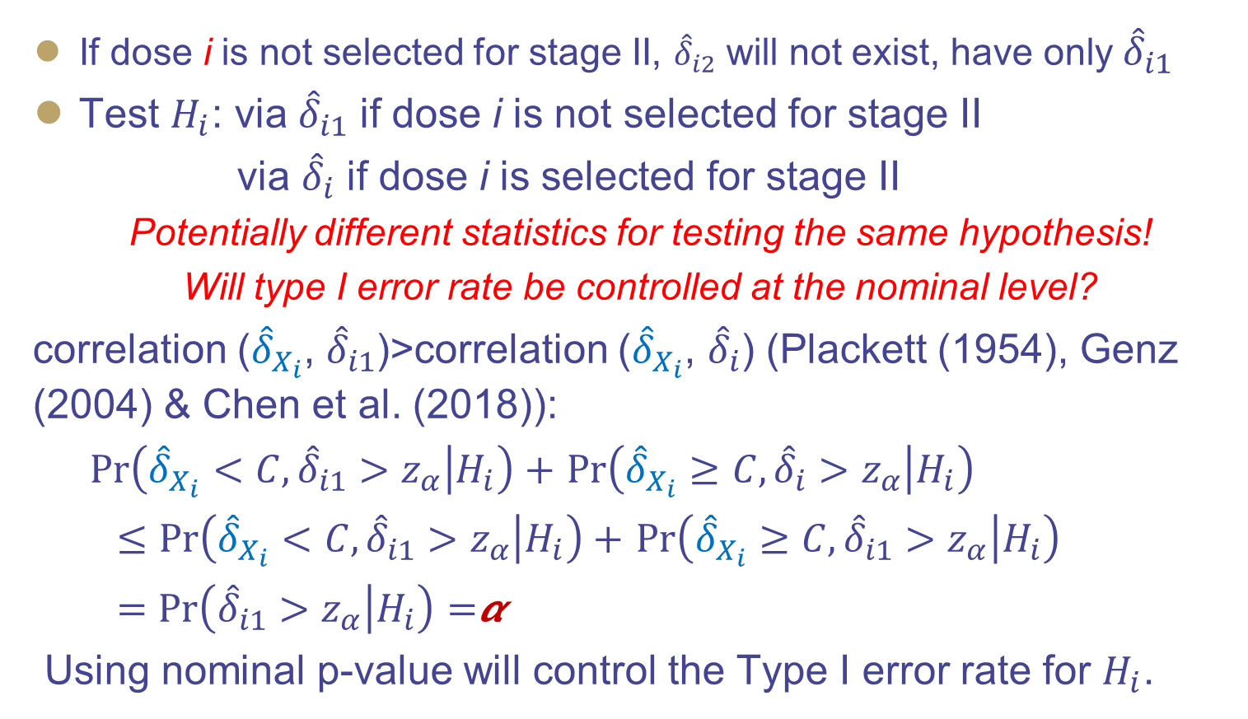
Test statistics (2/2)
If dose i is not selected for stage II, ${\hat{δ}}_{i2}$ will not exist, have only${\hat{δ}}_{i1}$
Test $H_{i}$: via ${\hat{δ}}_{i1}$ if dose i is not selected for stage II
via ${\hat{δ}}_{i}$ if dose i is selected for stage II
Potentially different statistics for testing the same hypothesis!
Will type I error rate be controlled at the nominal level?
correlation (${\hat{δ}}_{X_{i}}$, ${\hat{δ}}_{i1}$)>correlation (${\hat{δ}}_{X_{i}}$, ${\hat{δ}}_{i}$) (Plackett (1954), Genz (2004) & Chen et al. (2018)):
$Pr\left({\hat{δ}}_{X_{i}}<C, {\hat{δ}}_{i1}>z_{α} | H_{i}\right)+$ $Pr\left({\hat{δ}}_{X_{i}}≥C, {\hat{δ}}_{i}>z_{α} | H_{i}\right)$
$≤Pr\left({\hat{δ}}_{X_{i}}<C, {\hat{δ}}_{i1}>z_{α} | H_{i}\right)+$ $Pr\left({\hat{δ}}_{X_{i}}≥C, {\hat{δ}}_{i1}>z_{α} | H_{i}\right)$
$=Pr\left({\hat{δ}}_{i1}>z_{α} | H_{i}\right)=$𝞪
Using nominal p-value will control the Type I error rate for $H_{i}$.

Slide 11
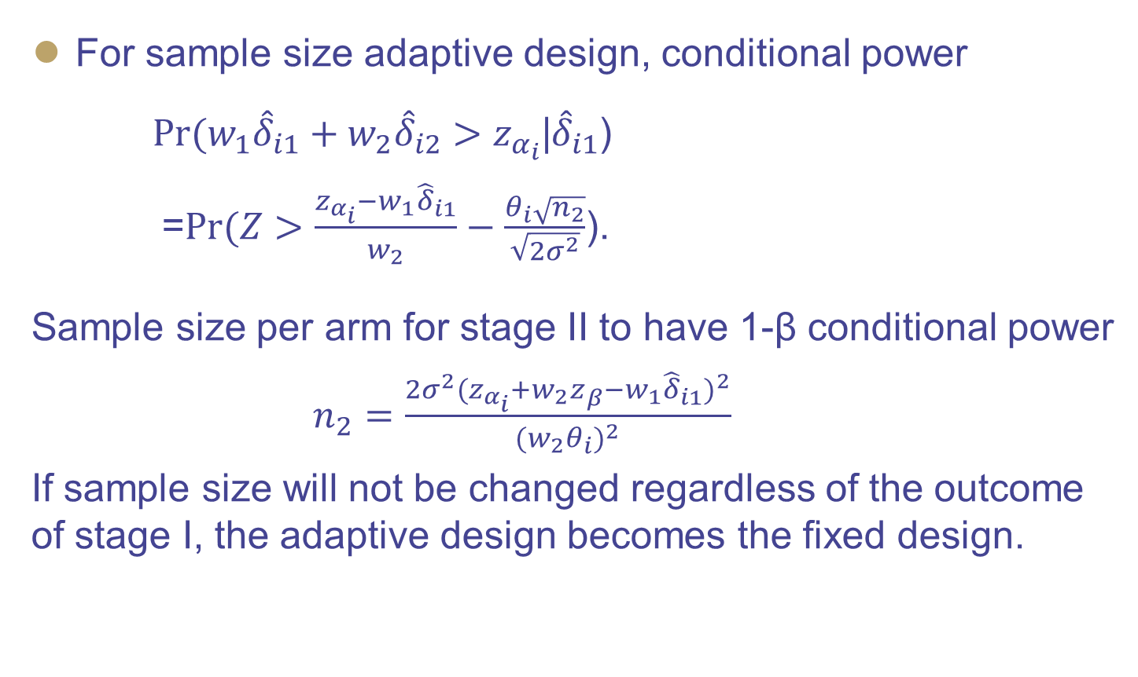
Conditional power and stage II sample size
For sample size adaptive design, conditional power
$Pr({w_{1}{\hat{δ}}_{i1}+w_{2}\hat{δ}}_{i2}>z_{α_{i}}$|${\hat{δ}}_{i1}$)
=$Pr(Z>\frac{z_{α_{i}}−w_{1}{\hat{δ}}_{i1}}{w_{2}}−\frac{θ_{i}\sqrt{n_{2}}}{\sqrt{2σ^{2}}}$).
Sample size per arm for stage II to have 1-β conditional power
$n_{2}=\frac{2σ^{2}(z_{α_{i}}+w_{2}z_{β}−w_{1}{\hat{δ}}_{i1})^{2}}{(w_{2}θ_{i})^{2}}$
If sample size will not be changed regardless of the outcome of stage I, the adaptive design becomes the fixed design.

Slide 12

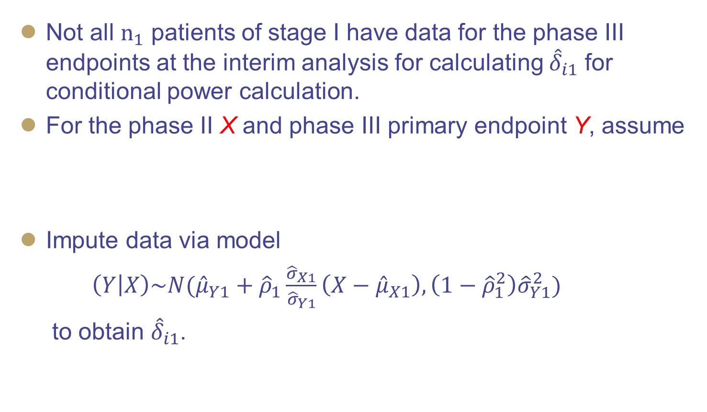
Data imputation for conditional power calculation
Not all $n_{1}$ patients of stage I have data for the phase III endpoints at the interim analysis for calculating ${\hat{δ}}_{i1}$ for conditional power calculation.
For the phase II X and phase III primary endpoint Y, assume
Impute data via model
$\left(Y | X\right)\sim N({\hat{μ}}_{Y1}+{\hat{ρ}}_{1}\frac{{\hat{σ}}_{X1}}{{\hat{σ}}_{Y1}}\left(X−{\hat{μ}}_{X1}\right),\left(1−{\hat{ρ}}_{1}^{2}\right){\hat{σ}}_{Y1}^{2})$
to obtain ${\hat{δ}}_{i1}$.
$$\left(\begin{matrix}X \\ Y\end{matrix}\right)\sim N(\left(\begin{matrix}μ_{X} \\ μ_{Y}\end{matrix}\right),\left(\begin{matrix}σ_{X}^{2} & ρσ_{X}σ_{Y} \\ ρσ_{X}σ_{Y} & σ_{Y}^{2}\end{matrix}\right)$$

Slide 13
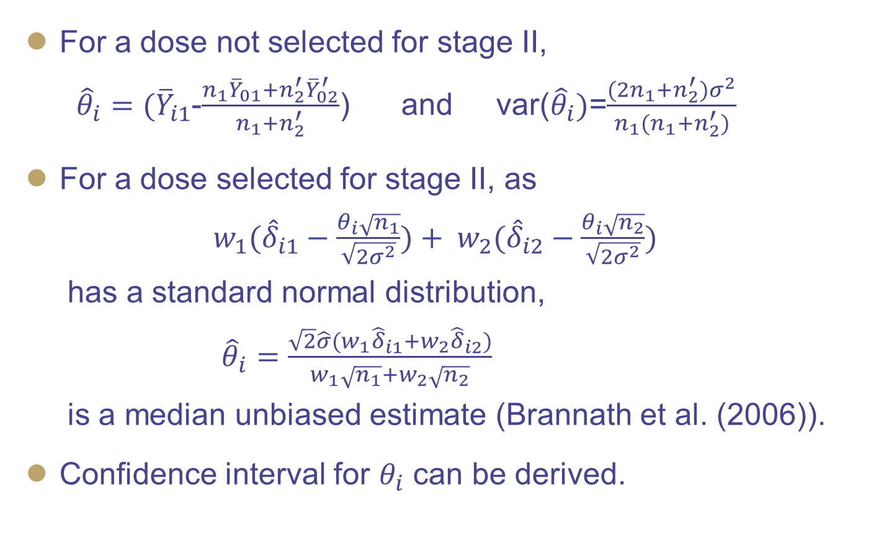
Estimation of treatment effect
For a dose not selected for stage II,
${\hat{θ}}_{i}=({\overline{Y}}_{i1}$-$\frac{n_{1}{\overline{Y}}_{01}+n_{2}^{′}{\overline{Y}}_{02}^{′}}{n_{1}+n_{2}^{′}}$) and var(${\hat{θ}}_{i})$=$\frac{(2n_{1}+n_{2}^{′})σ^{2}}{n_{1}(n_{1}+n_{2}^{′})}$
For a dose selected for stage II, as
$w_{1}({\hat{δ}}_{i1}−\frac{θ_{i}\sqrt{n_{1}}}{\sqrt{2σ^{2}}})+ w_{2}({\hat{δ}}_{i2}−\frac{θ_{i}\sqrt{n_{2}}}{\sqrt{2σ^{2}}})$
has a standard normal distribution,
${\hat{θ}}_{i}=\frac{\sqrt{2}\hat{σ}(w_{1}{\hat{δ}}_{i1}+w_{2}{\hat{δ}}_{i2})}{w_{1}\sqrt{n_{1}}+w_{2}\sqrt{n_{2}}}$
is a median unbiased estimate (Brannath et al. (2006)).
Confidence interval for $θ_{i}$ can be derived.

Slide 14
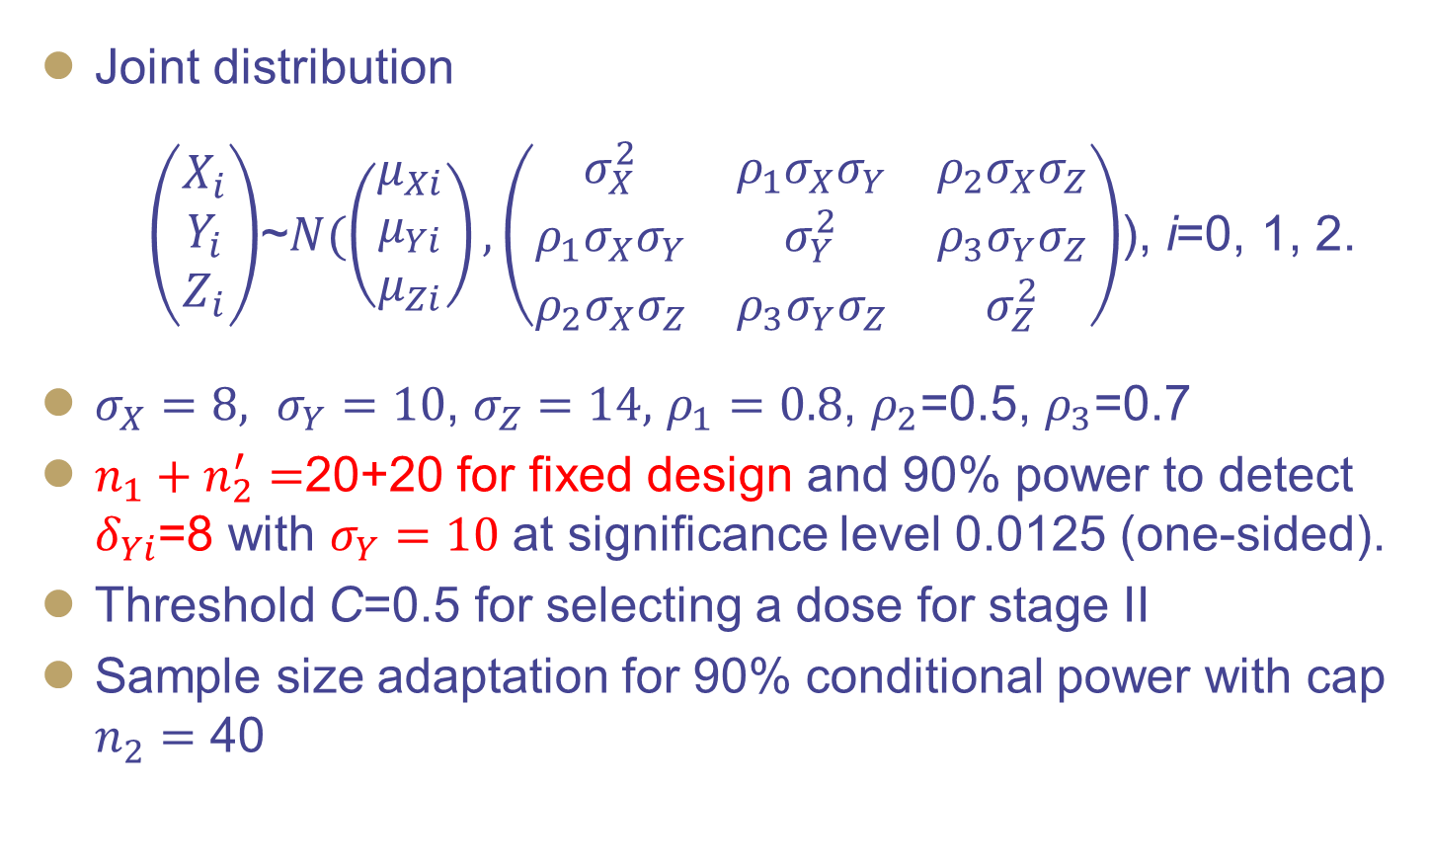
Simulations
Joint distribution
$\left(\begin{matrix}X_{i} \\ Y_{i} \\ Z_{i}\end{matrix}\right)$~$N(\left(\begin{matrix}μ_{Xi} \\ μ_{Yi} \\ μ_{Zi}\end{matrix}\right), \left(\begin{matrix}σ_{X}^{2} & ρ_{1}σ_{X}σ_{Y} & ρ_{2}σ_{X}σ_{Z} \\ ρ_{1}σ_{X}σ_{Y} & σ_{Y}^{2} & ρ_{3}σ_{Y}σ_{Z} \\ ρ_{2}σ_{X}σ_{Z} & ρ_{3}σ_{Y}σ_{Z} & σ_{Z}^{2}\end{matrix}\right)$), i=0, 1, 2.
$σ_{X}=8,$ $σ_{Y}=10$, $σ_{Z}=14,$ $ρ_{1}=0.8$, $ρ_{2}$=0.5, $ρ_{3}$=0.7
$n_{1}+n_{2}^{′}=$20+20 for fixed design and 90% power to detect $δ_{Yi}$=8 with $σ_{Y}=10$ at significance level 0.0125 (one-sided).
Threshold C=0.5 for selecting a dose for stage II
Sample size adaptation for 90% conditional power with cap $n_{2}^{}=$ 40

Slide 15
Simulation results (1/2)
Graphical procedure
 | High Dose |  |  | Low Dose
 | Primary Power (%) | Secondary Power (%) | SS for Stage II | Primary Power (%) | Secondary Power (%) | SS for Stage II
Scenario 1 – true effects for LD, HD for X, Y, Z = (4, 5, 10), (5, 6, 10)
Fixed | 70.63 | 67.05 | Fixed 20 | 57.08 | 55.70 | Fixed 20
Seamless | 70.91 | 67.32 | 19.89 | 57.01 | 55.63 | 19.60
SSA | 78.97 | 75.98 | 25.95 | 66.53 | 65.58 | 28.09
Scenario 2 – true effects for LD, HD for X, Y, Z = (4, 8,10), (4, 8, 10)
Fixed | 93.28 | 84.39 | Fixed 20 | 92.86 | 84.64 | Fixed 20
Seamless | 92.76 | 83.87 | 19.67 | 92.17 | 83.99 | 19.60
SSA | 96.79 | 90.80 | 26.69 | 96.01 | 90.62 | 26.58
Scenario 3 – true effects for LD, HD for X, Y, Z = (0, 0.5, 10), (4, 7, 10)
Fixed | 81.27 | 73.93 | Fixed 20 | 4.00 | 4.00 | Fixed 20
Seamless | 82.28 | 75.50 | 19.67 | 4.04 | 4.04 | 13.82
SSA | 89.30 | 83.67 | 27.17 | 4.42 | 4.42 | 25.67

Slide 16
Simulation results (2/2)
Step-down Hochberg procedure
 | High Dose |  |  | Low Dose
 | Primary Power (%) | Secondary Power (%) | SS for Stage II | Primary Power (%) | Secondary Power (%) | SS for Stage II
Scenario 1 – true effects for LD, HD for X, Y, Z = (4, 5, 10), (5, 6, 10)
Fixed | 71.89 | 51.20 | Fixed 20 | 58.67 | 51.99 | Fixed 20
Seamless | 72.06 | 50.97 | 19.89 | 58.51 | 51.79 | 19.60
SSA | 80.11 | 61.66 | 25.95 | 67.98 | 62.62 | 28.09
Scenario 2 – effects for LD, HD for X, Y, Z = (4, 8, 10), (4, 8, 10)
Fixed | 94.36 | 82.60 | Fixed 20 | 93.78 | 83.12 | Fixed 20
Seamless | 93.69 | 81.45 | 19.67 | 92.97 | 82.00 | 19.60
SSA | 97.09 | 89.12 | 26.69 | 96.45 | 89.50 | 26.58
Scenario 3 – true effects for LD, HD for X, Y, Z = (0, 0.5, 10), (4, 7, 10)
Fixed | 81.30 | 4.01 | Fixed 20 | 4.06 | 4.04 | Fixed 20
Seamless | 82.31 | 4.04 | 19.67 | 4.10 | 4.07 | 13.82
SSA | 89.31 | 4.42 | 27.17 | 4.49 | 4.48 | 25.67

Slide 17
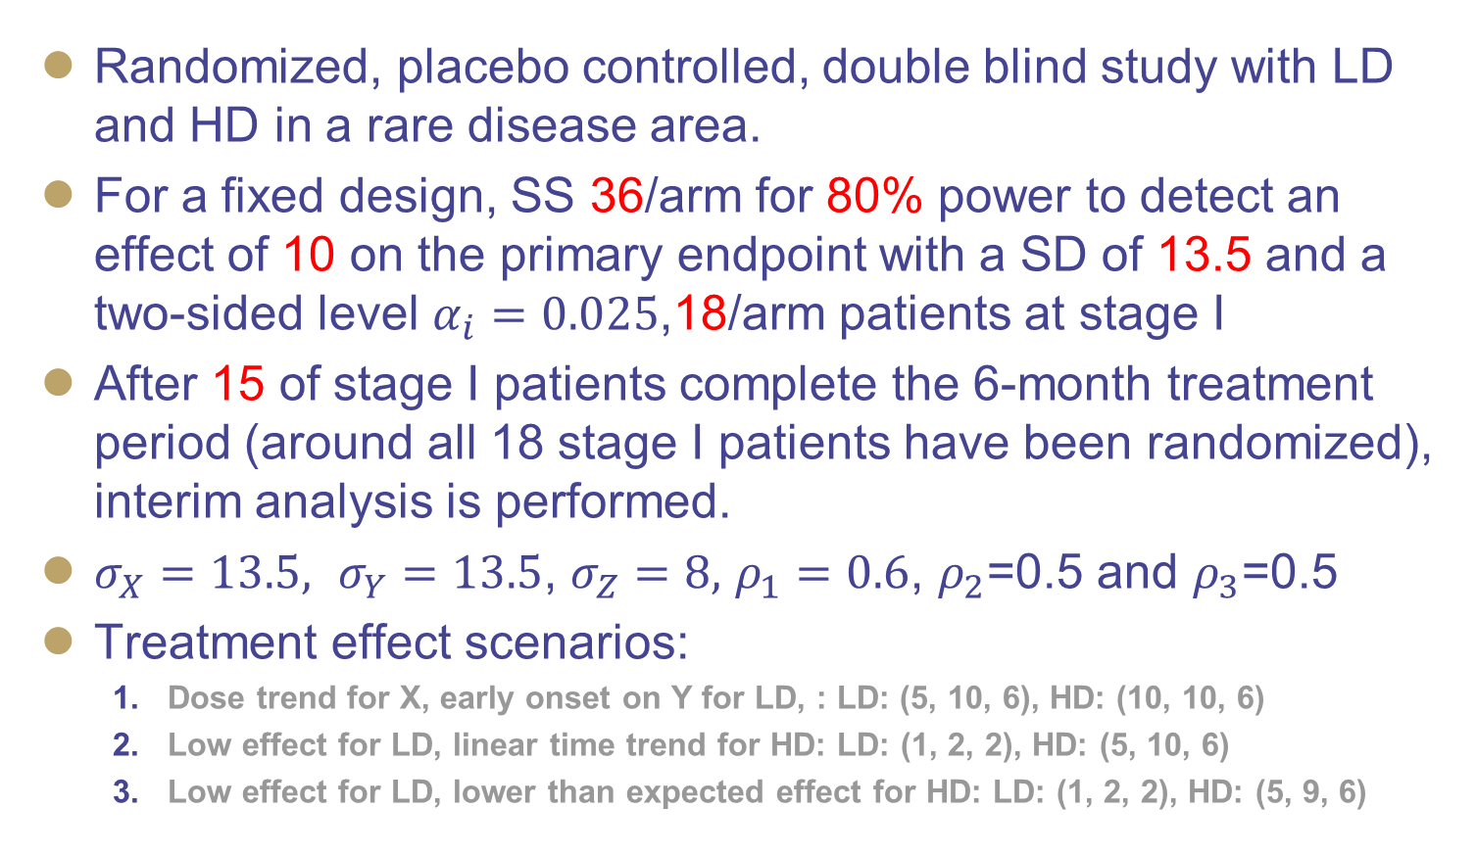
Example (1/2)
Randomized, placebo controlled, double blind study with LD and HD in a rare disease area.
For a fixed design, SS 36/arm for 80% power to detect an effect of 10 on the primary endpoint with a SD of 13.5 and a two-sided level $α_{i}=0.025$,18/arm patients at stage I
After 15 of stage I patients complete the 6-month treatment period (around all 18 stage I patients have been randomized), interim analysis is performed.
$σ_{X}=13.5,$ $σ_{Y}=13.5$, $σ_{Z}=8,$ $ρ_{1}=0.6$, $ρ_{2}$=0.5 and $ρ_{3}$=0.5
Treatment effect scenarios:
  Dose trend for X, early onset on Y for LD, : LD: (5, 10, 6), HD: (10, 10, 6)
  Low effect for LD, linear time trend for HD: LD: (1, 2, 2), HD: (5, 10, 6)
  Low effect for LD, lower than expected effect for HD: LD: (1, 2, 2), HD: (5, 9, 6)

Slide 18
Example (2/2)
Simulation results for the trial example – graphical procedure
C for go at interim | Effect scenario | Average SS | Prob of go >= 1 dose | Power HD primary |  | Power HD secondary |  | Power LD primary |  | Power LD secondary
Fixed
 | 1 | 108 |  |  | 85.25 |  | 76.80 |  | 85.23 |  | 77.31
 | 2 | 108 |  |  | 81.62 |  | 71.05 |  | 8.80 |  | 4.42
 | 3 | 108 |  |  | 71.73 |  | 63.56 |  | 8.71 |  | 4.38
Seamless design
C = 0 | 1 | 104 | 98.66 |  | 84.96 |  | 76.92 |  | 80.43 |  | 72.29
 | 2 | 93 | 88.70 |  | 75.87 |  | 66.95 |  | 8.14 |  | 4.08
C = -999 | 3 | 108 | 100 |  | 71.72 |  | 63.44 |  | 8.64 |  | 4.39
SSA
C = 0 | 1 | 117 | 98.66 |  | 87.33 |  | 80.19 |  | 82.95 |  | 76.24
 | 2 | 110 | 88.70 |  | 78.20 |  | 70.61 |  | 8.63 |  | 4.39
C = -999 | 3 | 133 | 100 |  | 79.74 |  | 73.38 |  | 9.94 |  | 5.16

Slide 19
Discussion
To streamline new drug development process, an adaptive phase II/III inferential seamless design can be applied to a rare disease area – at least avoid the separate phase II and phase III two-study scenario
Multiplicity adjustment is necessary for multiple doses on multiple endpoints
  The graphical procedure provides balanced power for the doses and endpoints
Simulation should be conducted to determine the optimal strategy for a specific trial.
Interim analysis should not be performed too early
The idea can be applied to other therapeutic areas.

Slide 20
References
Posch M, Koenig F, Branson M, Brannath W, Dunger-Baldauf C and Bauer P. Testing and estimation in flexible group sequential designs with adaptive treatment selection. SiM. 2005; 24: 3697-3714.
Todd S and Stallard N. A new clinical trial design combining phases II and III: sequential designs with treatment selection and a change of endpoint. Drug Information Journal 2005; 39: 109-118.
Stallard N. A confirmatory seamless phase II/III clinical trial design incorporating short-term endpoint information. SiM 2010; 29: 959-971.
Friede T, Parsons N, Stallard N, Todd S, Marquez EV, Chataway J and Nicholas R. Designing a seamless phase II/III clinical trial using early outcomes for treatment selection: an application in multiple sclerosis. Statistics in Medicine. 2011; 30: 1528-1540.
Heritier S, Lo SN and Morgan CC. An adaptive confirmatory trial with interim treatment selection: practical experience and unbalanced randomization. Statistics in Medicine 2011; 30: 1541-1554.
Kunz CU, Friede T, Parsons N, Todd S and Stallard N. Data-driven treatment selection for seamless phase II/III trials incorporating early-outcome data. Pharmaceutical Statistics 2014; 13: 238-246.
Stallard N, Kunz CU, Todd S, Parsons N and Triede T. Flexible selection of a single treatment incorporating short-term endpoint information in a phase II/III clinical trial. Statistics in Medicine 2015; 34: 3104-3115.
Maca J, Bhattacharya S, Dragalin V, Gallo P and Krams M. Adaptive seamless phase II/III designs – background, operational aspects, and examples. Drug Information Journal 2006; 40: 463-473.
Bretz F, Schmidli H, Konig F, Racine A and Maurer W. Confirmatory seamless phase II/III clinical trials with hypotheses selection at interim: general concepts. Biometrical Journal 2006; 48: 623-634.
Bretz F, Maurer W., Brannath W and Posch M. A graphical approach to sequentially rejective multiple test procedures. SiM, 2009; 28: 586-604.
Cui L, Hung HM and Wang SJ. Modification of sample size in group sequential clinical trials. Biometrics 1999; 55: 853-857.
Plackett RL. A reduction formula for normal multivariate probabilities. Biometrika, 1954; 41: 351-360.
Genz A. Numerical computation of rectangular bivariate and trivariate normal and t probabilities. Stat. Comput. 2004; 14: 251-260.
Chen C, Anderson K, Mehrotra DV, Rubin EH and Tse A. A 2-in-1 adaptive phase 2/3 design for expedited oncology drug development. Contemporary Clinical Trials, 2018; 64: 238-242.
Hochberg Y. A sharper Bonferroni procedure for multiple tests of significance. Biometrika 1988; 75, 800-802.
Brannath W. Konig F and Bauer P. Estimation in flexible two stage designs. Statistics in Medicine. 2006; 25: 3366-3381.
Gallo P, Chuang-Stein C, Dragalin V, Gaydos B, Krams M, Pinheiro J. Adaptive designs in clinical drug development – an executive summary of the pharma working group. Journal of Biopharmaceutical Statistics 2006; 16: 275 -283.
Quan H, Zhou D, Mancini P, He P and Koch G. Adaptive Patient Population Selection Design in Clinical Trials. Statistics in Biopharm Research 2012.
Quan H, Xu Y, Chen Y, Gao L and Chen X. A Case Study of an Adaptive Design for a Clinical Trial with Two Doses. Pharmaceutical Statistics, 2018.

Slide 21
Thank you

