Slide 1

Statistical Considerations on Early-to-Late Transition of Oncology Projects
Cong Chen, PhD
Executive Director and Head of Early Oncology Statistics
ASA NJ Chapter, Rutgers, June 28th, 2019

Slide 2
Does the Drug Work?

Slide 3

Efficacy Screening
Benefit of finding an active new drug quickly and cost-effectively outweighs the risk of wrong tumor selection
A set of tumor types are often investigated simultaneously in a basket trial to account for Type III error of missed opportunities
3-5 shots on goal
Chen C, Deng Q, He L, Mehrotra D, Rubin EH, Beckman RA. How many tumor indications should be initially studied in clinical development of next generation immunotherapies? Contemporary Clinical Trials 2017; 59:113-117.

Slide 4
Hypothetical Outcome of a Basket Trial
Five tumor cohorts (n=25 each) in patients refractory to PD-1 treatment (ORR under null: 10%)
Number of responses range from 2 (8%) to 6 (24%)
6
5
4
3
ORR under null: 10%
2

Slide 5
Independent Evaluation
Each tumor cohort is evaluated separately, with or without multiplicity adjustment
6
?
5
4
X
X
P=0.033
3
P=0.098
X
P=0.24
ORR under null: 10%
2
X

Slide 6
Ad-hoc Assessment
Clinical director 1: Look at the 3 top ones! The drug is working!!
Clinical director 2: This is cherry-picking.
6
5
4
3
ORR under null: 10%
2

Slide 7
Bayesian Information Borrowing
Expert statisticians all assume some form of homogeneity on response rates across tumor cohorts
  Thall et al. 2003, Berry et al. 2013, Simon et al., 2016, Cunanan et al., 2017
Clinical director 1: I like Bayesian, but why does response to an active drug have to be homogeneous?
Clinical director 2: It is too complicated for me. Can’t you just tell me how to cherry-pick properly?

Slide 8
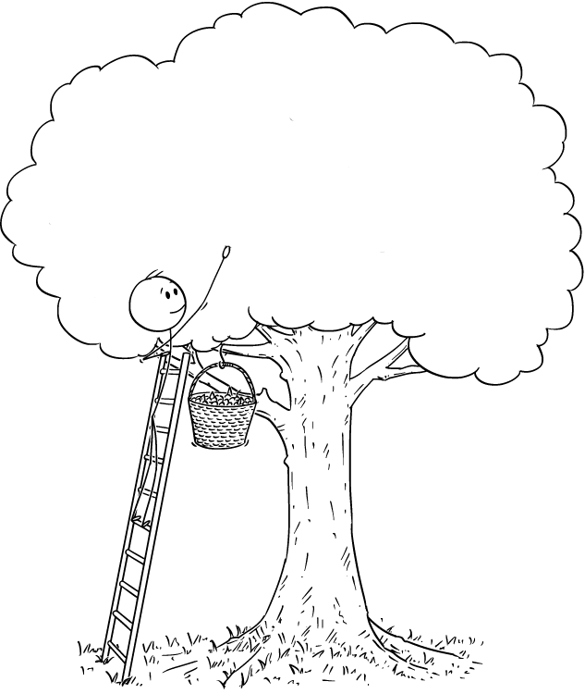




Multiplicity Control for Cherry-picking
Chen C, Li N, Yuan S, Antonijevic Z, Kalamegham R, Beckman RA. Statistical design and considerations of a Phase 3 basket trial for simultaneous investigation of multiple tumor types in one study. Statistics in Biopharmaceutical Research 2016; 8 (3): 248-257.
Zhou H, Liu F, Wu C, Rubin EH, Giranda VL, Chen C. Optimal Two-stage Designs for Exploratory Basket Trials, Contemporary Clinical Trials, in press.
Wu C, Liu F, Zhou H, Rubin EH, Giranda VL, Chen C. Optimal Design and Analysis of Efficacy Expansion in Phase I Oncology Trials, to be submitted.
Chen C, Zhou H, Li W, Beckman RA. How Many Substudies Should be Included in a Master Protocol? to be submitted.

Slide 9
Basket Designs with Cherry-picking
Prune inactive ones if p-value>α_{s} and pool active ones in the pooled analysis (α*), i.e., pruning and pooling
  Overall Type I error is at α level under global null
Type II error is calculated under a non-informative prior for number of active tumors (i.e., uniform distribution)
  Design parameters can be obtained similarly when an informative prior is available
Don’t rely on homogeneous assumption for analysis

Slide 10
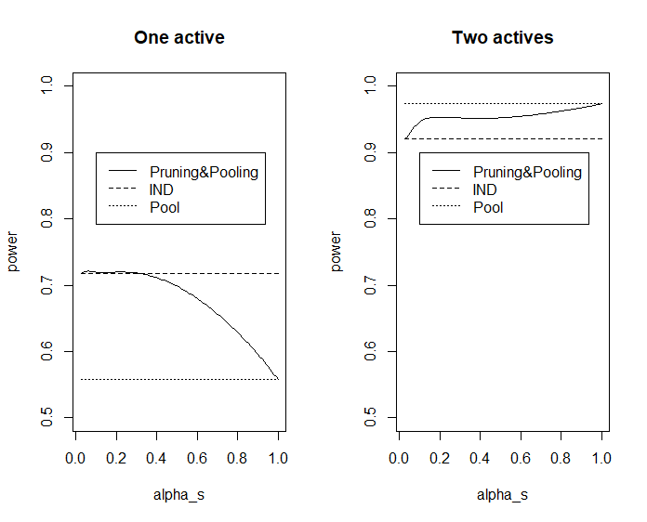
A Two-tumor Basket Trial
Independent evaluation (α_{s} =α/2, α*=1) and pooling w/o pooling (α_{s} =1, α*=α) are special cases of the pruning and pooling method

Slide 11

Fit-for-purpose
Fix power or sample size?
One or two-stage?
Same or different hypotheses?

Slide 12
A One-stage Design Example with Same Null/Alternative Hypotheses
Design of a 5-tumor basket trial with minimal sample size targeting (α, β)=(0.05, 0.20)
The sample size in the hypothetical trial is optimal
  The clinical intuition of pooling tumors with ≥4 responses makes sense
  The pooled data should be tested at α*=0.009
P0 | P1 | r | α* | n
0.10 | 0.25 | 4 | 0.009 | 25

Slide 13
Positive Outcomes in the Hypothetical Trial
The drug is deemed active based on hypothetical outcome (4+5+6=15 responses in 3 tumor cohorts)
  However, it doesn’t mean all 3 tumor cohorts are active
# Tumors | Sample size | Min #resp | Min ORR
1 | 25 | 8 | 32%
2 | 50 | 12 | 24%
3 | 75 | 15 | 20%
4 | 100 | 19 | 19%
5 | 125 | 22 | 18%

Slide 14
A One-stage Design Example with Heterogenous Null/Alternative Hypotheses
Set-up for (H0, H1)
  Mono in 3 tumor cohorts without SOC: (0.05, 0.2)
  Combo with SOC in 2 tumor cohorts: (0.2, 0.35)
Design features
  Each has comparable probability to be pooled
  Minimum overall sample size to achieve the desired Type I/II error rates
Overall response rate in the pool is compared to H0 for the pooled tumor cohorts weighted by sample size

Slide 15
Design of the Hypothetical Trial
Design parameters at (α, β)=(0.05, 0.20)
  Total sample size=3*18+2*34=122
Probability of pooling
  (23%, 23%) under P0 for (mono, combo)
  (90%, 89%) under P1 for (mono, combo)
P0 | P1 | r | n | α*
0.05 | 0.2 | 2 | 18 | 0.011
0.2 | 0.35 | 9 | 34

Slide 16
Examples of A Positive Outcome
Assuming there is one mono and one combo left in the pool (n=52=18+34)
#resp(%) to mono | #resp(%) to combo | Overall #resp(%) | Weighted ORR (H0) | P-value
2 (11%) | 13 (38%) | 15 (29%) | 14.8% | 0.0069
4 (22%) | 11 (32%)
6 (33%) | 9 (26%)

Slide 17
Two-stage Optimal Basket Designs
Design parameters of a two-stage 5-tumor basket trial with minimal sample size for same (P0, P1)=(0.1, 0.25) targeting (α, β)=(0.05, 0.20)
  An extension of Simon’s two-stage designs for single arm trials to a multi-arm basket trials
  N=43/40 under Simon’s designs for single arm trials
 | r1 | n1 | α* | n
Optimal | 2 | 9 | 0.019 | 33
Minimax | 3 | 18 | 0.009 | 25
Tumor cohorts with ≥r1/n1 responders will be pooled for analysis at end of second stage

Slide 18
Two-stage Design Under Fixed Sample Size
Remaining sample size for early-terminated tumor cohorts is evenly distributed to the continuing ones
Design parameters of a two-stage 5-tumor basket trial with minimal sample size for same (P0, P1) & (α, β)
  Planned sample size per arm (n=20) is smaller than under the optimal design (n=33)
  However, may have more patients in a remaining arm (e.g., n=35 if 3 arms were terminated in first stage)
r1 | n1 | α* | n
2 | 10 | 0.018 | 20

Slide 19
Comments
The basket designs based on pruning and pooling provide closed-form sample size estimates for planning purpose
Rejection of the global null means drug is active which paves the way for further investigation
RWE may be used to assist with GNG decisions in this dynamic era post immunotherapy revolution
Alternative endpoint to ORR and randomized controlled designs may be considered as appropriate
Various extensions under investigation (e.g., two-stage under heterogeneous hypotheses)

Slide 20
Adaptive 2-in-1 Design for Seamless Phase 2/3

Slide 21
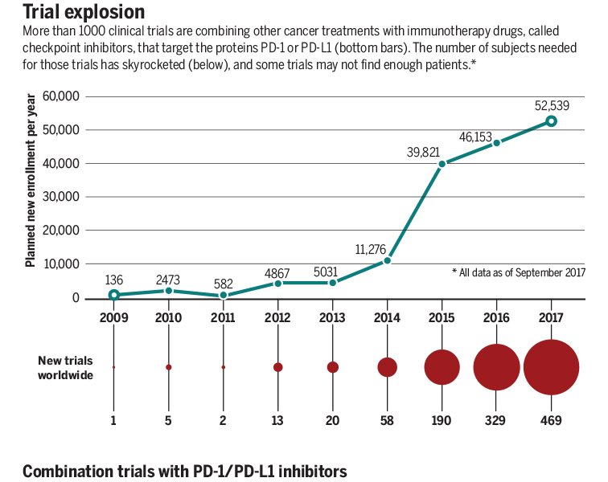

Status Quo for Early to Late Transition
A typical program tests a new drug combination with an approved IO in Phase 1, and intends to go directly to Phase 3 once encouraging signal is observed
Phase 1B Phase 3
Science, March 23, 2018

Slide 22

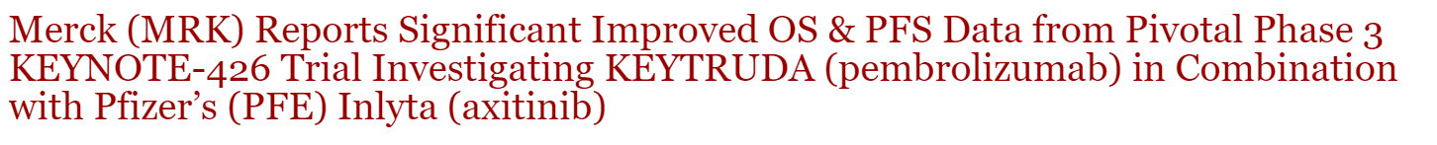
Keytruda+Axitinib in 1L RCC
Both Keytruda and axitinib were known to have monotherapy activity in RCC prior to combination study
Phase 1B: 38/52 (73%; 95% CI 59·0-84·4) patients achieved an objective response (vs 31% for sunitinib)
  The median progression-free survival was estimated as 21 months (vs 11 months for sunitinib)
KN-426 (Oct 18, 2018)
streetinsider.com

Slide 23
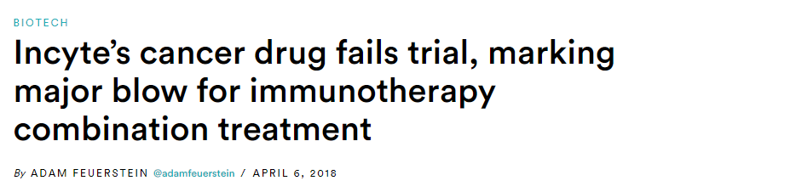
Epacadostat (IDO1) in Melanoma
The most advanced new MOA right after PD-1/PD-L1
ECHO-202: Phase 1/2 in combo with pembrolizumab
  ORR=56%* (100 mg) vs ~37% for pembrolizumab alone based on historical data
ECHO-301

Slide 24
Options Post Phase 1B Efficacy Screening
Follow-up trials in those with a positive outcome
Go to Phase 3
Traditional Phase 2 with a separate Phase 3
Phase 2 with an option to expand to Phase 3 (2-in-1)
A small Phase 3 for AA
A large Phase 3 for FA
Chen C, Anderson K, Mehrotra DV, Rubin EH and Tse A. A 2-in-1 adaptive Phase 2/3 design for expedited drug development. Contemporary Clinical Trials 2018; 64:238-242.

Slide 25

A 2-in-1 Design for Phase 2/3 Adaptation
A randomized Phase 2 trial is started with a pre-specified criterion for expansion to Phase 3
  All patients including those used for the expansion decision will be included in the Phase 3 final analysis
The trial is considered positive if Phase 2 (w/o expansion) or Phase 3 (w/ expansion) is positive

Slide 26

A Generic 2-in-1 Design
The three standardized test statistics X, Y and Z can be based upon different endpoints
No penalty if Phase 2 endpoint is used for expansion decision (a sufficient but not necessary condition)
  i.e.,w=1.96 to keep alpha controlled at 2.5% (1-sided)
Y>w?
No
Keep as a Phase 2 trial
X>C?
Phase 2 trial
Expand to Phase 3
Z>w?
Yes

Slide 27

Key Questions Before You Consider 2-in-1
Realistically, should you consider a randomized Phase 2 instead of a straight Phase 3 based on Phase 1 data?
Is the program ready for a registration enabling study?
  Any mid-trial change is subject to heavy scrutiny
Is logistics worked out to enable seamless transition?

Slide 28
An Example
A small Phase 1 trial of a combination therapy with SOC has demonstrated exciting ORR in 1st line gastric cancer
  More patients are being added but uncertainty of treatment effect remains due to single-arm
A seamless Phase 2/3 trial based on 2-in-1 design with Phase 2 oversized for AA is considered
Expansion decision targets one month ahead of Phase 2 accrual completion to ensure seamless expansion

Slide 29
Design Details
Phase 2 (in case of no expansion)
  With 240 patients, it has 88% power for detecting an ORR increase of 20% at 2.5% (one-sided) alpha level
  Stop the trial early in case of no ORR improvement
  P-value<0.025 for ORR leads to filing for AA (a Phase 3 trial may still be considered otherwise)
Phase 3 (in case of expansion)
  With 460 OS events (600 patients in total), it has 90% power for detecting a hazard ratio (HR) of 0.74 at 2.5% (one-sided) alpha level
  P-value<0.025 for OS leads to filing for FA

Slide 30

A Cost-effective Expansion Bar
Type I error is controlled for any expansion bar
A benefit-cost ratio analysis
  Benefit: value adjusted probability of a positive trial
    A positive Phase 2=1/3 of a positive Phase 3
  Cost: expected overall sample size for the study
    240+prob(expansion under null or alternative)*360
  Test drug is assume have 50% chance of being active
Sun L, Li W, Chen C, and Zhao J. Advanced Utilization of Intermediate Endpoints for Making Optimized Cost-Effective Decisions in Seamless Phase II/III Oncology Trials. Under review for publication.

Slide 31
Resulting Design
Keep as Phase 2 with 240 patients (ORR)
Improvement in ORR >11%?
No
A 240 patient 1:1 randomized Phase 2 trial (ORR)
Yes
Enroll additional 360 patients (OS)
Stop if
no ORR effect
Probability of expansion is 80%, 44% and 14% when true ORR improvement is 20%, 10% and 0%, respectively
Probability of a positive Phase 2 is ~50% if true ORR is 11% but is potentially higher due to longer follow-up

Slide 32
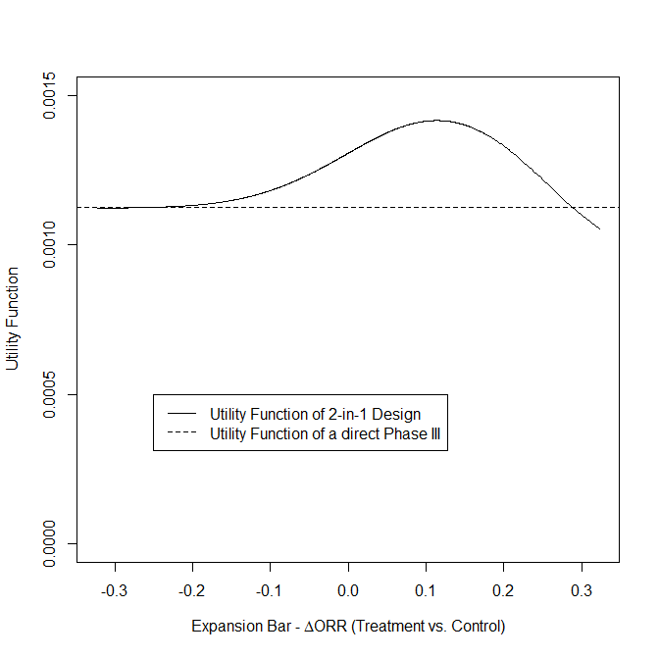
BCR Changes with the Expansion Bar

Slide 33
Sensitivity of Input Variables
Prior distribution of treatment effect for OS |  | Relative value of a positive Phase 2 vs. a positive Phase 3 | Approximate optimal expansion bar in ΔORR
P(HR = 0.74) | P(HR = 1)
1/3 | 2/3 | 1:3 | 12%
 |  | 1:5 | 10%
1/2 | 1/2 | 1:3 | 11%
 |  | 1:5 | 9%
2/3 | 1/3 | 1:3 | 10%
 |  | 1:5 | 8%

Slide 34
Comparison with Other Adaptive Designs
Same endpoint is often used for both adaptation decision and hypothesis testing in the literature
The 2-in-1 design allows the use of an intermediate endpoint, key to timely and cost-effective adaptation
Adaptive decision based on an intermediate endpoint
Enrollment
Extended f/u
Adaptive decision based on the clinical endpoint

Slide 35
Comparison to Phase 3 Futility Analysis
Both are penalty-free (a correlation assumption for 2-in-1 design is generally expected to hold in practice)
There is usually less incentive to stop an ongoing Phase 3 oncology trial for futility, despite potentially low POS
  Futility bar is often set low, rending it a “disaster check”, while 2-in-1 design facilitates a bona-fide POC
The 2-in-1 design allows declaration of a positive outcome for Phase 2 even without expansion but a Phase 3 trial can’t be rescued after futility stopping

Slide 36
Comments
Expansion bars may be based on other considerations
The 2-in-1 design may be considered an alternative approach to sample size re-estimation
  Conventional methods that increase sample size when the data are less promising are less cost-effective
The 2-in-1 design may be extended (e.g., GSD for Phase 3, co-primary endpoints)
The properties of 2-in-1 design in its basic form is “well-understood”, paving the way for regulatory acceptance
  Analytic proof or simulations may be needed otherwise

Slide 37


