Slide 1
Examining Intuitions About Statistical Inference in Applied Research
Eric Loken
University of Connecticut

Slide 2
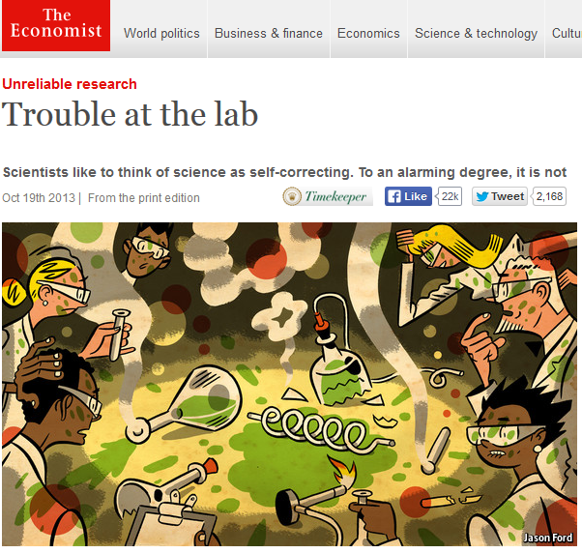

Slide 3
Sources of the Crisis
Fraud
Poor procedures and data management
Intentional p-hacking

Slide 4
Sources of the Crisis
Fraud
Poor procedures and data management
Intentional p-hacking
Low power research
Unintentional p-hacking
Poor intuitions about statistical inference

Slide 5
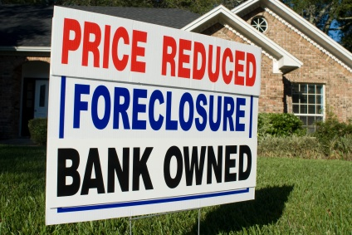
Similarity to Another Recent Crisis?

Slide 6
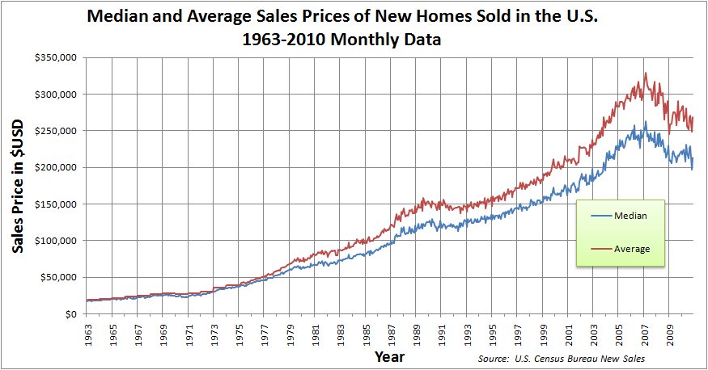

Slide 7
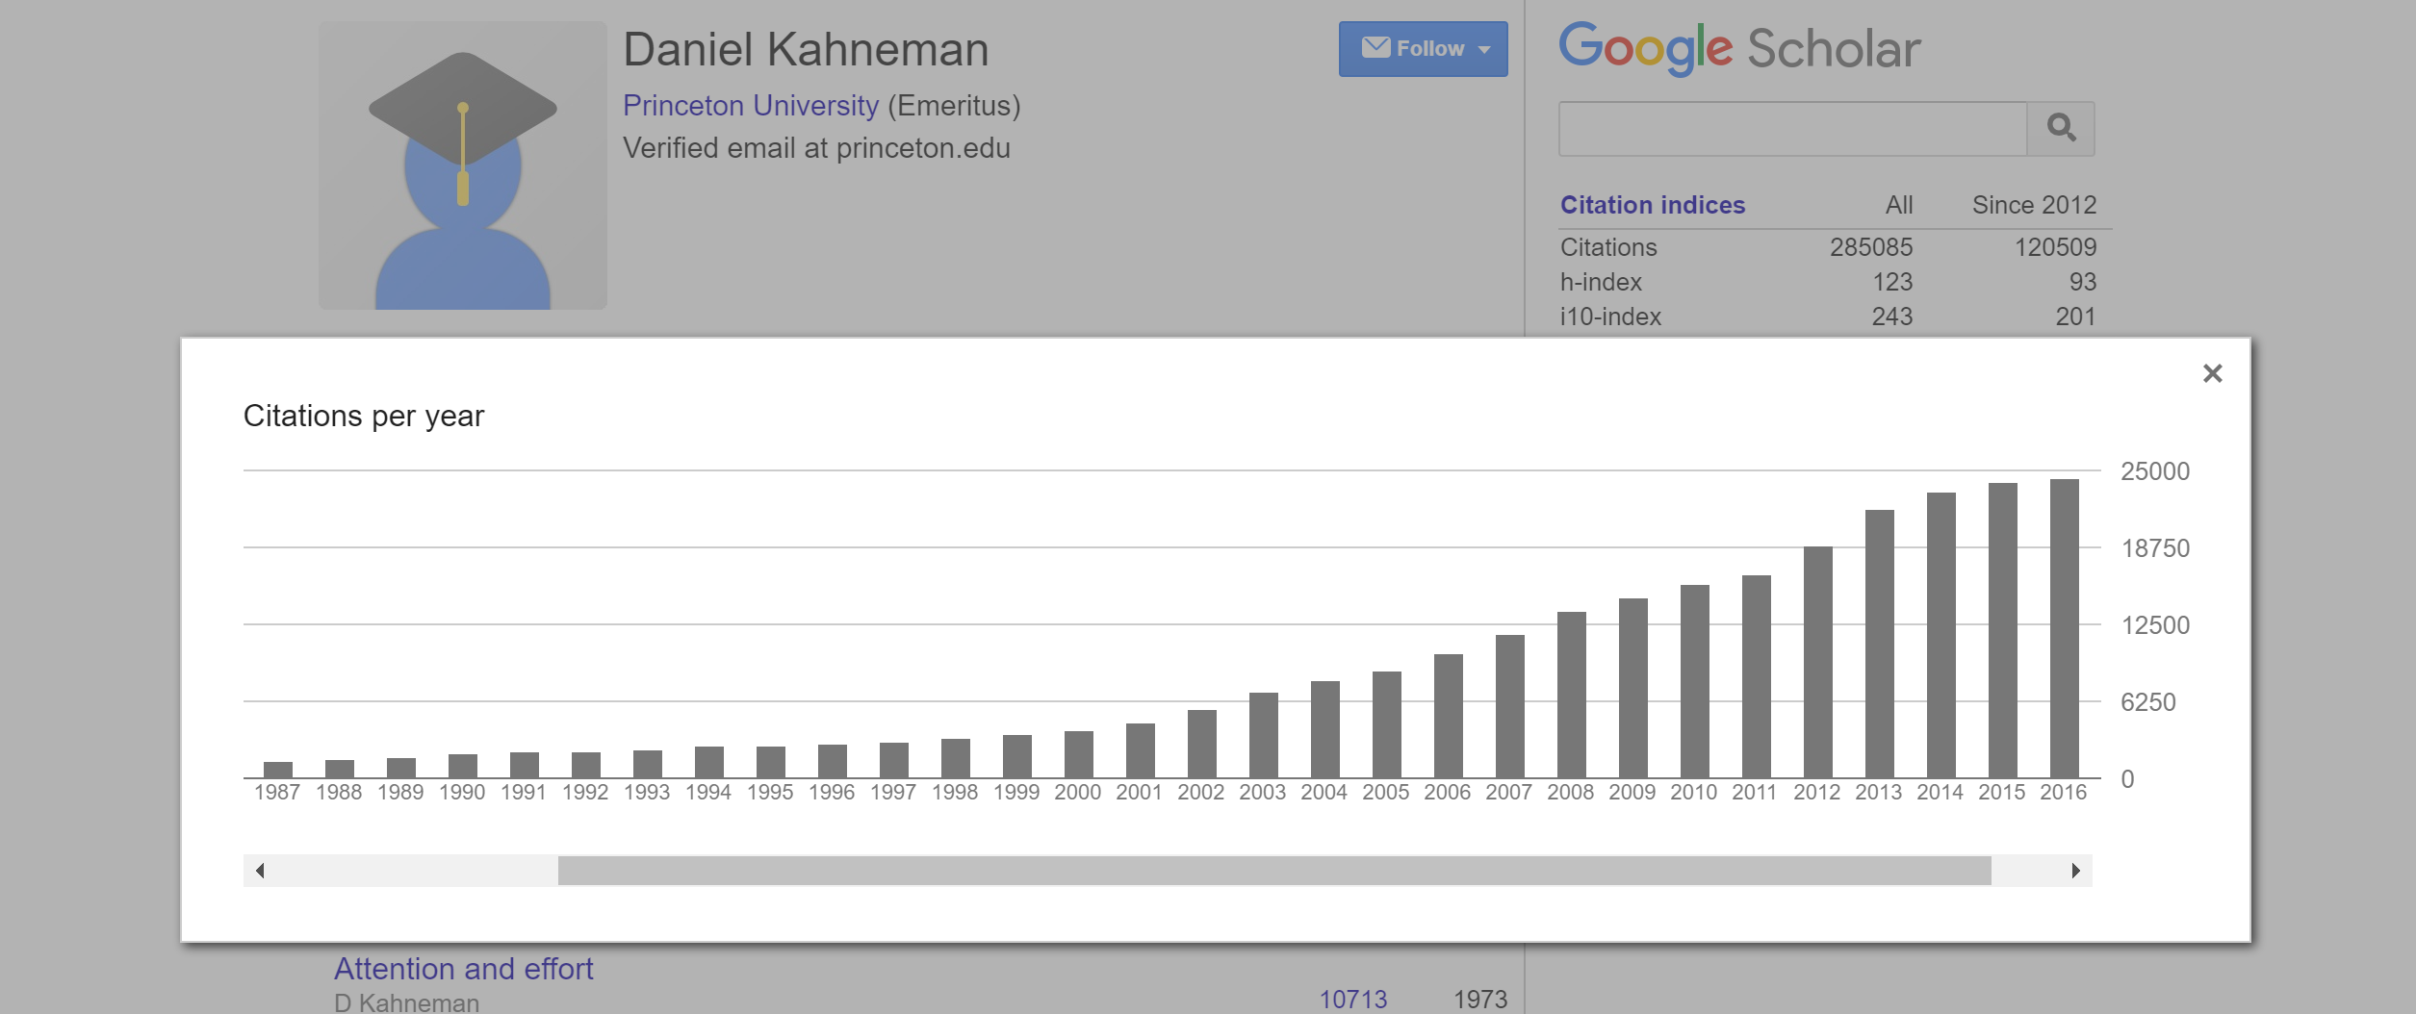

Slide 8
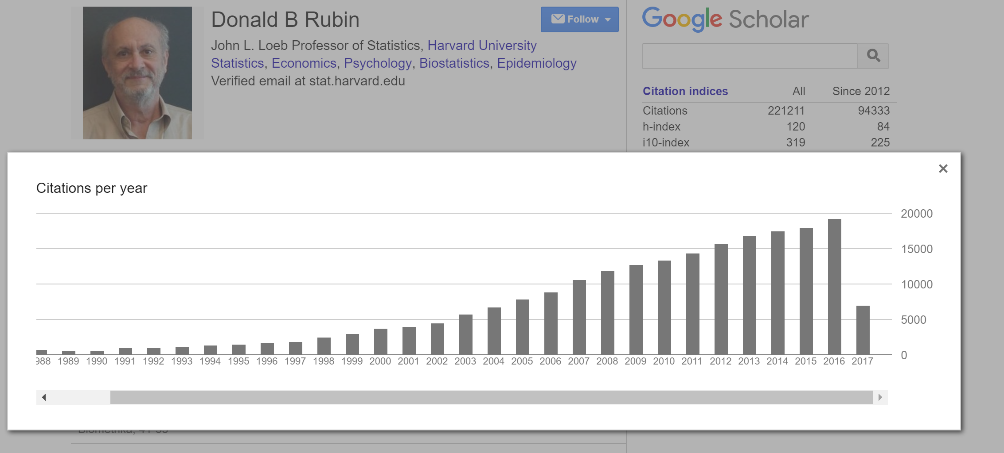

Slide 9
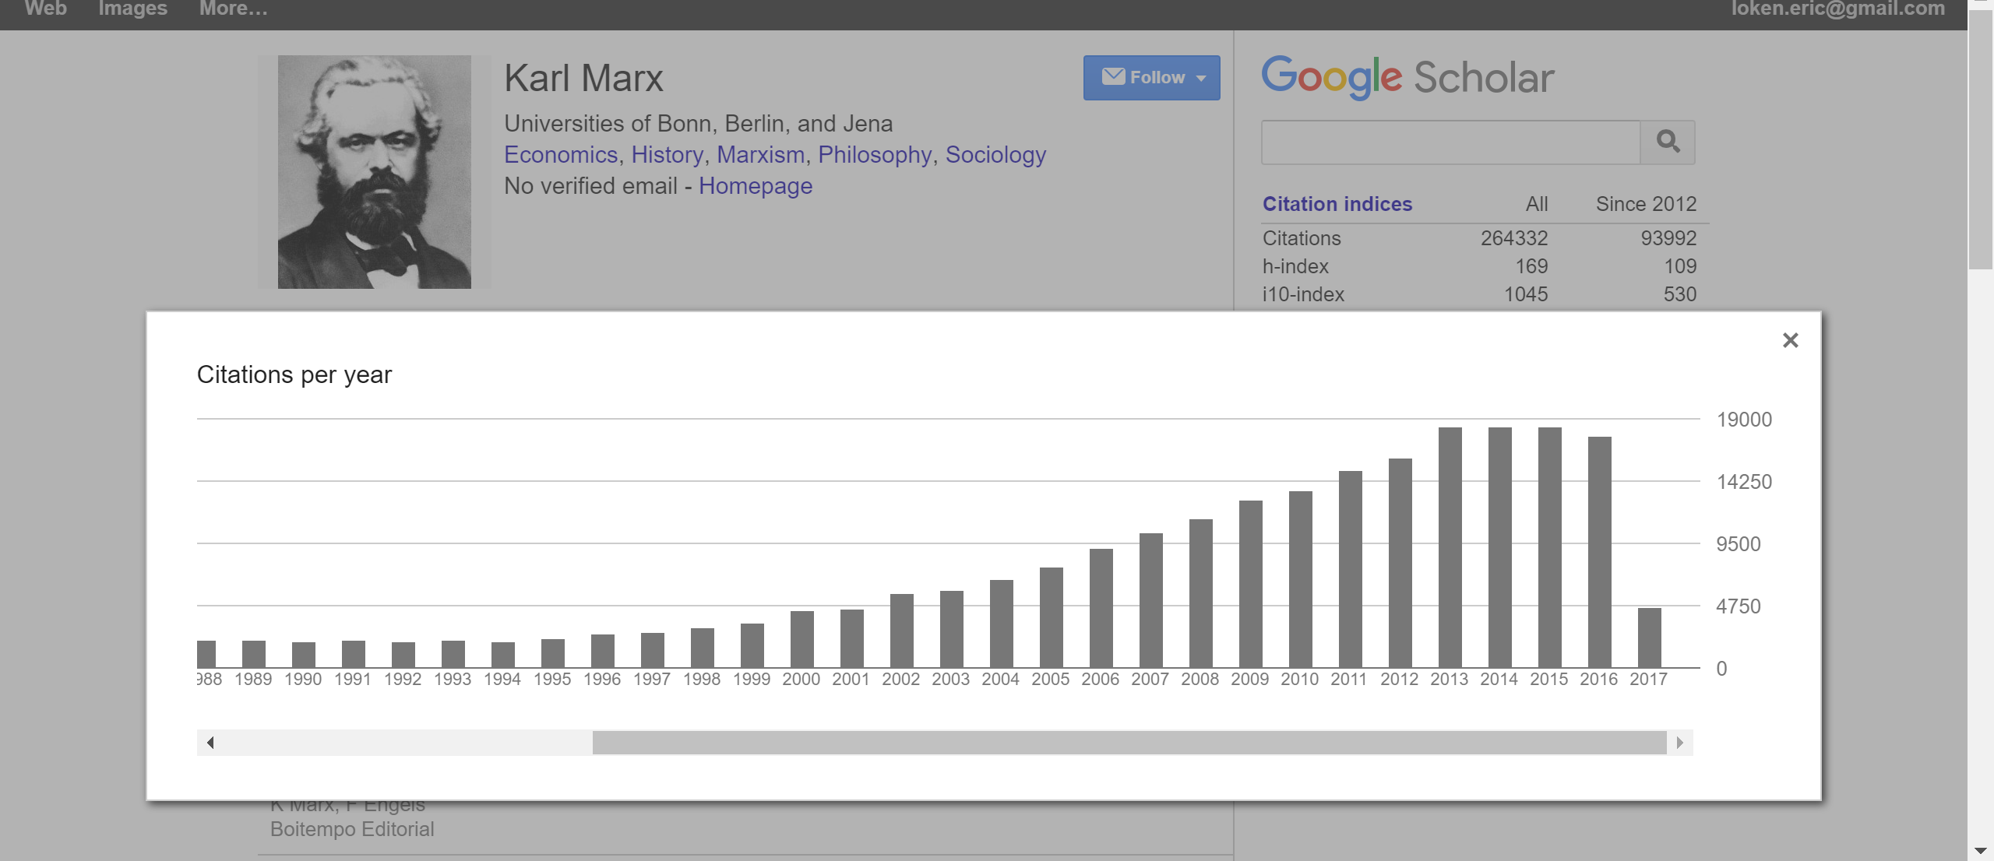

Slide 10
Anatomy of a Crisis
Poor calibration of value and risk (AAA ratings)
Passing on the risk to others
Churn
Keeping up with everyone else

Slide 11
Science may not be “self-correcting”
Ioannidis 2005

Slide 12
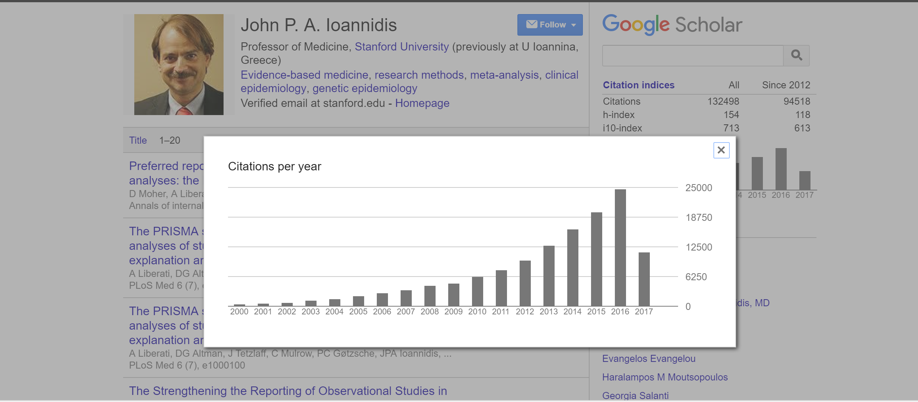

Slide 13
Failure to Replicate Scientific Results
Ioannidis 2005
  Low power research yields over-estimates of effect sizes after conditioning on significance

Slide 14
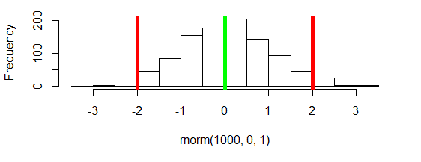
Sampling Distribution Under the Null

Slide 15
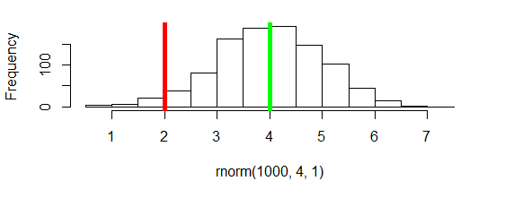
Large effect, small error

Slide 16
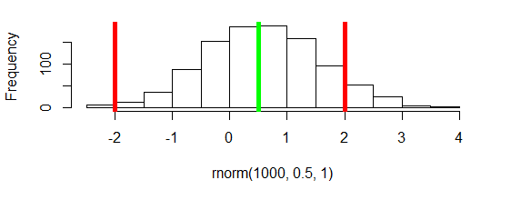
Small effect, relatively large error

Slide 17
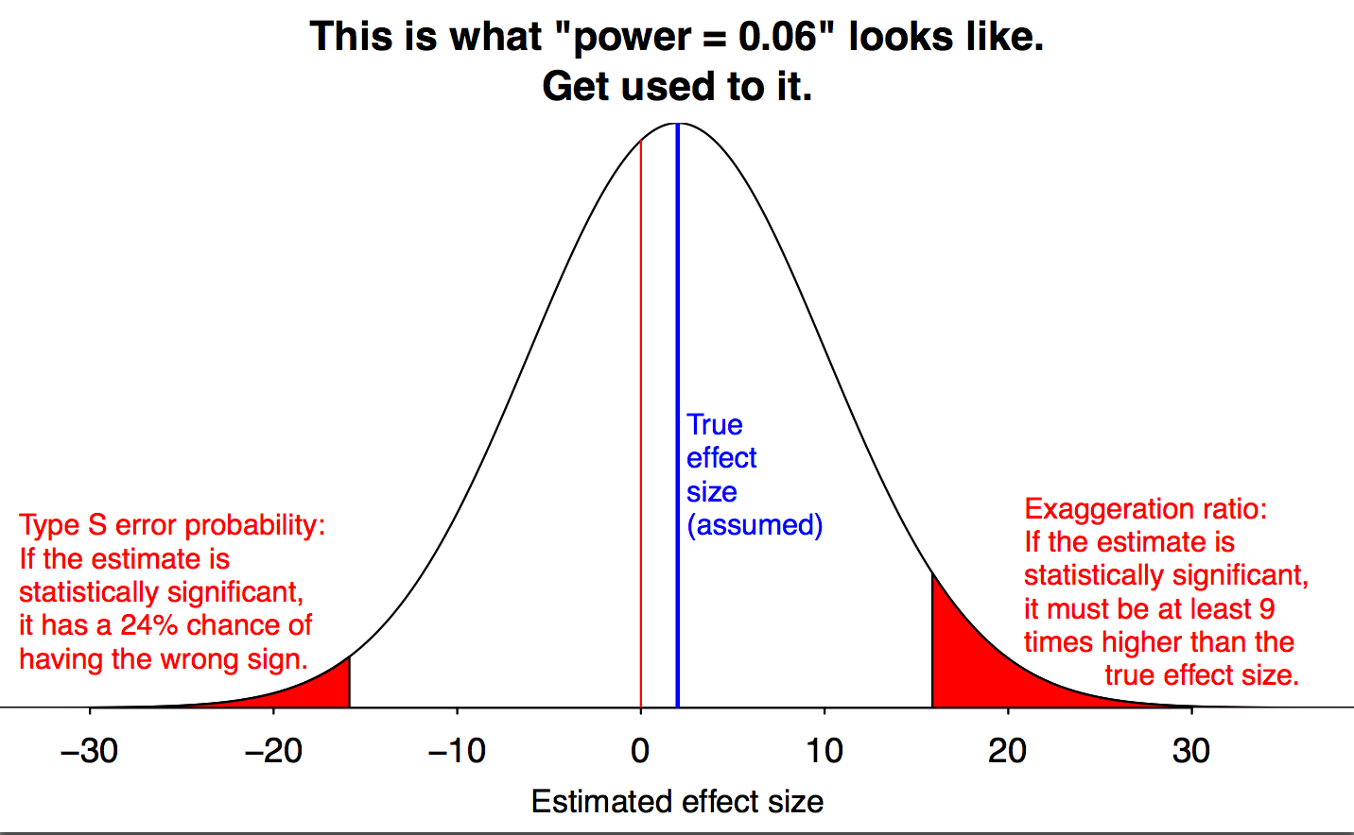
Gelman, A. 11/17/2014

Slide 18
Where is all this unreliable, low-power research happening?
Genetics
Neuroscience
Medicine
Psychology
Nutrition

Slide 19
Nutrition faces methodology issues
Schoenfeld & Ioannidis (2012) Is everything we eat associated with cancer?
Ioannidis (2013) Editorial in BMJ Implausible Results in Human Nutrition Research

Slide 21
Schoenfeld, J. D., & Ioannidis, J. P. (2013). Is everything we eat associated with cancer? A systematic cookbook review. The American journal of clinical nutrition, 97(1), 127-134.

Slide 22


Slide 23
Outline of a Research study
General statement of a research question, weak connection to a statistical test
Binary interpretation of results
Uncritical about huge effect size
Low power replication
Measurement issues
Data dependent decisions

Slide 24
Garden of Forking Paths
(Gelman & Loken, 2014)
-- test statistic T(y; φ)
-- φ represents choices in data analysis – selection of variables, transformations, covariates, interaction effects, missing data etc.
-- if φ a function of y, then would choices have been the same with different data?

Slide 25
NOT just an issue of fishing
Of course if φ is chosen to maximize the test statistic, then we have fishing
But we make these choices all the time in data analysis, even when headed toward “one” analysis for purposes of inference
Pre-registration can limit these researcher degrees of freedom

Slide 26
A Computer Science Take
Computer scientists think of an “adversary” trying to compromise a database
Consider making K-queries of a large database, where query k could depend on results of previous query
How large does K need to be such that the database is compromised, or results represent overfitting?

Slide 27
K in the single digits can be a problem !?
Contrast with applied research practices:
  Frequently used databases
  Lab groups
  Demonstrating productivity on a grant

Slide 28

Robust in the face of noise?

Slide 29


Slide 30
Noise only works against you?
The effects reported for the programs I discuss survive batteries of rigorous testing procedures. They are conducted by independent analysts who did not perform or design the original experiments. The fact that samples are small works against finding any effects for the programs, much less the statistically significant and substantial effects that have been found.
Heckman about education effect sizes

Slide 31
if our categorization did result in some women being mis-categorized as low-risk when in fact they were high risk, or vice-versa, this would increase error and decrease the size of any effects found.
Beal and Tracy – response to criticism about wearing red study

Slide 32
First, some kinds of studies, by their nature, may be more robust than others….It is difficult to control all, or even many, of the variables in a field study. Why is this lack of control a good thing? If a phenomenon is discoverable under these messy conditions, it is likely to be a robust one that is worthy of explanation.
Susan Goldin-Meadow, APS Observer

Slide 33
Hausman “Iron Law”
When there is error in X in a simple regression β is downwardly biased
β = Cov(X,Y)/var(X)
also called attenuation due to unreliability in psychometrics
Also non-differential misclassification error in epidemiology

Slide 34
Shadish Cook and Campbell:
“Measurement error always attenuates bivariate correlations.”

Slide 35
Shadish Cook and Campbell:
“Measurement error always attenuates bivariate correlations.”
Always?

Slide 36
Simple Demonstration
Consider a simple bivariate regression
Simulate x,y pairs under modest correlation
Estimate slope (“without error”)
Add independent error to x and y
Estimate slope (“with error”)
Repeat in high and low power settings

Slide 37
Loken & Gelman, Science, 2017

Slide 38
Loken & Gelman, Science, 2017

Slide 39
Loken & Gelman, Science, 2017

Slide 40

How to do well on a test?
Suppose you’ve answered two questions on a three item multiple choice test. You’ve answered an easy item correctly, and a medium question incorrectly.
For your last item, would you prefer to attempt a medium item, or a hard item?

Slide 41
Which Pattern Demonstrates Higher Ability?
Easy Q
Medium Q
Medium Q
Easy Q
Medium Q
Hard Q

Slide 42
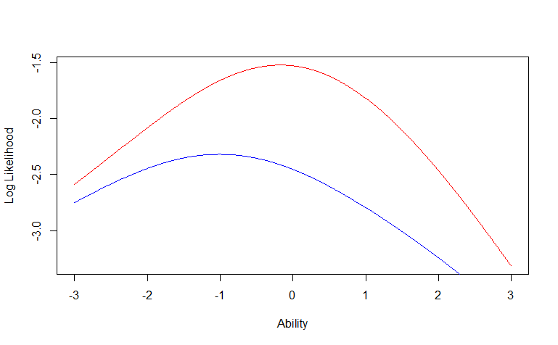
Likelihoods for getting medium or hard item correct

Slide 43
Robust to Alternative Analyses?
Uri Simonsohn’s gives an example of making a surprising discovery
…. and then showing that it is “still significant” after adding in various possible confounders

Slide 44
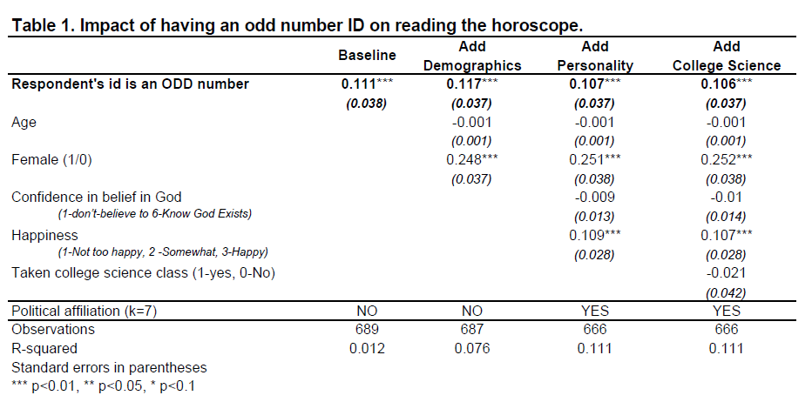
Robust to Confounders?
Uri Simonsohn

Slide 45
Is there a correlation between dietary intake and weight?
Surprisingly, this is somewhat controversial
Must distinguish between and within hypotheses

Slide 46
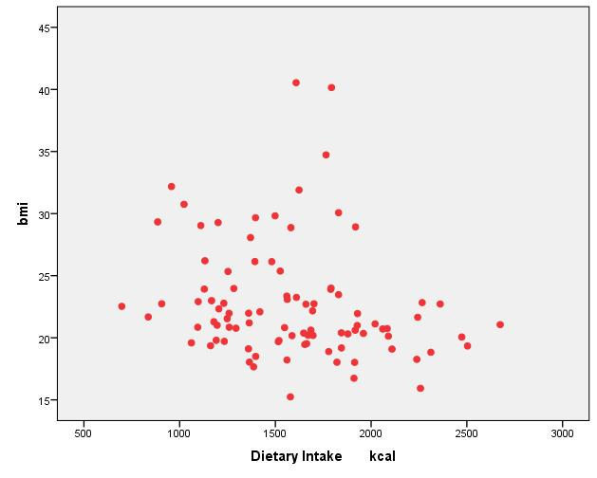
Body Mass Index as a Function of Dietary Intake

Slide 47
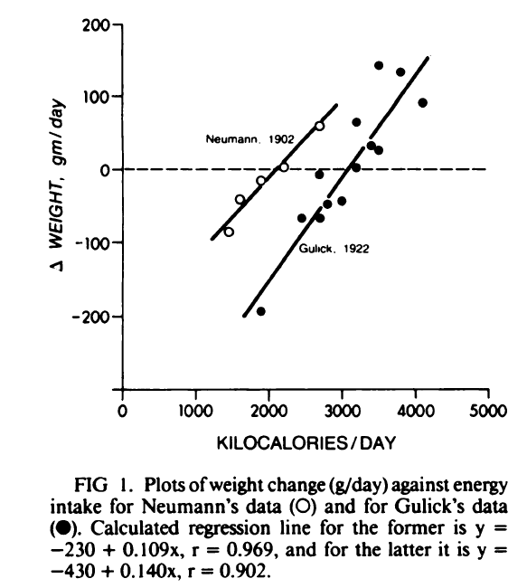
Forbes, 1984

Slide 48
The rather precise nature of the relationship in Figure 1 serves as a reminder of the central role of energy intake in weight homeostasis.
Forbes, 1984
Forbes, 1984

Slide 49
Do We Fool Ourselves?
Dan Kahan, motivated reasoning, and statistical errors that increase with numeracy

Slide 50
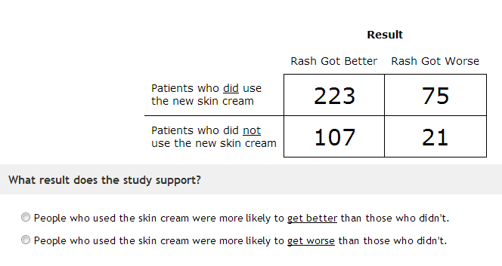

Slide 51
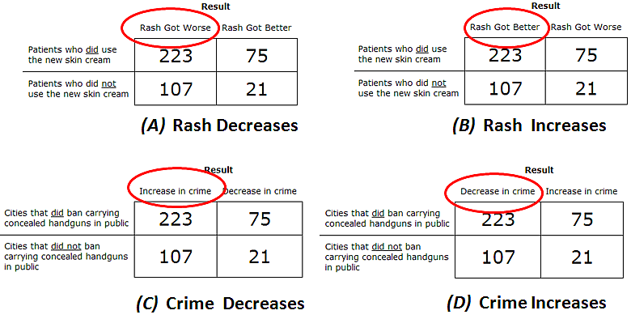

Slide 52
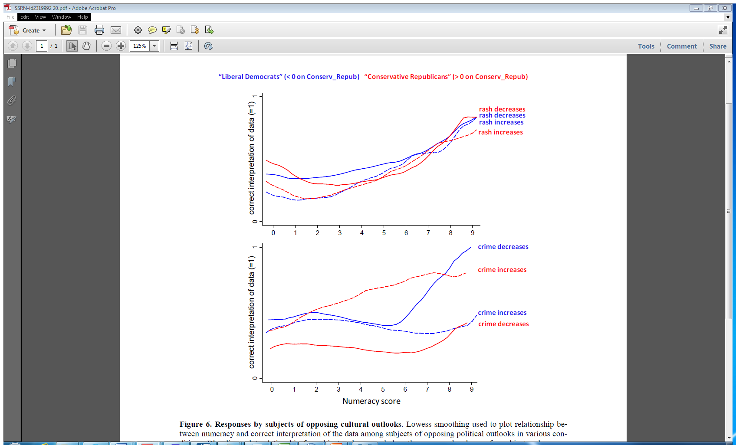

Slide 54
Summing up
Unreliable research like a frothy market
Much of it conducted at low power, leaving us with little more than our prior knowledge
Weak intuitions about data dependent decisions, or consequences of measurement error
With statistical reasoning, motivation and skill can be counter-productive

Slide 55
The Bad News….
Low power, over-estimated effects
Missing literature
Process of combining research questions with statistical analyses and inferences
Garden of forking paths
The impact of measurement error and noise
Robust to other predictors?
Interpretation of regression coefficients
Conflation of within/between hypotheses
Ability to fool ourselves

Slide 56
The good news….
High level of awareness
Multidisciplinary insights
Open science movements
  Pre-registration
  Data sharing
  Replication efforts

Slide 57

Soft Landing?

Slide 58


Slide 59
Questions?
eric.loken@uconn.edu

Slide 60
“Controlling for” covariation?
Metacognitive Self-Regulation
Rehearsal Strategies
Mean exam scores for the semester
Sample of approximately 3000 students in college class

Slide 61
Predicting Exam Scores (out of 100)

Slide 62
Predicting Exam Scores (out of 100)

Slide 63
Predicting Exam Scores (out of 100)

Slide 64
Predicting Exam Scores (out of 100)

Slide 65
Variables carry many meanings
Suppressor effects
  Regression coefficients swing opposite
  R² for a regression with two variables is greater than sum of R² for individual regressions

Slide 66
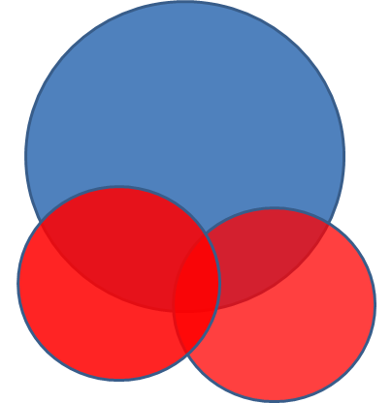
Y
x1
x2

Slide 67
It’s all in the correlation matrix….

Slide 68
Reasoning about
-- heckman, beal and tracy, field studies golden-meadow,

Slide 69
How Do We Know Power is Low?
Human variability
Multiply determined events
Measurement challenges
Reporting inaccuracies
Between-person and within-person analyses

