Slide 1

Doctor, It Hurts When I p
Ronald L. Wasserstein, Executive Director, ASA
NJ ASA Chapter Annual Symposium
May 25, 2017

Slide 2
The Talk
They think they know all about it already, because they learned about it from others like them.
It is not nearly as interesting as they thought it would be.
They’ve stopped listening before you’ve stopped talking.
Chances are, they now understand it even less.
Notes:
If you are a parent, then you know what “The Talk” is. About three years ago, my wife and I proudly brought home two 10 year-old-boys from Haiti. A few months later, my wife brought them downstairs to me, where I was relaxing and watching a Nats game, and announced that the boys needed The Talk. The Talk is complicated enough, but when you are talking to two boys who are just learning English, it is an extra challenge.
It occurred to me recently that explaining p-values to non-statisticians is a bit like having The Talk.
(read list)

Slide 3
Why did the ASA issue a “statement on p-values and statistical significance?”
Notes:
Before getting briefly into the particulars of the statement, a few words about why we did this. It hasn’t been the culture of the ASA to make declarations like this one. We’ve made statements about very narrow aspects of statistics – how to use statistical methods to audit elections, for example. But inference is at the very heart of statistics, and our long tradition is to let the community work out such statistical issues in the journals and in the arena of practice. However, this is simply not working when it comes to this matter.

Slide 4
"It has been widely felt, probably for thirty years and more, that significance tests are overemphasized and often misused and that more emphasis should be put on estimation and prediction.
Cox, D.R. 1986. Some general aspects of the theory of statistics. International Statistical Review 54: 117-126.
A world of quotes illustrating the long history of concern about this can be viewed at David F. Parkhurst, School of Public and Environmental Affairs, Indiana University
http://www.indiana.edu/~stigtsts/quotsagn.html
Notes:
The estimable D R Cox, recent winner of the first International Prize in Statistics, said this 30 years ago. Thus, the problem has been well identified and widely acknowledged, and yet it is getting worse.

Slide 5
“Let’s be clear. Nothing in the ASA statement is new.”
Statisticians and others have been sounding the alarm about these matters for decades, to little avail.
(Wasserstein and Lazar, 2016)
Notes:
The problems with the use and interpretation of p-values have been known for a long time. Nonetheless, the problems persist and so the statement resonates. It has been downloaded over 170,000 times, and has already over 300 citations.

Slide 6
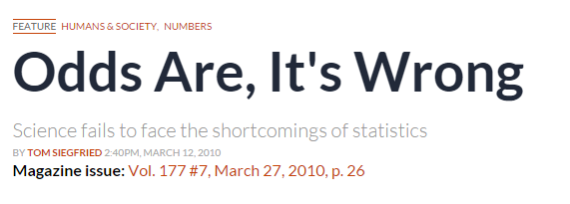

Why did the ASA issue a “statement on p-values and statistical significance?”
Notes:
We were spurred into actions by attacks on p-values that morphed into attacks on our profession.

Slide 7
Why did the ASA issue a “statement on p-values and statistical significance?”
Science fails to face the shortcomings of statistics

Slide 8
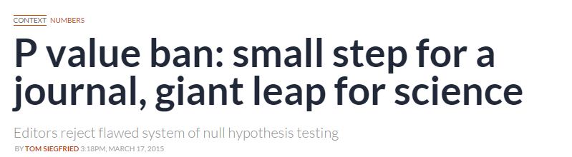
A journal went so far as to ban p-values
Notes:
In this environment, we thought a statement by the world’s largest association of statisticians might have a beneficial impact on the conduct of science with respect to statistics.

Slide 9
P-value “clarified” (in the ASA Statement)
Informally, a p-value is the probability under a specified statistical model that a statistical summary of the data (for example, the sample mean difference between two compared groups) would be equal to or more extreme than its observed value.
“That definition is about as clear as mud”
Christie Aschwanden, lead writer for science, FiveThirtyEight
Notes:
Here’s what we wrote. This informal definition took us a long time to agree on, and it works. (Click to show FiveThirtyEight quote.)

Slide 10
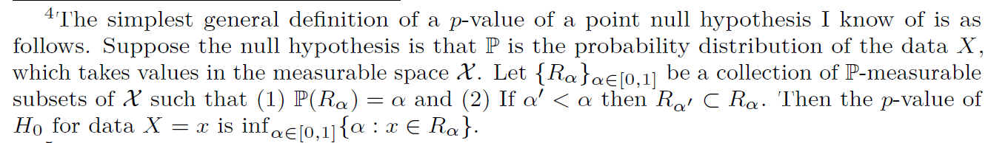
Perhaps this is clearer
(Stark, 2016)

Slide 11
What goes into the p-value?
Many things!
Assumption that the null hypothesis is true is typically the only thing considered
However, much more than that goes into the p-value. Many choices by the researcher can affect it.
Notes:
One thing that the experts that worked on the ASA Statement were adamant about is that the p-value isn’t just conditioned on the null hypothesis, but on everything else that goes into the model. And while we can argue what constitutes the model, the takeaway message is that correctly interpreting the p-value depends not only on the assumptions made in calculating it, but on the factors that lead to its calculation.
I think of it this way: What is everything I need to know in order to take the RAW data from the experimenters and arrive at the same test statistic and p-value they did? If different choices would lead to different p-values, then surely that information is critically important in interpreting the p-value.

Slide 12
ASA statement articulates six principles
P-values can indicate how incompatible the data are with a specified statistical model.
P-values do not measure the probability that the studied hypothesis is true, or the probability that the data were produced by random chance alone.
Scientific conclusions and business or policy decisions should not be based only on whether a p-value passes a specific threshold.
Proper inference requires full reporting and transparency
A p-value, or statistical significance, does not measure the size of an effect or the importance of a result.
By itself, a p-value does not provide a good measure of evidence regarding a model or hypothesis.
Notes:
The ASA statement articulates six principles.
The first gives a measured view of what a p-value can do.
The second, what it does not do but is often accused of doing.
The third is the most important one, signaling in a strong way what not to do.
The fourth is nearly as important, for many reaons.
The fifth is another warning about interpretation, and
The sixth is a bit more technical, but along with the third principle argues for care in making p-value-based decisions.

Slide 13
ASA statement articulates six principles
P-values can indicate how incompatible the data are with a specified statistical model.
P-values do not measure the probability that the studied hypothesis is true, or the probability that the data were produced by random chance alone.
Scientific conclusions and business or policy decisions should not be based only on whether a p-value passes a specific threshold.
Proper inference requires full reporting and transparency
A p-value, or statistical significance, does not measure the size of an effect or the importance of a result.
By itself, a p-value does not provide a good measure of evidence regarding a model or hypothesis.
Notes:
The ASA statement articulates six principles.
The first gives a measured view of what a p-value can do.
The second, what it does not do but is often accused of doing.
The third is the most important one, signaling in a strong way what not to do.
The fourth is nearly as important, for many reaons.
The fifth is another warning about interpretation, and
The sixth is a bit more technical, but along with the third principle argues for care in making p-value-based decisions.

Slide 14

Does the ASA statement go far enough?
The ASA statement does not go as far as it should go.
However, it goes as far as it could go.
Notes:
It doesn’t go as far as this signpost suggests, but the statement reached as far as it could with a basic level of agreement.
The biggest shortcoming of the statement is that it did not spell out clear alternatives. Many people have written me to say that we’ve left them hanging. One concern the p-value experts had was that people would try a straight substitution. “OK, the ASA says p-values and .05 are bad. So, instead, if my Bayes Factor is bigger than 6.87, bingo!”
Fundamentally, the statement developers don’t think we should expect to be able to make inference based only on a single index.

Slide 15
Biggest takeaway message from the ASA statement – bright line thinking is bad for science
“(S)cientists have embraced and even avidly pursued meaningless differences solely because they are statistically significant, and have ignored important effects because they failed to pass the screen of statistical significance…It is a safe bet that people have suffered or died because scientists (and editors, regulators, journalists and others) have used significance tests to interpret results, and have consequently failed to identify the most beneficial courses of action.” (Rothman)

Slide 16
p equal or nearly equal to 0.06
almost significant
almost attained significance
almost significant tendency
almost became significant
almost but not quite significant
almost statistically significant
almost reached statistical significance
just barely below the level of significance
just beyond significance
"... surely, God loves the .06 nearly as much as the .05." (Rosnell and Rosenthal 1989)
Notes:
If you think bright-line thinking is not going on, and that it isn’t clustered around 0.05, consider these quotes, taken from actual research articles
Rosnell, R.L. and Rosenthal, R. 1989. Statistical procedures and the justification of knowledge and psychological science. American Psychologist 44: 1276-1284
The quote continues: “Can there be any doubt that God views the strength of evidence for or against the null as a fairly continuous function of the magnitude of p?”

Slide 17
p equal or nearly equal to 0.08
a certain trend toward significance
a definite trend
a slight tendency toward significance
a strong trend toward significance
a trend close to significance
an expected trend
approached our criteria of significance
approaching borderline significance
approaching, although not reaching, significance

Slide 18
And, God forbid, p close to but not less than 0.05
hovered at nearly a significant level (p=0.058)
hovers on the brink of significance (p=0.055)
just about significant (p=0.051)
just above the margin of significance (p=0.053)
just at the conventional level of significance (p=0.05001)
just barely statistically signiﬁcant (p=0.054)
just borderline significant (p=0.058)
just escaped significance (p=0.057)
just failed significance (p=0.057)

Slide 19
Thanks to Matthew Hankins for these quotes
https://mchankins.wordpress.com/2013/04/21/still-not-significant-2/

Slide 20
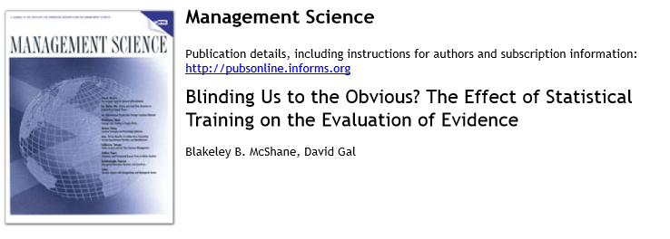

Slide 21
Hypothesis: Focus on statistical significance levels leads researchers to misinterpret data
Participants: Authors of articles published in the 2013 volume of the NEJM

Slide 22
Below is a summary of a study from an academic paper:
The study aimed to test how different interventions might affect terminal cancer patients’ survival. Participants were randomly assigned to one of two groups. Group A was instructed to write daily about positive things they were blessed with while Group B was instructed to write daily about misfortunes that others had to endure. Participants were then tracked until all had died. Participants in Group A lived, on average, 8.2 months post-diagnosis whereas participants in Group B lived, on average, 7.5 months post-diagnosis (p=0.27).

Slide 23
Response wording 1: Which statement is the most accurate summary of the results?
Speaking only of the subjects who took part in this particular study, the average number of post-diagnosis months lived by the participants who were in Group A was greater than that lived by the participants who were in Group B.
Speaking only of the subjects who took part in this particular study, the average number of post-diagnosis months lived by the participants who were in Group A was less than that lived by the participants who were in Group B.
Speaking only of the subjects who took part in this particular study, the average number of post-diagnosis months lived by the participants who were in Group A was no different than that lived by the participants who were in Group B.
Speaking only of the subjects who took part in this particular study, it cannot be determined whether the average number of post-diagnosis months lived by the participants who were in Group A was greater/no different/less than that lived by the participants who were in Group B.

Slide 24
Response wording 2: Which statement is the most accurate summary of the results?
The average number of post-diagnosis months lived by the participants who were in Group A was greater than that lived by the participants who were in Group B.
The average number of post-diagnosis months lived by the participants who were in Group A was less than that lived by the participants who were in Group B.
The average number of post-diagnosis months lived by the participants who were in Group A was no different than that lived by the participants who were in Group B.
It cannot be determined whether the average number of post-diagnosis months lived by the participants who were in Group A was greater/no different/less than that lived by the participants who were in Group B.

Slide 25
Response wording 3: Which statement is the most accurate summary of the results?
The participants who were in Group A tended to live longer post-diagnosis than the participants who were in Group B.
The participants who were in Group A tended to live shorter post-diagnosis than the participants who were in Group B.
Post-diagnosis lifespan did not diﬀer between the participants who were in Group A and the participants who were in Group B.
It cannot be determined whether the participants who were in Group A tended to live longer/no diﬀerent/shorter post-diagnosis than the participants who were in Group B.

Slide 26
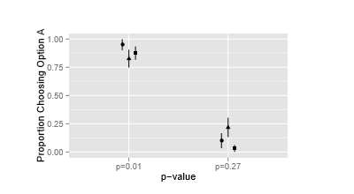
Results recall:
A. group A>group B
B. group A<group B
C. No difference
D. cannot tell
Regardless of the wording presented, most people selected A (the correct answer) when p=0.27 and failed to select A when p=0.01.
In the case of p=0.01, most of the few people who did chose A chose D
In the case of p=0.27, among the great majority of people who chose did not chose A, there was generally a split between C and D, with C favored by most.

Slide 27
Robustness checks
Similar study with
  editorial board of Psychological Science
  Marketing Science Institute Young Scholars
  Statistically trained undergraduates
  Undergraduates without statistical training
There was no substantial change to the pattern of results

Slide 28
Study 2: Does this pattern of results extend from descriptive statements to the evaluation of evidence via likelihood judgments
Participants: Authors of articles published in the 2013 volume of the American Journal of Epidemiology
Participants completed a likelihood judgment question followed by a choice question. Participants were randomly assigned to one of sixteen conditions following a four by two by two design. The ﬁrst level of the design varied whether the p-value was set to 0.025, 0.075, 0.125, or 0.175 and the second level of the design varied the magnitude of the treatment diﬀerence (52% and 44% versus 57% and 39%).

Slide 29
Below is a summary of a study from an academic paper:
The study aimed to test how two diﬀerent drugs impact whether a patient recovers from a certain disease. Subjects were randomly drawn from a ﬁxed population and then randomly assigned to Drug A or Drug B. Fifty-two percent (52%) of subjects who took Drug A recovered from the disease while forty-four percent (44%) of subjects who took Drug B recovered from the disease. A test of the null hypothesis that there is no diﬀerence between Drug A and Drug B in terms of probability of recovery from the disease yields a p-value of 0.175.

Slide 30
Likelihood judgment question: Assuming no prior studies have been conducted with these drugs, which of the following statements is most accurate?
A person drawn randomly from the same population as the subjects in the study is more likely to recover from the disease if given Drug A than if given Drug B.
A person drawn randomly from the same population as the subjects in the study is less likely to recover from the disease if given Drug A than if given Drug B.
A person drawn randomly from the same population as the subjects in the study is equally likely to recover from the disease if given Drug A than if given Drug B.
It cannot be determined whether a person drawn randomly from the same population as the subjects in the study is more/less/equally likely to recover from the disease if given Drug A or if given Drug B.

Slide 31
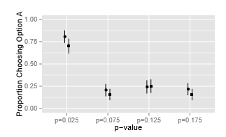
Likelihood judgment question: Assuming no prior studies have been conducted with these drugs, which of the following statements is most accurate?
more likely
less likely
equally likely
cannot be determined

Slide 32
Personal choice question: If you were to advise a loved one who was a patient from the same population as those in the study, what drug would you advise him or her to take?
I would advise Drug A.
I would advise Drug B.
I would advise that there is no diﬀerence between Drug A and Drug B.

Slide 33
Distant choice question: If you were to advise physicians treating patients from the same population as those in the study, what drug would you advise these physicians prescribe for their patients?
I would advise Drug A.
I would advise Drug B.
I would advise that there is no diﬀerence between Drug A and Drug B.

Slide 34
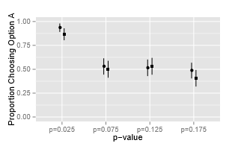
Notes:
Combined across personal choice or distant choice

Slide 35
Why did they make these choices?
Participants were provided a text box to explain their reasoning
The vast majority who incorrectly answered the “judgment question” responded with an answer about not achieving statistical significance
By the way:
This second study was tested on multiple populations with similar results
The size of the effect (the proportions of success for the two drugs) were also varied, with no change in the pattern

Slide 36
Dichtomizing evidence leads to strange behaviors!

Slide 37

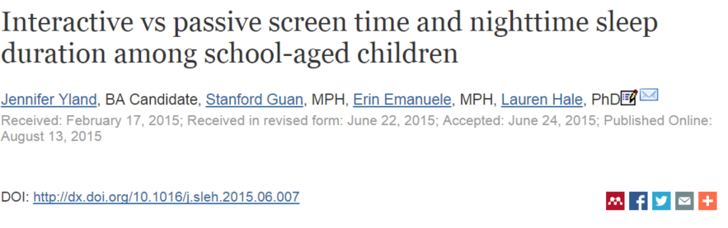
Does “screen time” affect sleep habits of school age children?
Notes:
Science often starts with questions of this type. Is there a relationship, an association, between one thing and another? If there is, what might be the cause or mechanism leading to this relationship?
Here, some scientists wanted to know whether certain kinds of “screen time” have an association with how long school kids sleep.
The gold standard for answering such questions is called a randomized controlled trial. In a simple version of such a trial, one group receives a certain treatment, intervention, and exposure, and another does not (or receives a different one). The subjects are as homogenous as possible, and are randomly assigned to one of the two groups.
In many kinds of studies, like this one, such an approach is simply not feasible. You can’t assign children to specific behaviors like this. It is not only ethical but – and trust me on this, as I have lots of kids – it isn’t possible.

Slide 38
The researchers had hypotheses, based on previous research
“We hypothesized that use of any form of electronic media would be negatively associated with sleep duration.”
“Furthermore, we expected that the strength of the association would vary based on the level of interactivity of the screen type.”
“More specifically, we hypothesized that interactive forms of screen time, such as computer use and video gaming, would be associated with shorter bedtime sleep duration compared to passive forms of screen time, such as watching television.”
Notes:
List them

Slide 39
Why were they interested?
Lack of sleep (insufficient sleep duration) increases risk of poor academic performance as well as certain adverse health outcomes
Is there a relationship between weekday nighttime sleep duration and screen exposure (television, chatting, video games)?
Notes:
The researchers state in their abstract: Insufficient sleep among school-aged children is a growing concern, as numerous studies have shown that chronic short sleep duration increases the risk of poor academic performance and specific adverse health outcomes. We examined the association between weekday nighttime sleep duration and 3 types of screen exposure: television, chatting, and video gaming.

Slide 40
Who were the subjects?
“We used age 9 data from an ethnically diverse national birth cohort study, the Fragile Families and Child Wellbeing Study, to assess the association between screen time and sleep duration among 9-year-olds, using screen time data reported by both the child (n = 3269) and by the child's primary caregiver (n = 2770).”

Slide 41
Fragile Families and Child Wellbeing Study
“The FFCW is a longitudinal cohort study that has followed approximately 5000 children, born between 1998 and 2000, since birth. Data were collected in 20 cities with populations of at least 200,000 across the United States. The sample was designed to include a high number of unmarried parents and racial minorities, along with a high proportion of low socioeconomic status.”

Slide 42
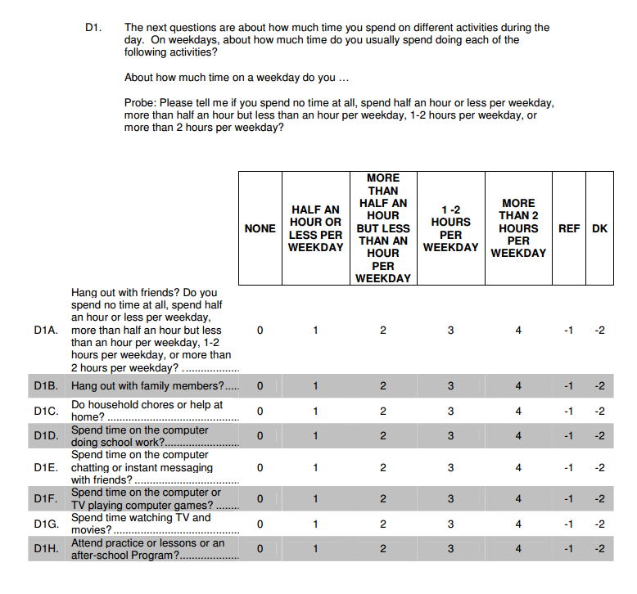
Notes:
This is a portion of the survey instrument that is administered through an interview.
The survey covers areas such as parental and sibling relationships, health, school issues, and more.

Slide 43
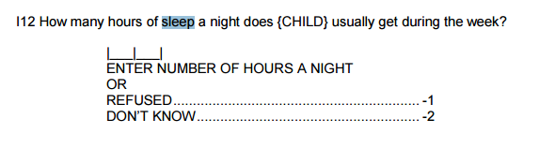
Notes:
Caregivers were asked a separate set of questions.
These researchers combined the caregivers responses on this question with the children’s responses from the other survey.

Slide 44
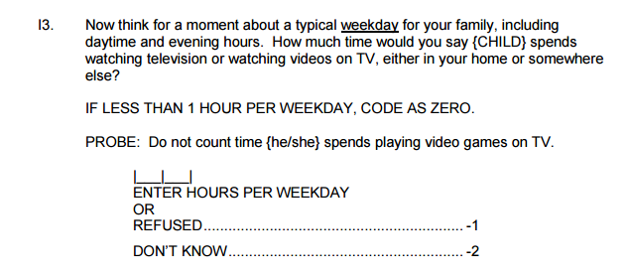
Notes:
Caregivers were also asked about their child’s screen use, so the question could be evaluated from both perspectives. In the interest of time we’ll focus on the child responses.

Slide 45
What did the researchers find?
Children who watched more than 2 hours/day of TV had shorter sleep duration compared with those who watched less than 2 hours/day (P<.001) by about 11 minutes.
Children who spent more than 2 hours per day of chatting on the computer had shorter sleep duration than those who chatted less than 2 hours/day (P<.05) by about 16 minutes.
The researchers did not find a significant association between playing videogames/working on the computer for more than 2 hours per day and weekday nighttime sleep duration

Slide 46
When the researchers adjusted for other factors
Children who watched more than 2 hours/day of TV had shorter sleep duration compared with those who watched less than 2 hours/day (P<.05) by about 6 minutes.
No other significant associations found.
Notes:
Researchers adjusted for sex, race/ethnicity, parental relationship, and mother's education, which attenuated the results.

Slide 47
This is a fairly typical type of study
Typical scientifically
Typical statistically
Atypical communication
Notes:
Typical scientifically: uses data that has been carefully collected to try to glean insight
Typical statistically: uses fairly standard approaches and reports results in a typical fashion
Communication: very carefully explains everything they did and why they did them. The researchers are to be commended for very carefully expressing in the details of their paper what the study limitations are.
Unfortunately, many times only the abstract is what gets read – for one thing, because it is free. I paid for access to the full article.
In any case, this is a very typical type of study within certain fields.

Slide 48
Unfortunately, it makes all-too-typical mistakes
Notes:
I did not have to hunt for an example of these problems. I was thinking about my kids and their sleep habits, and thought I’d just search for an article. This was the FIRST ONE I found. The point is that it is NOT hard to find such things.

Slide 49
Children who watched more than 2 hours/day of TV had shorter sleep duration compared with those who watched less than 2 hours/day (P<.001) by about 11 minutes.
Notes:
Again, this was the result that we’re talking about

Slide 50
This means that, if all of the assumptions are correct, including the null hypothesis, there is less than a 1 in 1000 chance that the researchers would have observed the result they did or one even larger. (The result they observed is an average difference of about 11 minutes from one group to the other.)
Notes:
There are MANY assumptions made, and the authors are good about stating them. One assumption is the accuracy of the self-reported information.
My two 12-year-olds have NO IDEA how much time they spend watching TV or playing video games. To be honest, though, I am sure it is more than two hours.

Slide 51
Hypothesis testing logic
A 1 in 1000 chance is not very likely
So it is not likely that, if all of the assumptions are correct, we would have observed the outcome we observed (11 minutes difference in sleep time) or one even larger.
Therefore, we should evaluate these assumptions, including the null hypothesis
Notes:
Here is how this should play out

Slide 52
What people tend to conclude in these situations? (What will the blogs say?)
Research shows that children who watch TV more during the weekday sleep less than those who don’t.
And from there it is a short walk to “TV is not good for kids and should be limited” or “TV is causing poor performance in school because it makes kids sleep less.”
Authors’ conclusion in abstract: “No specific type or use of screen time resulted in significantly shorter sleep duration than another, suggesting that caution should be advised against excessive use of all screens.” – In other words, though not demonstrated in the study, all screen usage is suspect.
Notes:
But here is what tends to happen.
The authors mention the other assumptions in the paper, mention that they could be wrong – and indeed likely are – but then report anyway that the difference is real (that is, the null hypothesis is false)
As I mentioned earlier, only the abstract makes the news, and shows up something like the first bullet point. And it is true – sort of, maybe, but incomplete.
“Research shows” – one study or many?
“Children who” – all children? 9 year olds? 9 year olds from this population? 9 year olds from this population several years ago?
“sleep less” – by how much
And then there’s the payoff: “excessive use” “caution”
And they make one really common mistake

Slide 53
There is no “p-value transitivity property”
They argue (in effect):
  TV = chatting = video games in this study
  TV results in less sleep in this study
  Therefore, we should watch out for all the other things, too.
But the study does not and cannot prove the first assertion!

Slide 54
“If there is enough evidence that one effect is significant, but not enough evidence for the second being significant, that doesn’t mean that the two effects are different from each other. Analogously, if you can prove that one suspect was present at a crime scene, but can’t prove the other was, that doesn’t mean that you have proved that the two suspects were in different places.” (emphasis mine)
(http://mindhacks.com/2015/10/03/statistical-fallacy-impairs-post-publication-mood/)

Slide 55
What is scientifically appropriate to conclude?
The children in this study who watched more than 2 hours/day of TV had shorter sleep duration compared with those who watched less than 2 hours/day by about 11 minutes.
If all of our assumptions, including those about the representativeness of the sample, are correct, the study suggests that nine year old children from this population who watch more than 2 hours/day of TV….

Slide 56
In the sleep research, even if all of our assumptions are correct…
Does 11 minutes less sleep really matter? Why?
Furthermore, the “11 minutes” measure is an estimate that has variance – we learn nothing about that variance from the way the data summary is reported (i.e., via a p-value)
Notes:
Am I ruining my kids lives by letting them play games or watch TV more than two hours a night on weeknights?
What if we just do 1 hour and 45 minutes? (smile)

Slide 57
And what if THIS had happened:
Suppose the study showed that children who watched 2 or more hours of TV slept on average 90 minutes per night less than those who did not, but the p-value was 0.09.
Is this result “insignificant”?

Slide 58
A fundamental problem
We want P(H|D) but p-values give P(D|H)
Notes:
The p-value is not conditioned on what we’d like it to be. We generally would like to know what is the probability of our hypothesis being true given the data we observed, but p-values tell you the probability of the data given the hypothesis (and, as a reminder, everything else needed or assumed to compute the p-value)

Slide 59
The problem illustrated (Carver 1978)
What is the probability of obtaining a dead person (D) given that the person was hanged (H); that is, in symbol form, what is p(D|H)?
Obviously, it will be very high, perhaps .97 or higher.
Notes:
Here is a crystal clear and very clever example from Ron Carver nearly 40 years ago.

Slide 60
The problem illustrated (Carver 1978)
Now, let us reverse the question: What is the probability that a person has been hanged (H) given that the person is dead (D); that is, what is p(H|D)?
This time the probability will undoubtedly be very low, perhaps .01 or lower.

Slide 61
The problem illustrated (Carver 1978)
No one would be likely to make the mistake of substituting the first estimate (.97) for the second (.01); that is, to accept .97 as the probability that a person has been hanged given that the person is dead.
Carver, R.P. 1978. The case against statistical testing. Harvard Educational Review 48: 378-399.
Notes:
“Even though this seems to be an unlikely mistake, it is exactly the kind of mistake that is made with the interpretation of statistical significance testing---by analogy, calculated estimates of p(D|H) are interpreted as if they were estimates of p(H|D), when they are clearly not the same." (Carver 1978)

Slide 62
Inference is hard work.
Simplistic (“cookbook”) rules and procedures are not a substitute for this hard work.
Cookbook + artificial threshold for significance = appearance of objectivity
Notes:
Inference is hard work. One way that has been commonly used to make inference easier, while giving the appearance of objectivity, is to specify calculations and procedures and to set thresholds of what makes something “statistically significant.” Indeed, the frequent criticism about certain Bayesian methods being subjective ignores the hidden subjectivity involved in some frequentist methods.
We would like to move beyond this.

Slide 63
Gelman and Carlin (2017) (to appear in JASA)
“…we think the solution is not to reform p-values or to replace them with some other statistical summary or threshold, but rather to move toward a greater acceptance of uncertainty and embracing of variation.”

Slide 64
In a world where p<0.05 carried no meaning…
What would you have to do to get your paper published, your research grant funded, your drug approved, your policy or business recommendation accepted?

Slide 65
You’d have to be convincing!
Notes:
You’d make good arguments for your position based on the nature and design of your study, which is based on what is already known or conjectured. You would use ALL the statistical results you had in hand, not just the p-value. And we suspect that researchers want to do that and know how to do that, but that a culture of using the p-value as a filter has set back that method of thinking.

Slide 66

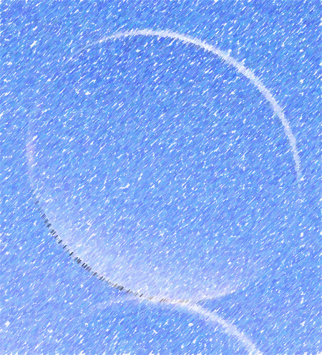

You will also have to be transparent
Notes:
The p-value is impacted by the numerous decisions that are made in data collection, preparation, and analysis. One must be really clear about the assumptions made and the actions taken leading up to the computation of that p-value.

Slide 67
“Small steps” (Gelman and Carlin)
Say No to binary conclusions in our collaboration and consulting projects: resist giving clean answers when that is not warranted by the data.
Instead, do the work to present statistical conclusions with uncertainty rather than as dichotomies.
Also, remember that most eﬀects can’t be zero (at least in social science and public health), and that an “eﬀect” is usually a mean in a population (or something similar such as a regression coeﬃcient)—a fact that seems to be lost from consciousness when researchers slip into binary statements about there being “an eﬀect” or “no eﬀect” as if they are writing about constants of nature.
It will be diﬃcult to resolve the many problems with p-values and “statistical signiﬁcance” without addressing the mistaken goal of certainty which such methods have been used to pursue.

Slide 68
Wrapping up:
P-values themselves are not the problem, but…
They are hard to explain
They are easy to misunderstand
They don’t directly address the question of interest
When mixed with bright line thinking, they lead to bad science.
So, maybe if you have only been dating p-values, it’s time to start seeing some other statistics.

Slide 69


Notes:
We do plan to go further. This October in DC we will gather researchers, policy makers and others to take about conducting research, using research, and sponsoring, disseminating, reproducing and replicating research in the 21st century.
Keep an eye out for information about this conference, coming soon.

Slide 70
Haiku
Little p-value
what are you trying to say
of significance?
-Steve Ziliak
Questions?
ron@amstat.org
@RonWasserstein
Notes:
I conclude with haiku. Thanks for the privilege of speaking with you, and thanks to Brad Carlin at the University of Minnesota for the idea for the title of this talk.

