Slide 1
Are Observational Studies Any Good?
David Madigan, Columbia University on behalf of the OMOP research team
“The sole cause and root of almost every defect in the sciences is this: that whilst we falsely admire and extol the powers of the human mind, we do not search for its real helps.”
— Novum Organum: Aphorisms [Book One], 1620, Sir Francis Bacon

Slide 2
Observational Medical Outcomes Partnership
Public-Private Research Partnership established to inform the appropriate use of observational healthcare databases for studying the effects of medical products:
  Conducting methodological research to empirically evaluate the performance of various analytical methods on their ability to identify true associations and avoid false findings
  Developing tools and capabilities for transforming, characterizing, and analyzing disparate data sources across the health care delivery spectrum
  Establishing a shared resource so that the broader research community can collaboratively advance the science
Notes:
2

Slide 3
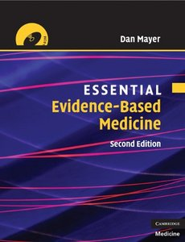
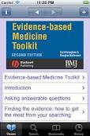
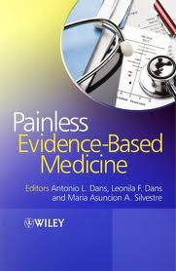
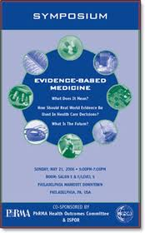
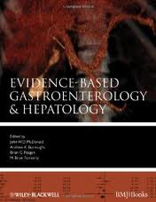
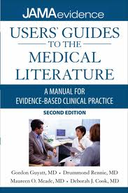
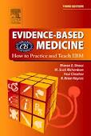
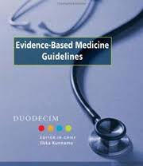
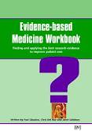

as against ???
“Evidence-Based Medicine”

Slide 4


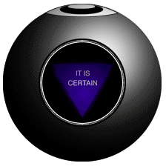


Slide 5
How does the combination of Clinical Judgment and Evidence-Based Medicine work in practice?

Slide 6
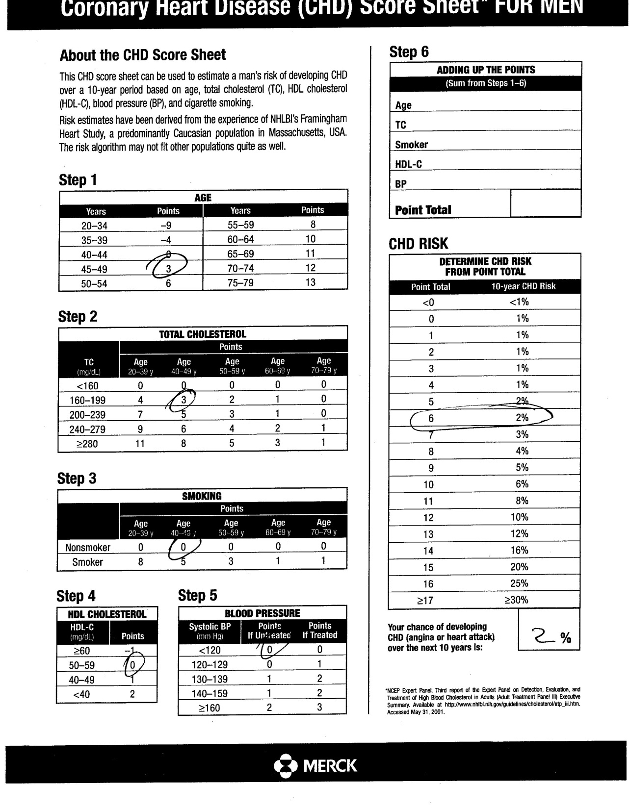
John went to see a world-class cardiologist
Should John have an angiogram?

Slide 7
“In this dependence on the limited, idiosyncratic capacities of individuals, medical practice lags centuries behind the domains of science and commerce.”
- Lawrence L. Weed

Slide 8
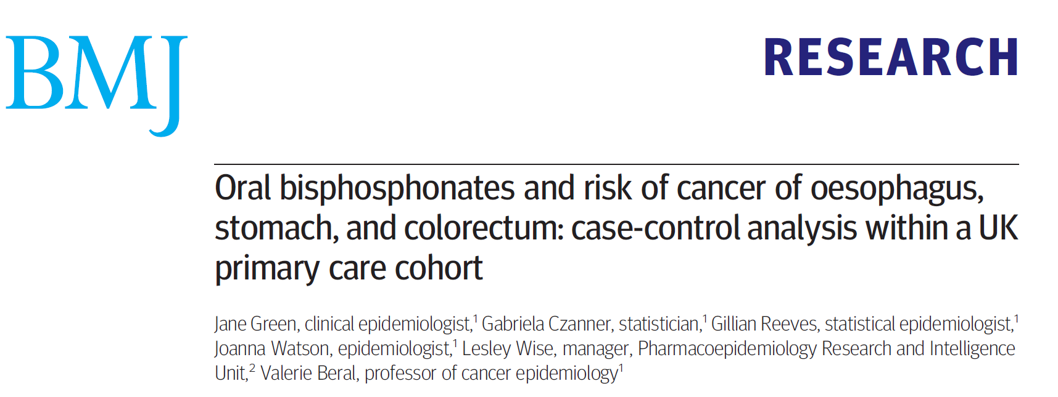

BMJ 2010; 341:c4444

Slide 9
BMJ study design choices
Data source: General Practice Research Database
Study design: Nested case-control
Inclusion criteria: Age > 40
Case: cancer diagnosis between 1995-2005 with 12-months of follow-up pre-diagnosis
5 controls per case
Matched on age at index date, sex, practice, observation period prior to index
Exposure definition: >=1 prescription during observation period
“RR” estimated with conditional logistic regression
Covariates: smoking, alcohol, BMI before outcome index date
Sensitivity analyses:
  exposure = 2+ prescriptions
  covariates not missing
  time-at-risk = >1 yr post-exposure
Subgroup analyses:
  Short vs. long exposure duration
  Age, Sex, smoking, alcohol, BMI
  Osteoporosis or osteopenia
  Fracture pre-exposure
  Prior diagnosis of Upper GI dx pre-exposure
  NSAID, corticosteroid, H2blocker, PPI utilization pre-exposure

Slide 10
In the design of observational studies we also rely heavily on “clinical judgment”
Even worse, we do so with very limited feedback
operating characteristics?
Like early days of lab testing – “trust me, I measured it myself”
Notes:
10

Slide 11
Do these choices matter?

Slide 12
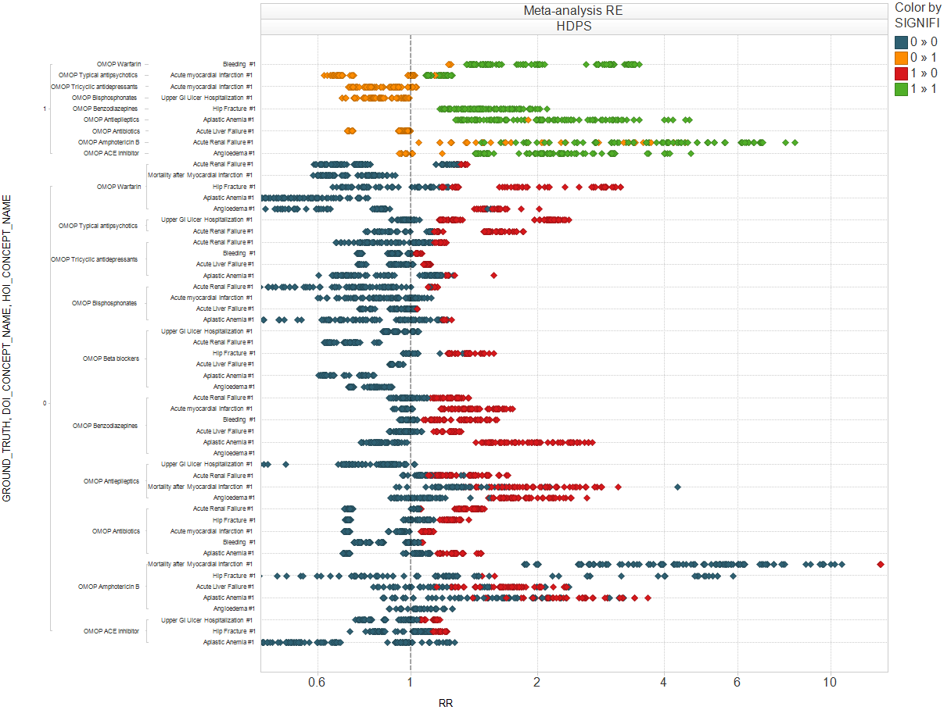
Range of estimates across high-dimensional propensity score inception cohort (HDPS) parameter settings
True -
False -
False +
True +
Parameter settings explored in OMOP:
Washout period (1): 180d
Surveillance window (3): 30 days from exposure start; exposure + 30d ; all time from exposure start
Covariate eligibility window (3): 30 days prior to exposure, 180, all-time pre-exposure
# of confounders (2): 100, 500 covariates used to estimate propensity score
Propensity strata (2): 5, 20 strata
Analysis strategy (3): Mantel-Haenszel stratification (MH), propensity score adjusted (PS), propensity strata adjusted (PS2)
Comparator cohort (2): drugs with same indication, not in same class; most prevalent drug with same indication, not in same class
Each row represents a drug-outcome pair.
The horizontal span reflects the range of point estimates observed across the parameter settings.
Ex. Benzodiazepine-Aplastic anemia: HDPS parameters vary in estimates from RR= 0.76 and 2.70
Relative risk

Slide 13
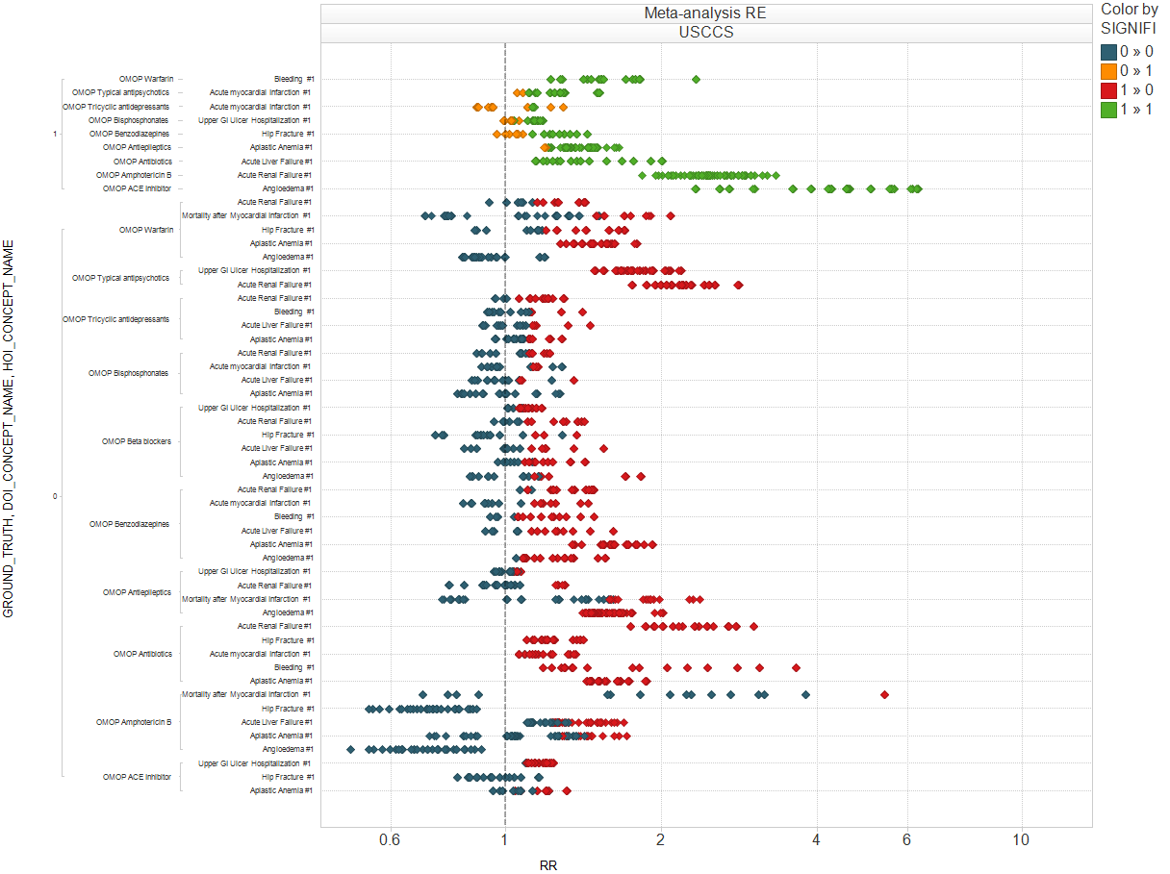
Range of estimates across univariate self-controlled case series (USCCS) parameter settings
True -
False -
False +
True +
USCCS Parameter settings explored in OMOP:
Condition type (2): first occurrence or all occurrences of outcome
Defining exposure time-at-risk:
Days from exposure start (2): should we include the drug start index date in the period at risk?
Surveillance window (4):
30 d from exposure start
Duration of exposure (drug era start through drug era end)
Duration of exposure + 30 d
Duration of exposure + 60 d
Precision of Normal prior (4): 0.5, 0.8, 1, 2
For Bisphosphonates-GI Ulcer hospitalization, USCCS using incident events, excluding the first day of exposure, and using large prior of 2:
  When surveillance window = length of exposure, no association is observed
  Adding 30d of time-at-risk to the end of exposure increased to a significant RR=1.14
Relative risk

Slide 14
Fix everything except the database…

Slide 15
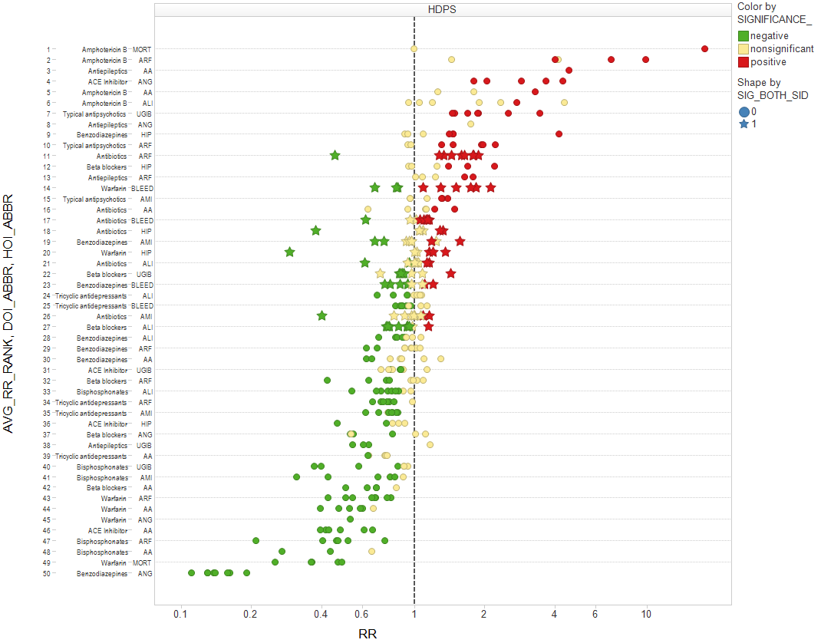
Cohort

Slide 16
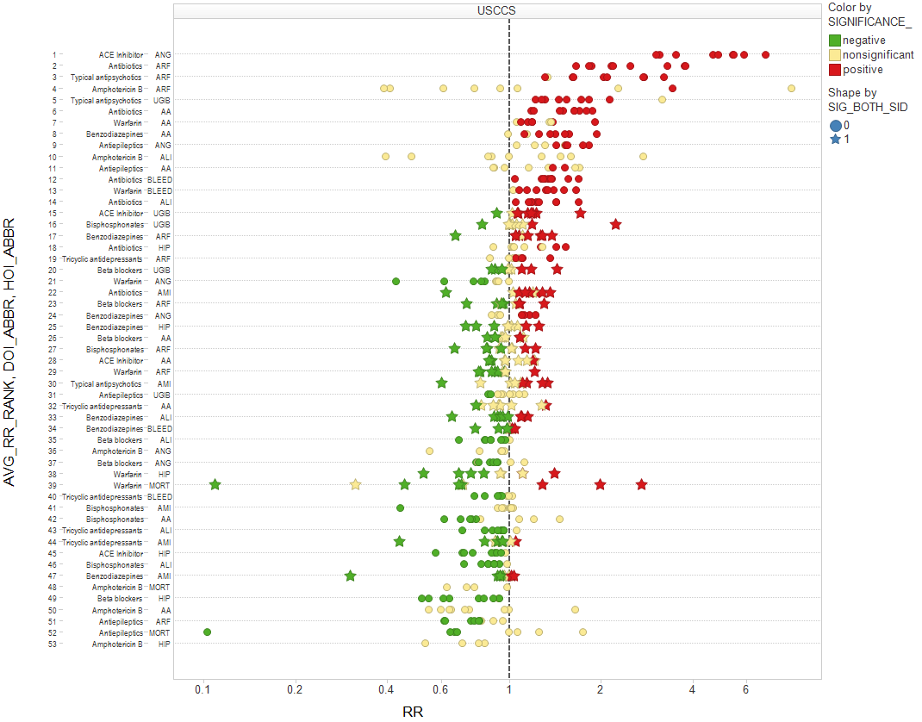
SCCS

Slide 17
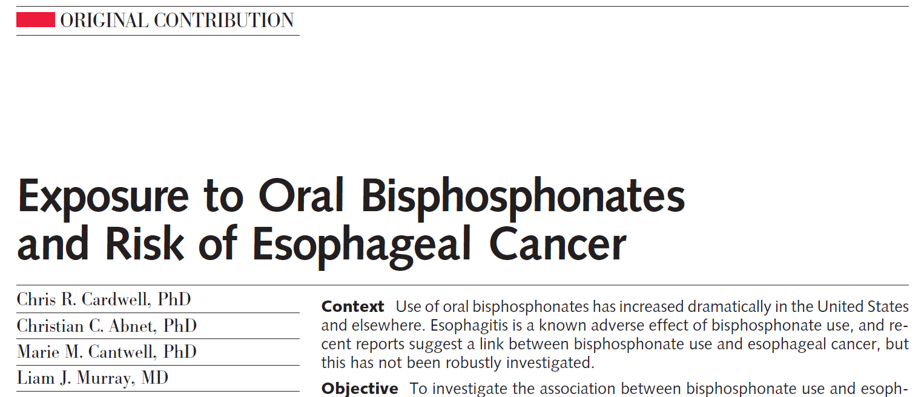


JAMA 2010; 304(6): 657-663

Slide 18
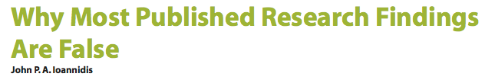



Does this stuff work at all?

Slide 19
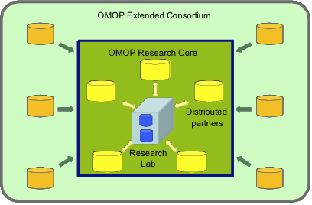
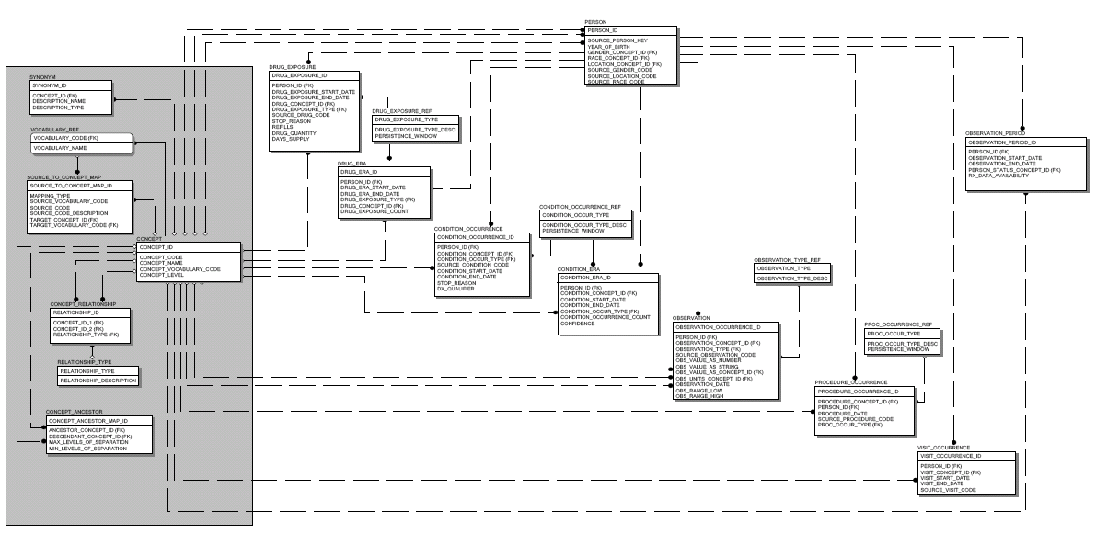
OMOP 2010/2011 Research Experiment
Open-source
Standards-based
OMOP Methods Library
Inception
cohort
Case control
Logistic
regression
Common Data Model
10 data sources
Claims and EHRs
200M+ lives
OSIM
14 methods
Epidemiology designs
Statistical approaches adapted for longitudinal data
Positives: 9
Negatives: 44

Slide 20
Ground truth for OMOP 2011/2012 experiments
isoniazid
fluticasone
indomethacin
clindamycin
ibuprofen
pioglitazone
loratadine
sertraline
Criteria for positive controls:
Event listed in Boxed Warning or Warnings/Precautions section of active FDA structured product label
Drug listed as ‘causative agent’ in Tisdale et al, 2010: “Drug-Induced Diseases”
Literature review identified no powered studies with refuting evidence of effect
Criteria for negative controls:
Event not listed anywhere in any section of active FDA structured product label
Drug not listed as ‘causative agent’ in Tisdale et al, 2010: “Drug-Induced Diseases”
Literature review identified no powered studies with evidence of potential positive association

Slide 21
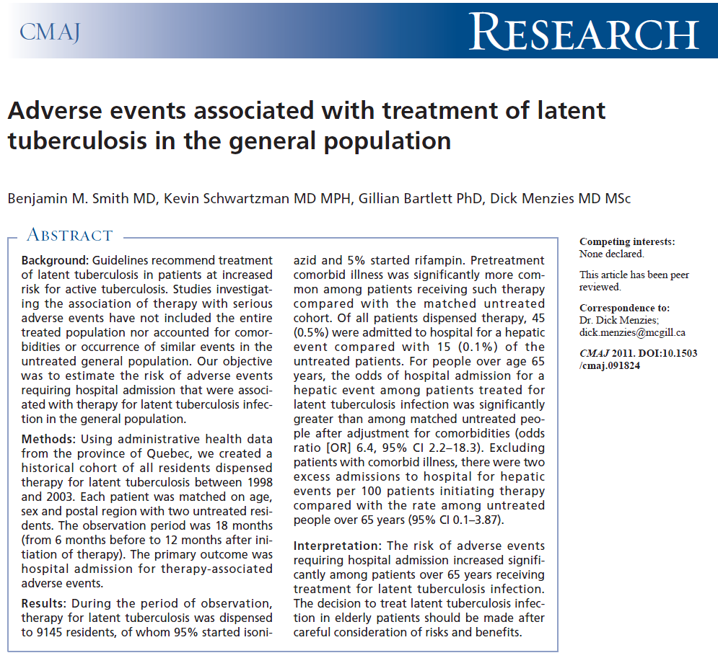

Exploring isoniazid and acute liver injury

Slide 22
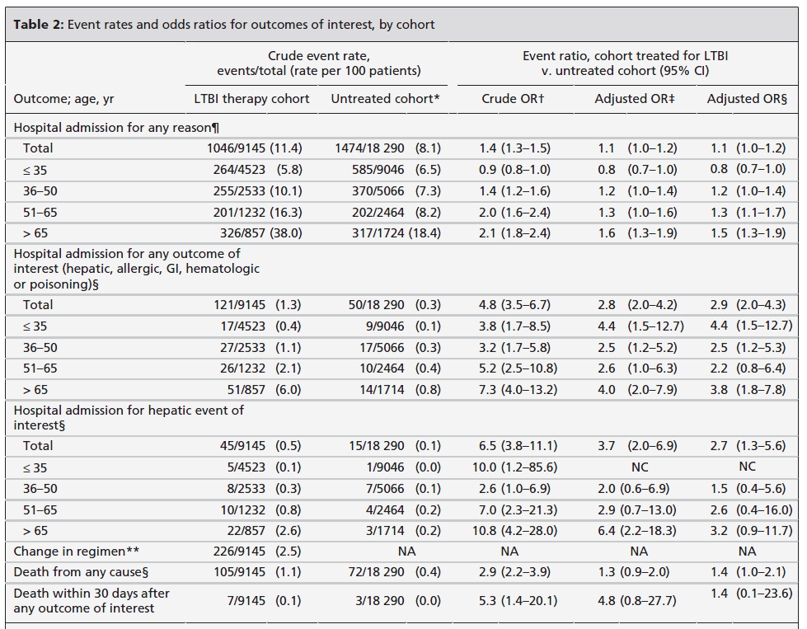
Smith et al. 2011 study design and results
Data source: Administrative claims from health insurance board of Quebec
Study design: Cohort
Exposure: all patients dispensed >=30d of therapy, 180d washout
Unexposed cohort: 2 patients per exposed, matched by age, gender, and region, with no tuberculosis therapy
Time-at-risk: Length of exposure + 60 days
Events: Incident hospital admission for noninfectious or toxic hepatitis
“Event ratio” estimated with conditional logistic regression
Covariates: prior hospitalization, Charlson score, comorbidities

Slide 23
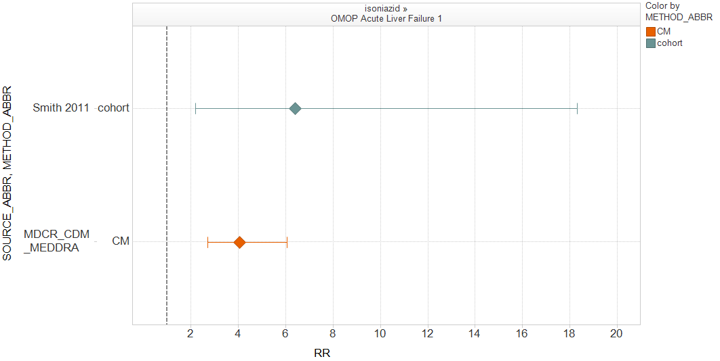
Revisiting the isoniazid – acute liver injury example
Data source: MarketScan Medicare Beneficiaries (MDCR)
Study design: Cohort
Exposure: all patients dispensed new use of isoniazid, 180d washout
Unexposed cohort: Patient with indicated diagnosis (e.g. pulmonary tuberculosis) but no exposure to isoniazid; negative control drug referents
Time-at-risk: Length of exposure + 30 days, censored at incident events
Covariates: age, sex, index year, Charlson score, number of prior visits, all prior medications, all comorbidities, all priority procedures
“Odds ratio” estimated through propensity score stratification (20 strata)
What if this study design were applied consistently across all the positive and negative controls?

Slide 24
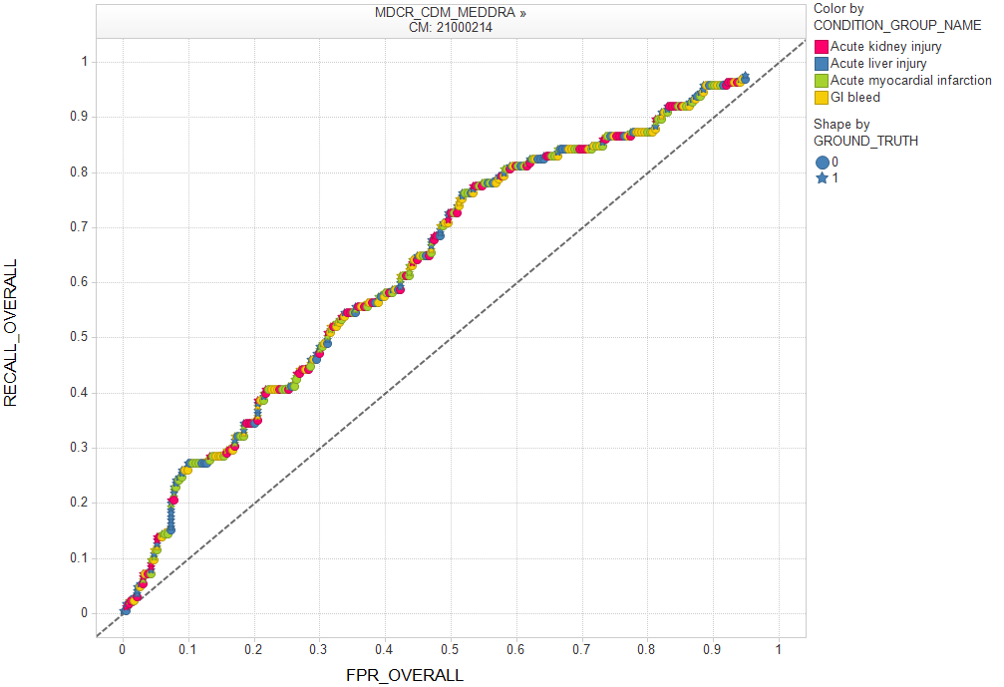
Receiver Operating Characteristic (ROC) curve
ROC plots sensitivity vs. false positive rate
Rank-order all pairs by RR from largest to smallest
Calculate sensitivity and specificity at all possible RR thresholds
Area under ROC curve (AUC) provides probability that method will score a randomly chosen true positive drug-outcome pair higher than a random unrelated drug-outcome pair
AUC=1 is perfect predictive model
AUC=0.50 is random guessing (diagonal line)
Cohort method on MDCR:
AUC = 0.64
Sensitivity
Isoniazid (RR=4.04):
Sensitivity = 4%
Specificity = 98%
False positive rate (1-Specificity)

Slide 25
Setting thresholds from an ROC curve
Sensitivity
If target sensitivity = 50%:
RR Threshold = 1.25
Specificity = 69%
Cohort method on MDCR: AUC = 0.64
AUC suggests that this method is modestly predictive, on the low end of diagnostic tests used in clinical practice, but at any given threshold there is a high false positive rate and/or false negative rate
Question: what strategies can be applied to do even better?
If threshold set to RR=2:
Sensitivity = 26%
Specificity = 90%
If target specificity = 95%:
RR Threshold = 2.87
Sensitivity = 10%
False positive rate (1-Specificity)

Slide 26
Strategies to improve predictive accuracy
Stratify results by outcome
Tailor analysis to outcome
Restrict to sufficient sample size
Optimize analysis to the data source

Slide 27
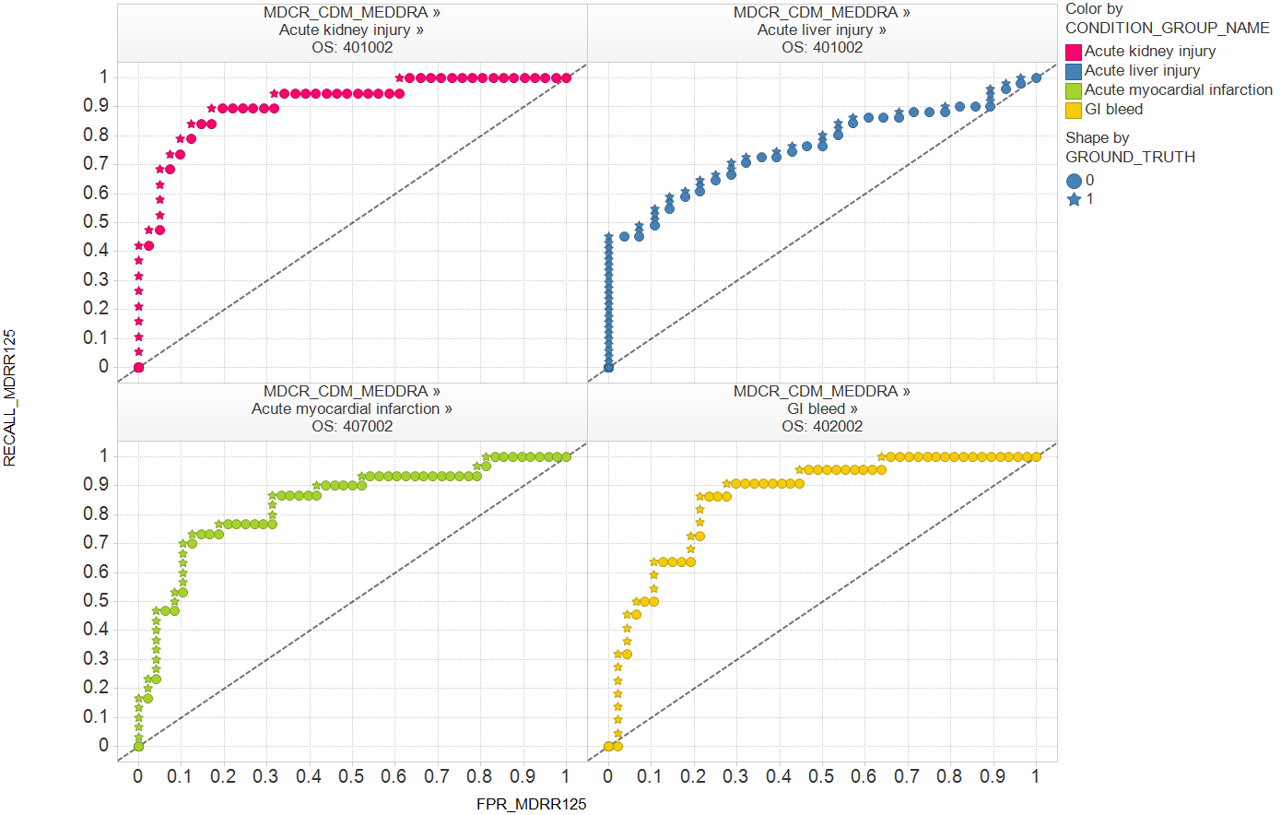
Performance after applying these strategies
AUC=0.92
AUC=0.76
Sensitivity
Positives: 19
Negatives: 41
Positives: 51
Negatives: 28
AUC=0.84
AUC=0.86
Restricting to drugs with sufficient sample further increased AUC for all outcomes, but the degree of change varied by outcome
Increased prediction comes as tradeoff with fewer drugs under surveillance
Self-controlled cohort design continue to be optimal design, but specific settings changed in all outcomes
Positives: 30
Negatives: 48
Positives: 22
Negatives: 47
False positive rate (1-Specificity)

Slide 28
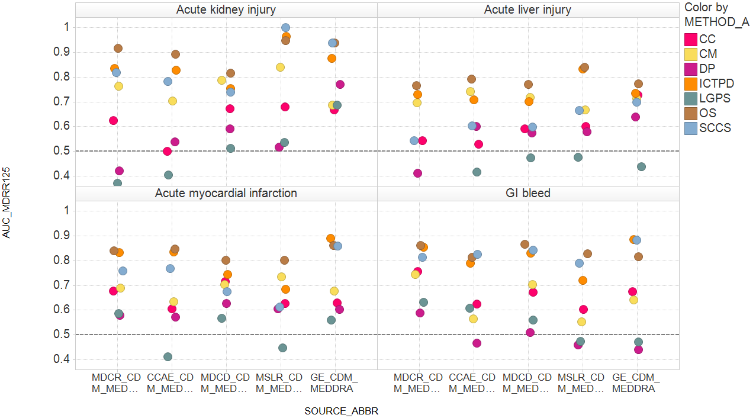
Performance across methods, by database
AUC for pairs with MDRR<=1.25
All self-controlled designs (OS, ICTPD, SCCS) are consistently at or near the top of performance across all outcomes and sources
Cohort and case-control designs have comparable performance, consistently lower than all self-controlled designs
Substantial variability in performance across the optimal settings of each method
Data source

Slide 29
Optimal methods (AUC) by outcome and data source
Data source | Acute kidney injury | Acute liver injury | Acute myocardial infarction | GI bleed
MDCR | (0.92) | (0.76) | (0.84) | (0.86)
CCAE | (0.89) | (0.79) | (0.85) | (0.82)
MDCD | (0.82) | (0.77) | (0.80) | (0.87)
MSLR | (1.00) | (0.84) | (0.80) | (0.83)
GE | (0.94) | (0.77) | (0.89) | (0.89)
Data source | Acute kidney injury | Acute liver injury | Acute myocardial infarction | GI bleed
MDCR | OS (0.92) | OS (0.76) | OS (0.84) | OS (0.86)
CCAE | OS (0.89) | OS (0.79) | OS (0.85) | SCCS (0.82)
MDCD | OS (0.82) | OS (0.77) | OS (0.80) | OS (0.87)
MSLR | SCCS (1.00) | OS (0.84) | OS (0.80) | OS (0.83)
GE | SCCS (0.94) | OS (0.77) | ICTPD (0.89) | ICTPD (0.89)
Data source | Acute kidney injury | Acute liver injury | Acute myocardial infarction | GI bleed
MDCR | OS: 401002 (0.92) | OS: 401002 (0.76) | OS: 407002 (0.84) | OS: 402002 (0.86)
CCAE | OS: 404002 (0.89) | OS: 403002 (0.79) | OS: 408013 (0.85) | SCCS: 1931010 (0.82)
MDCD | OS: 408013 (0.82) | OS: 409013 (0.77) | OS: 407004 (0.80) | OS: 401004 (0.87)
MSLR | SCCS: 1939009 (1.00) | OS: 406002 (0.84) | OS: 403002 (0.80) | OS: 403002 (0.83)
GE | SCCS: 1949010 (0.94) | OS: 409002 (0.77) | ICTPD: 3016001 (0.89) | ICTPD: 3034001 (0.89)
Self-controlled designs are optimal across all outcomes and all sources, but the specific settings are different in each scenario
AUC > 0.80 in all sources for acute kidney injury, acute MI, and GI bleed
Acute liver injury has consistently lower predictive accuracy
No evidence that any data source is consistently better or worse than others

Slide 30
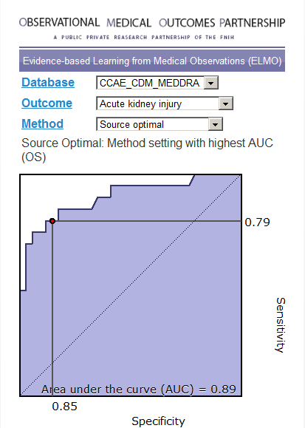

Good performance?
…it all depends on your tolerance of false positives and false negatives…
…but we’ve created a tool to let you decide
http://elmo.omop.org

Slide 31
Takeaways from insights about risk identification
Performance of different methods
  Self-controlled designs appear to consistently perform well
Evaluating alternative HOI definitions
  Broader definitions have better coverage and comparable performance to more specific definitions
Performance across different signal sizes
  A risk identification system should confidently discriminate positive effects with RR>2 from negative controls
Data source heterogeneity
  Substantial variation in estimates across sources suggest replication has value but may result in conflicting results
Method parameter sensitivity
  Each method has parameters that are expected to be more sensitive than others, but all parameters can substantially shift some drug-outcome estimates

Slide 32
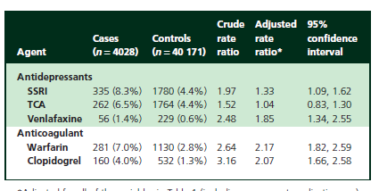
Revisiting clopidogrel & GI bleed (Opatrny, 2008)
OMOP, 2012 (CC: 2000314, CCAE, GI Bleed)
Relative risk: 1.86, 95% CI: 1.79 – 1.93
Standard error: 0.02, p-value: <.001

Slide 33
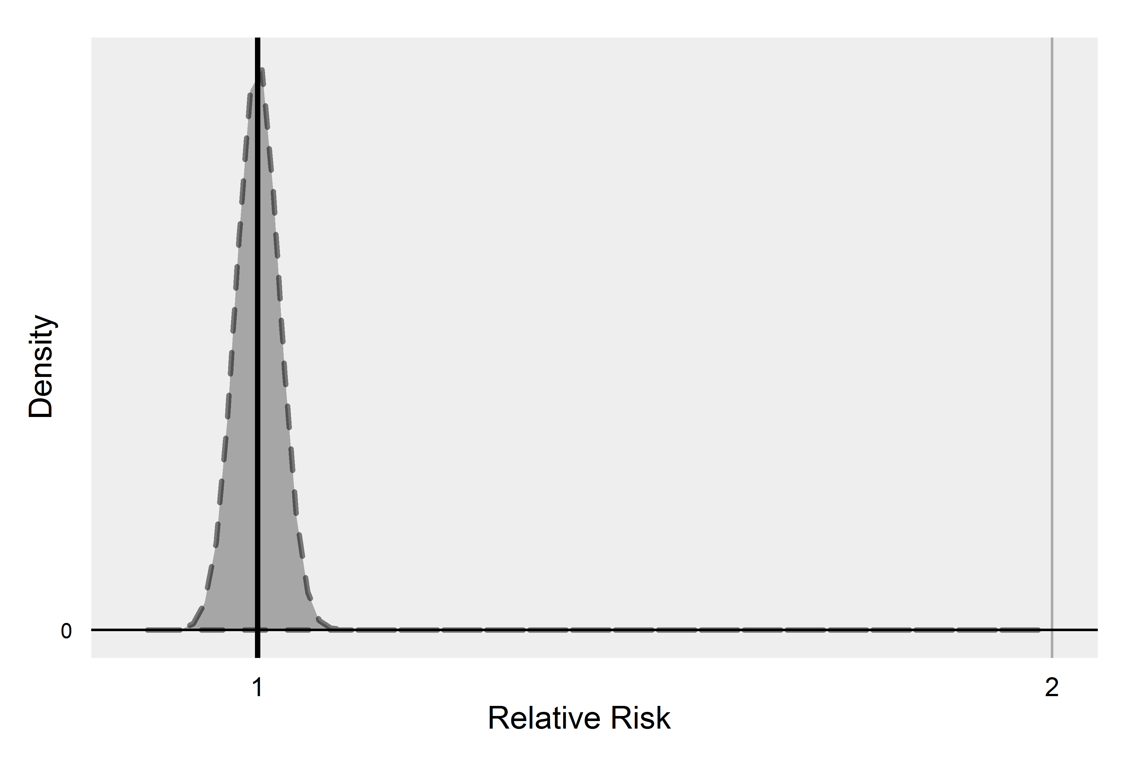
Null distribution
CC: 2000314, CCAE, GI Bleed
(Log scale)

Slide 34
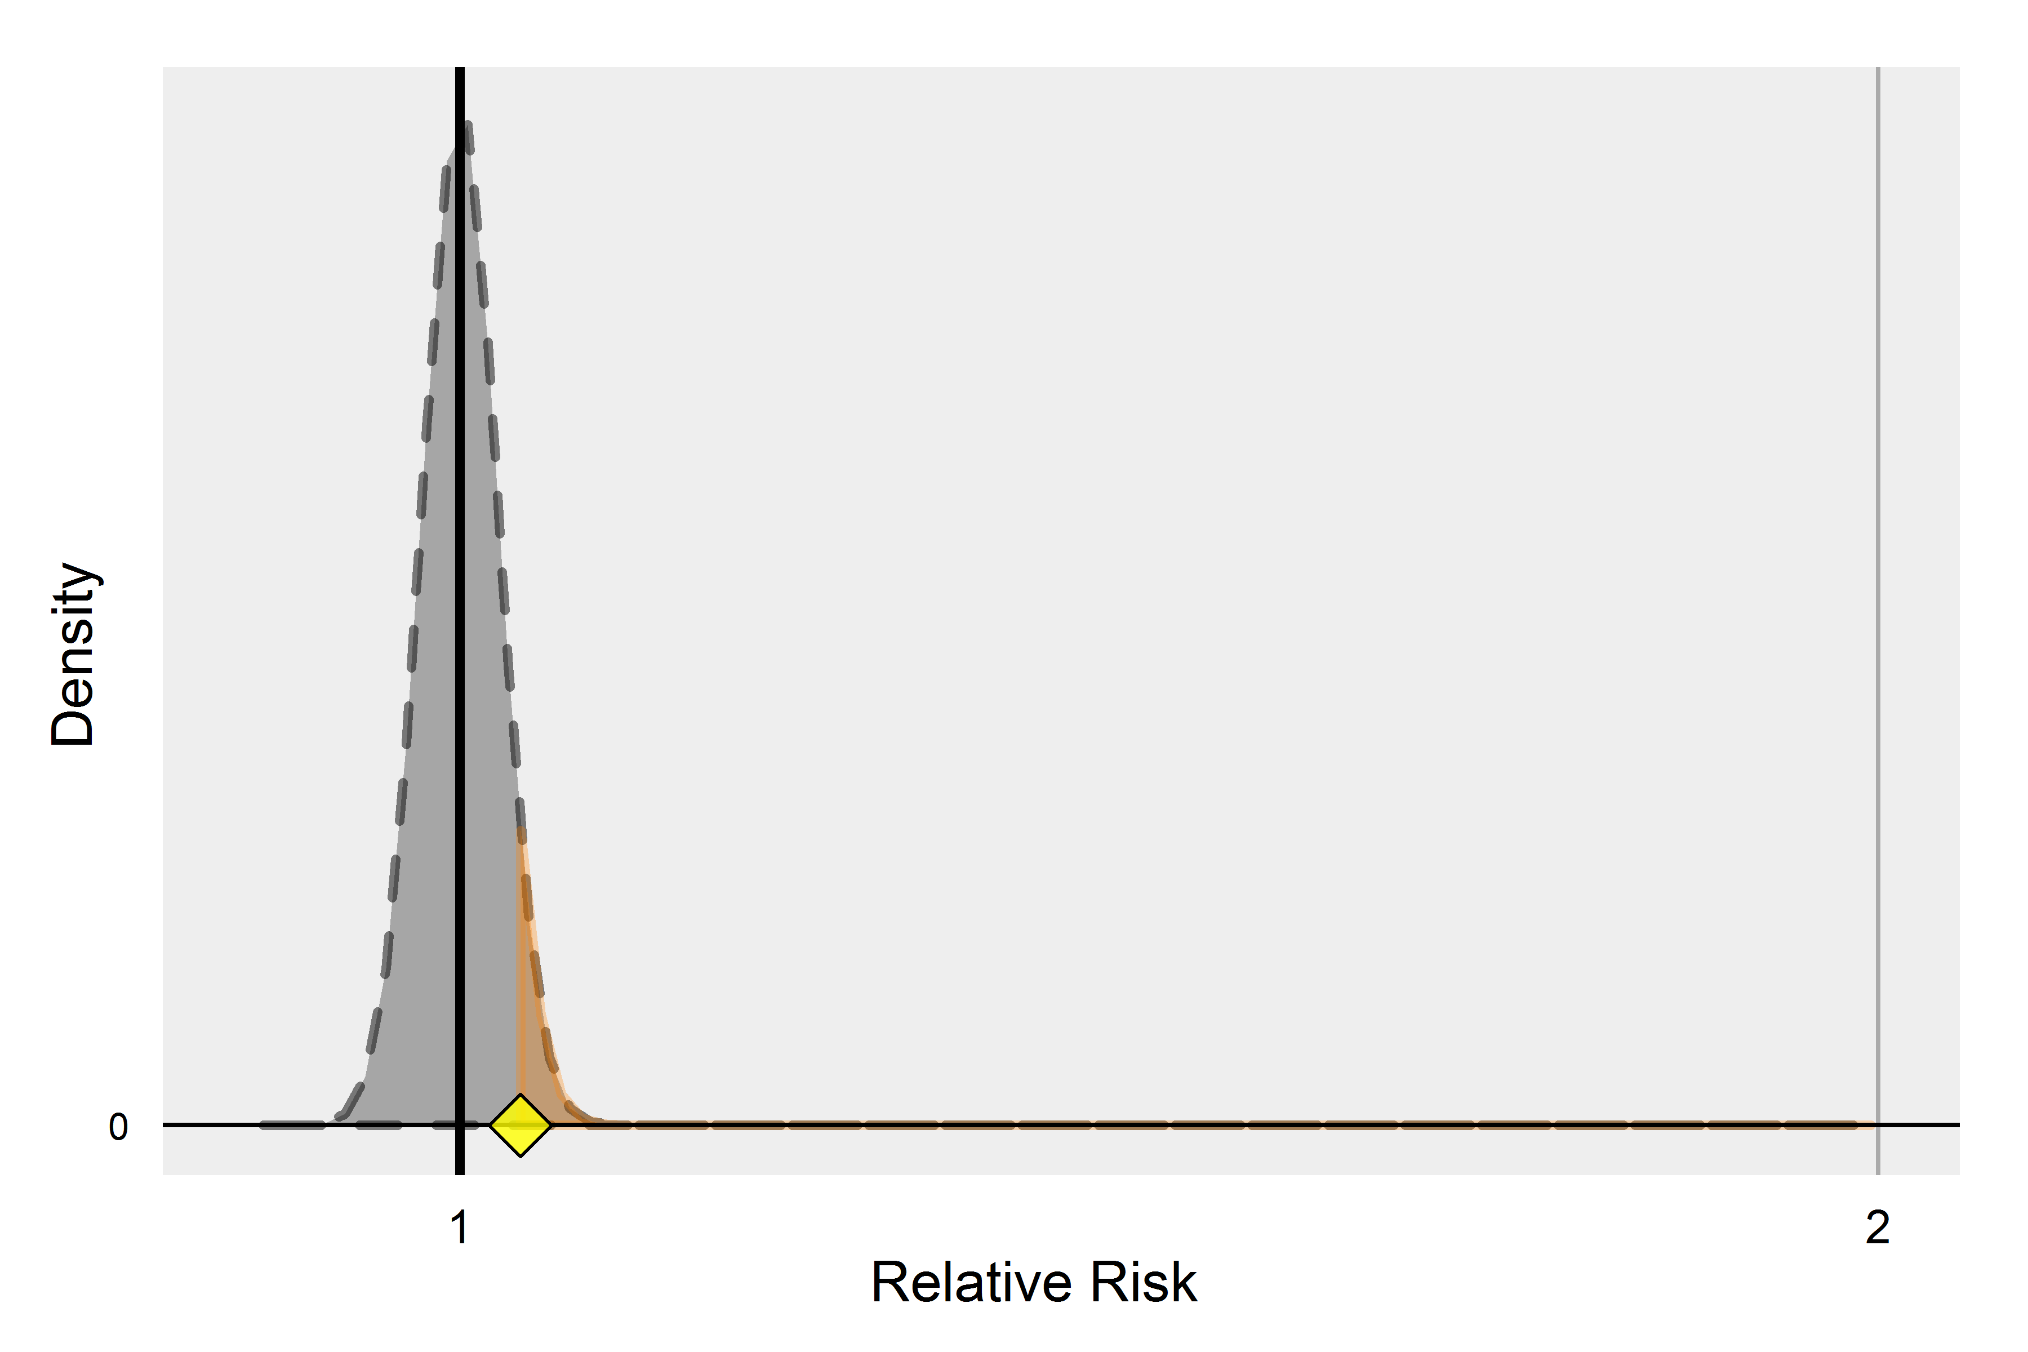
Null distribution
CC: 2000314, CCAE, GI Bleed
Some drug
(Log scale)

Slide 35
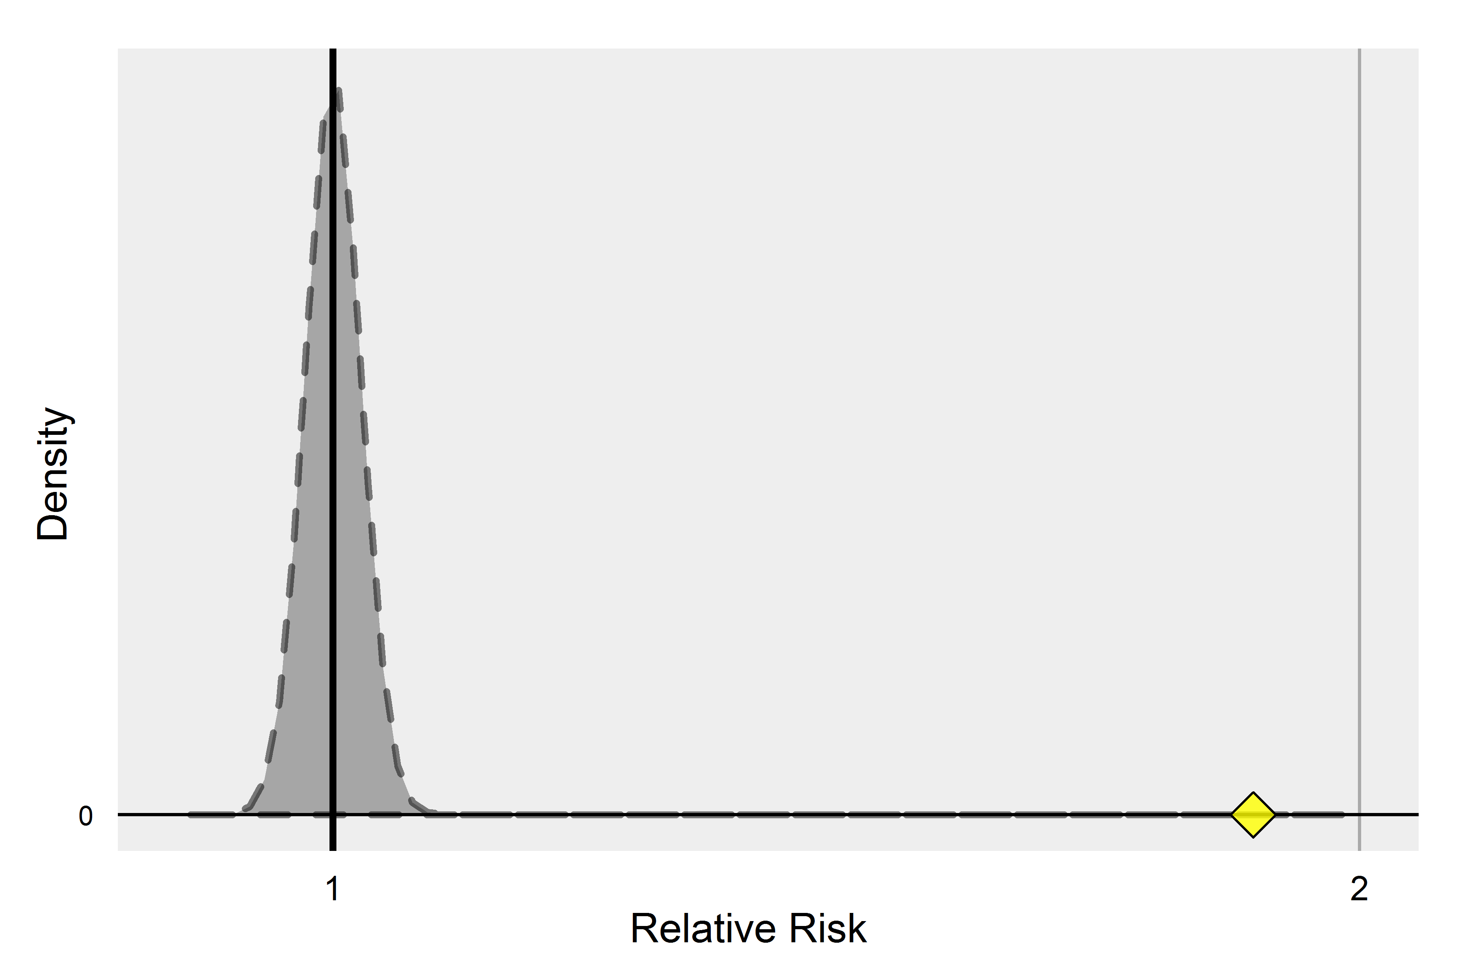
Null distribution
CC: 2000314, CCAE, GI Bleed
clopidogrel
(Log scale)

Slide 36
Evaluating the null distribution?
Current p-value calculation assumes that you have an unbiased estimator (which means confounding either doesn’t exist or has been fully corrected for)
Traditionally, we reject the null hypothesis at p<.05 and we assume this threshold will incorrectly reject the null hypothesis 5% of time. Does this hold true in observational studies?
We can test this using our negative controls

Slide 37
Ground truth for OMOP 2011/2012 experiments
Criteria for negative controls:
Event not listed anywhere in any section of active FDA structured product label
Drug not listed as ‘causative agent’ in Tisdale et al, 2010: “Drug-Induced Diseases”
Literature review identified no evidence of potential positive association

Slide 38
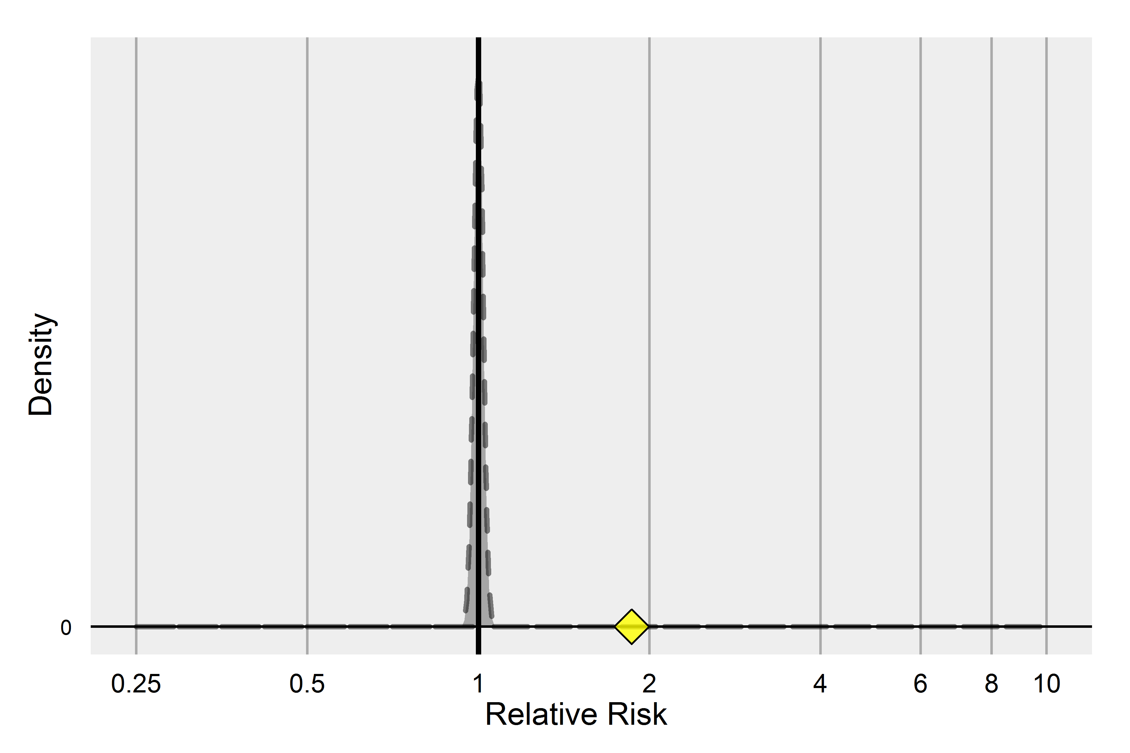
Negative controls & the null distribution
CC: 2000314, CCAE, GI Bleed
clopidogrel

Slide 39
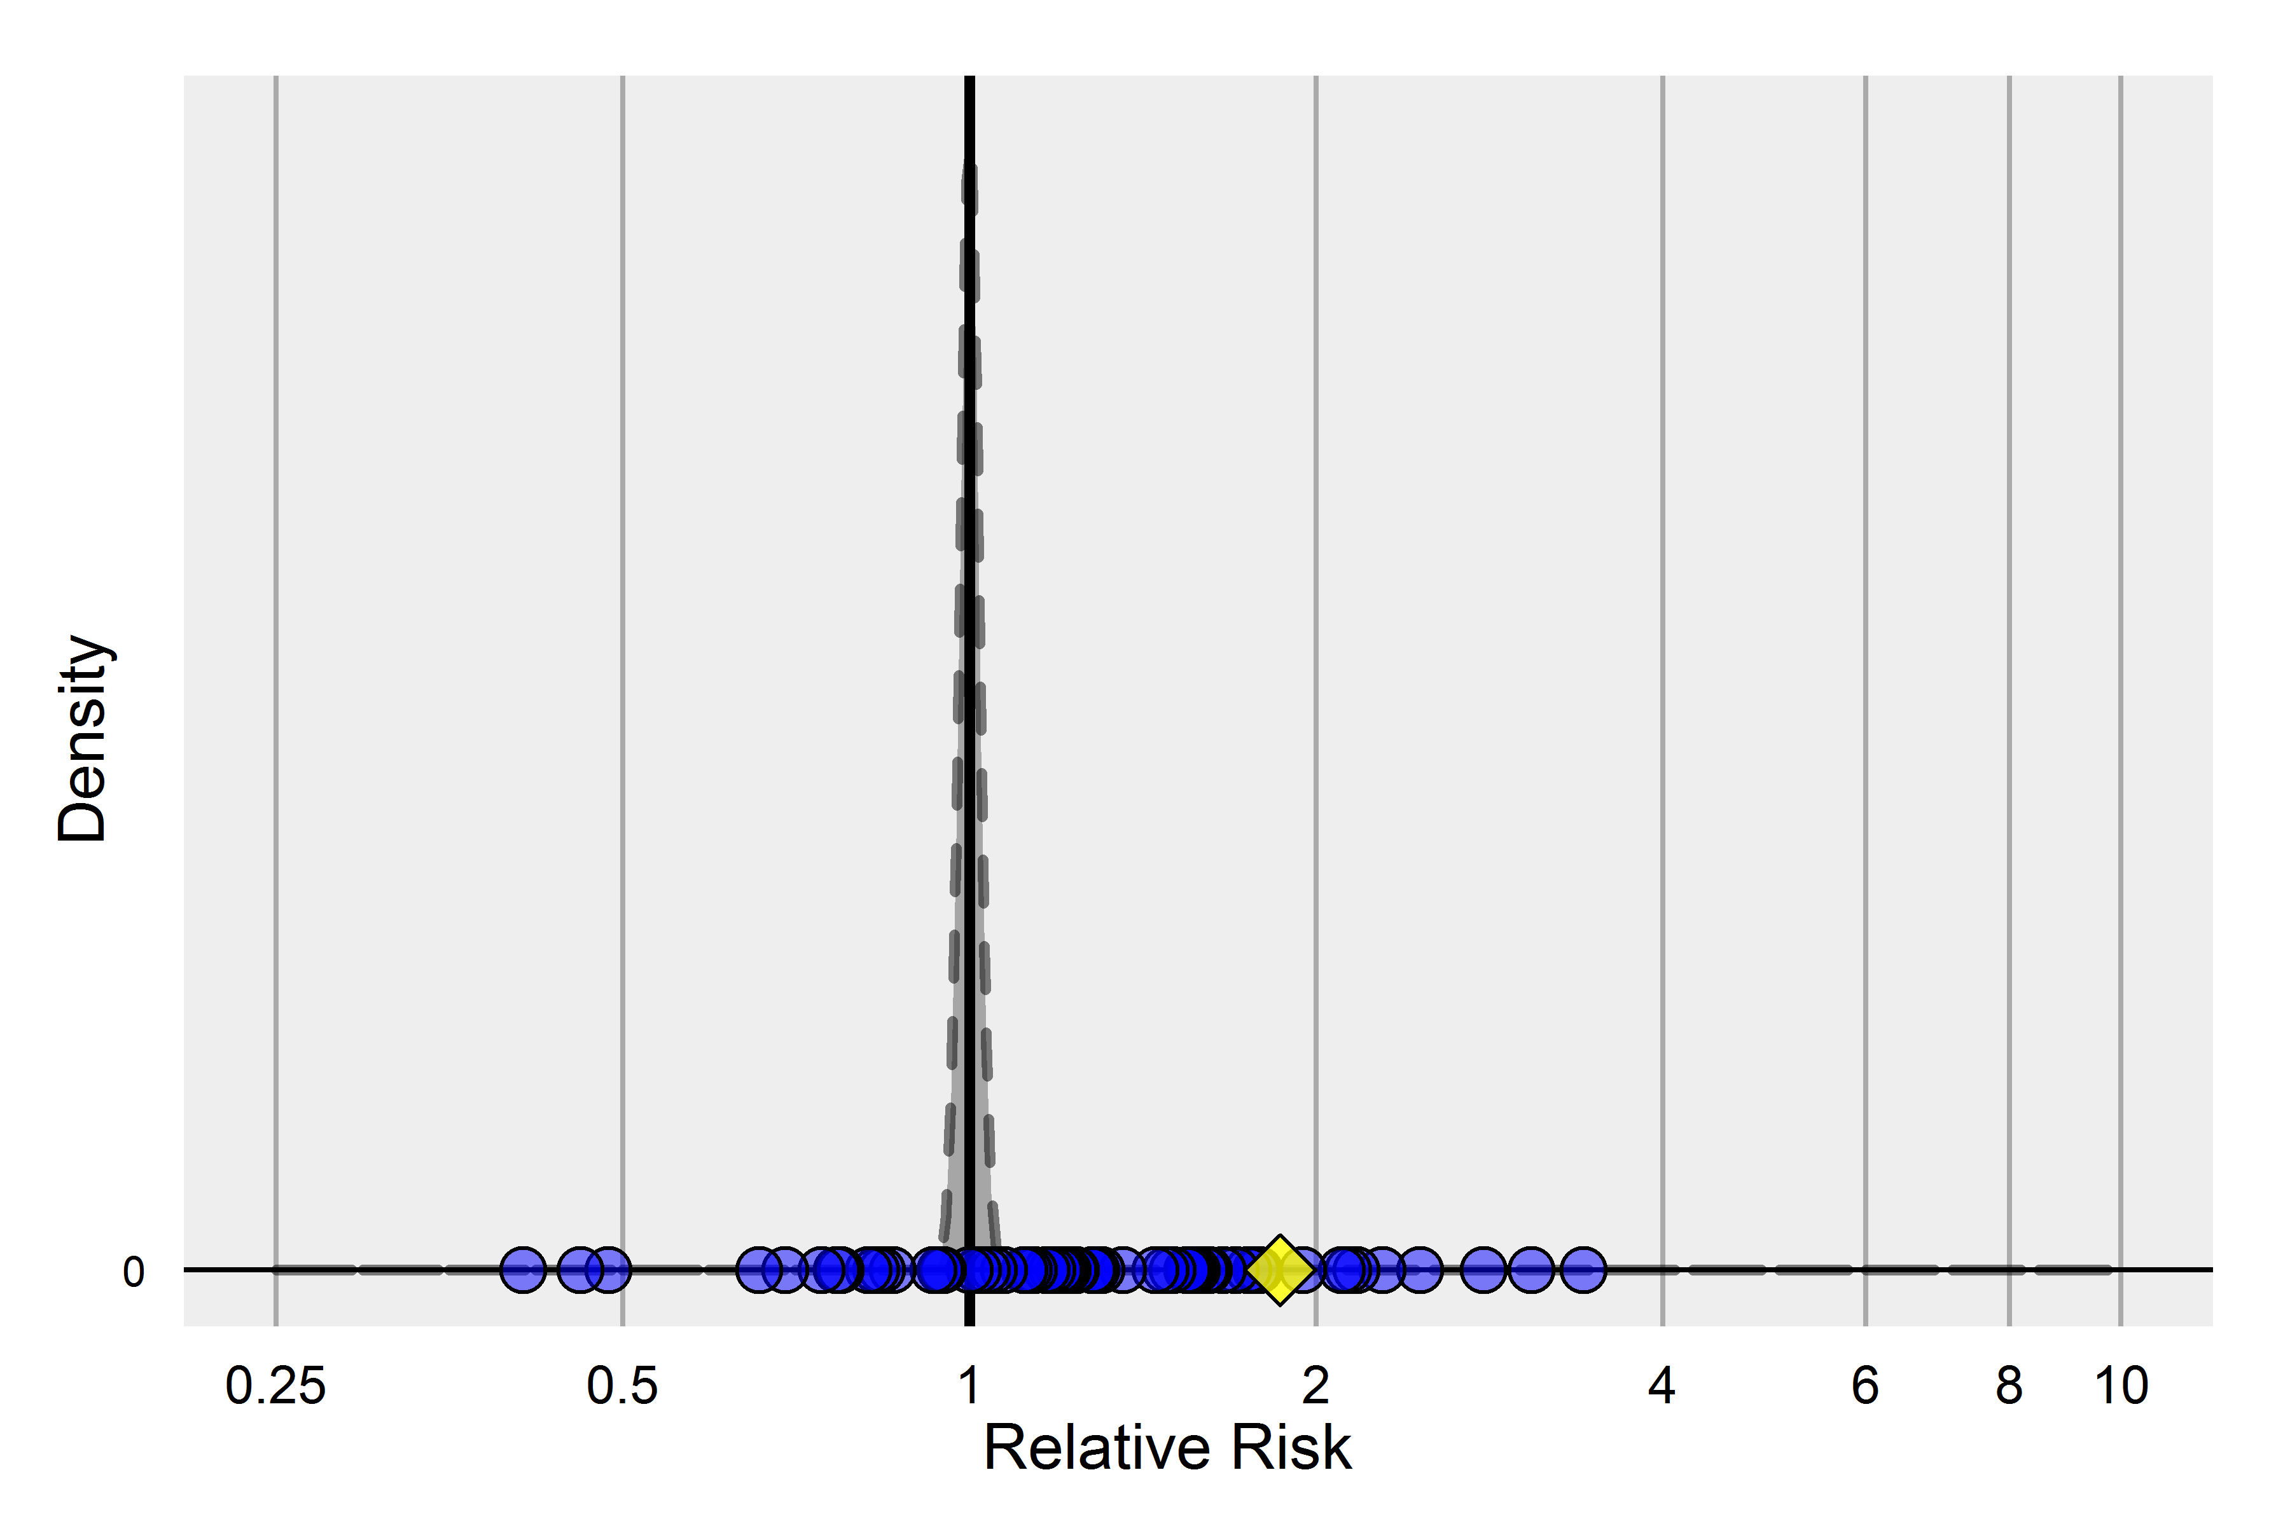
Negative controls & the null distribution
CC: 2000314, CCAE, GI Bleed
55% of these negative controls have p < .05
(Expected: 5%)

Slide 40
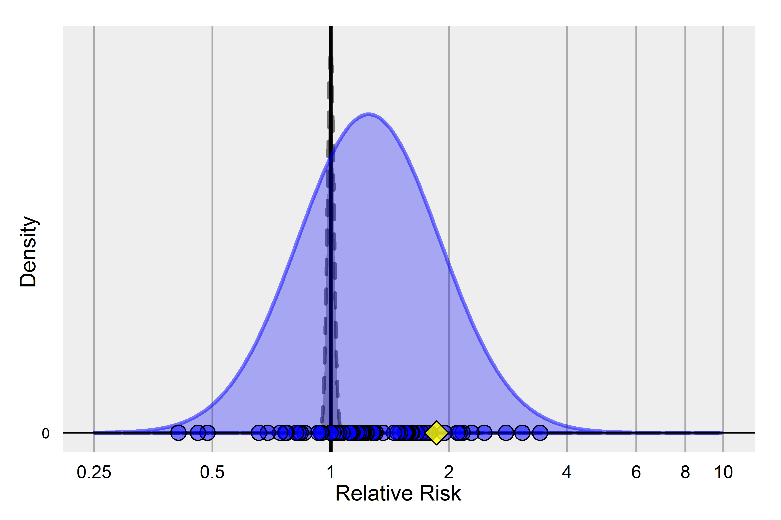
Negative controls & the null distribution
CC: 2000314, CCAE, GI Bleed

Slide 41
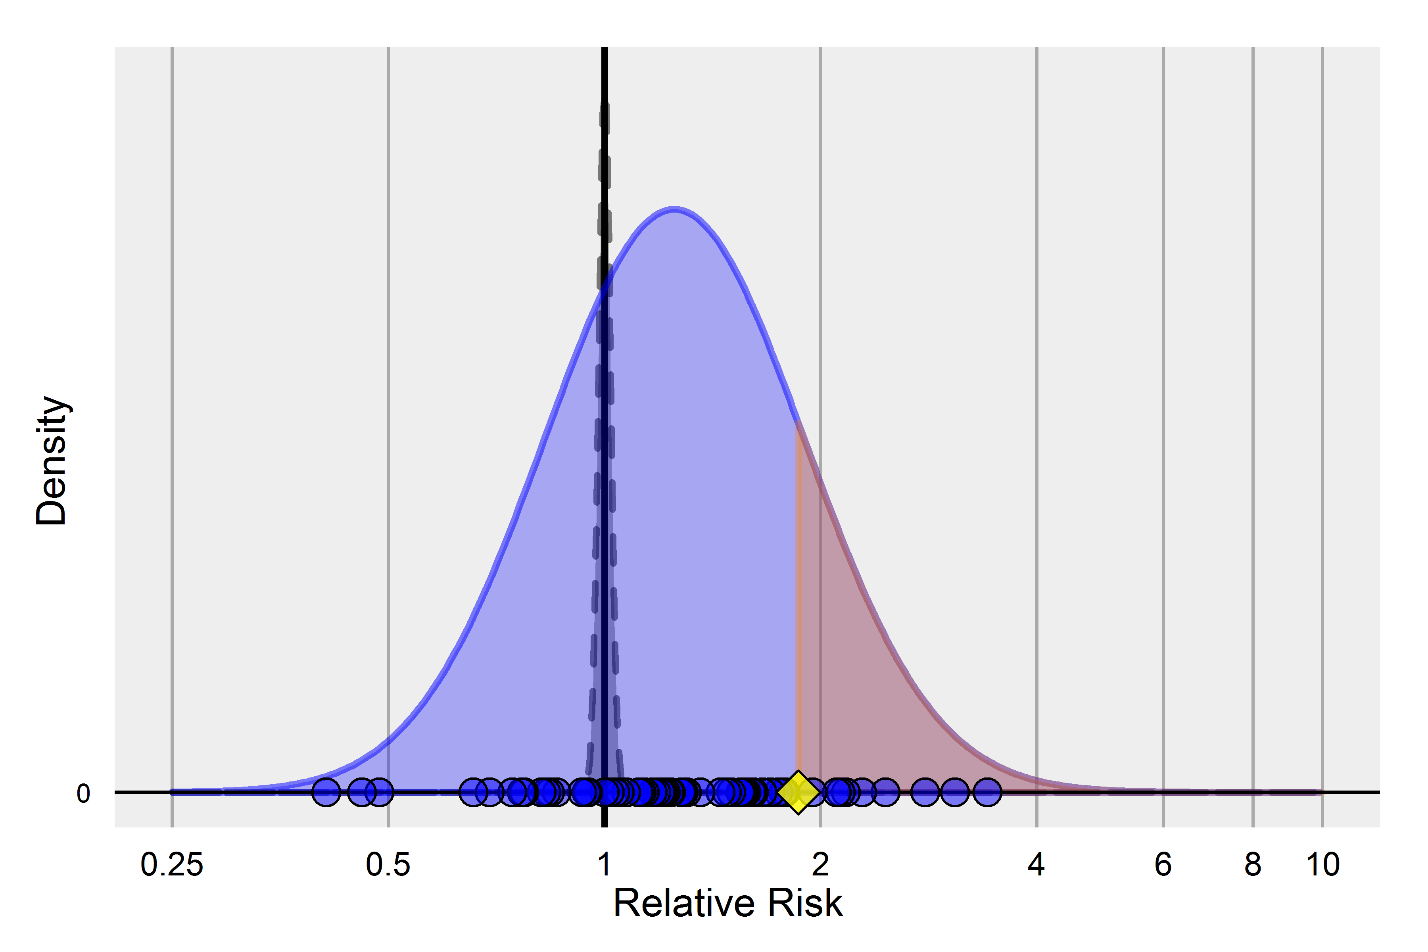
Negative controls & the null distribution
CC: 2000314, CCAE, GI Bleed

Slide 42
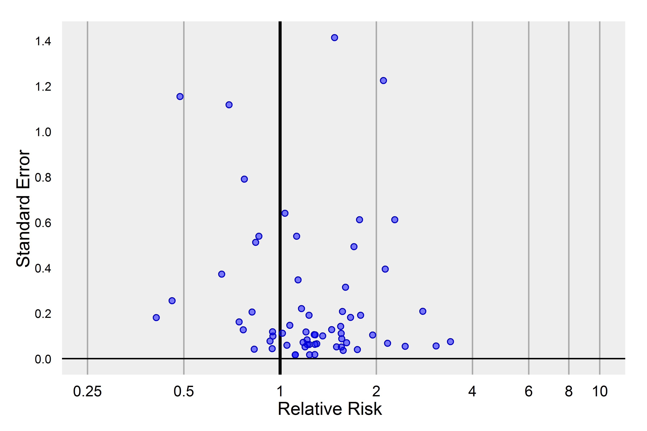
p-value calibration plot
CC: 2000314, CCAE, GI Bleed

Slide 43
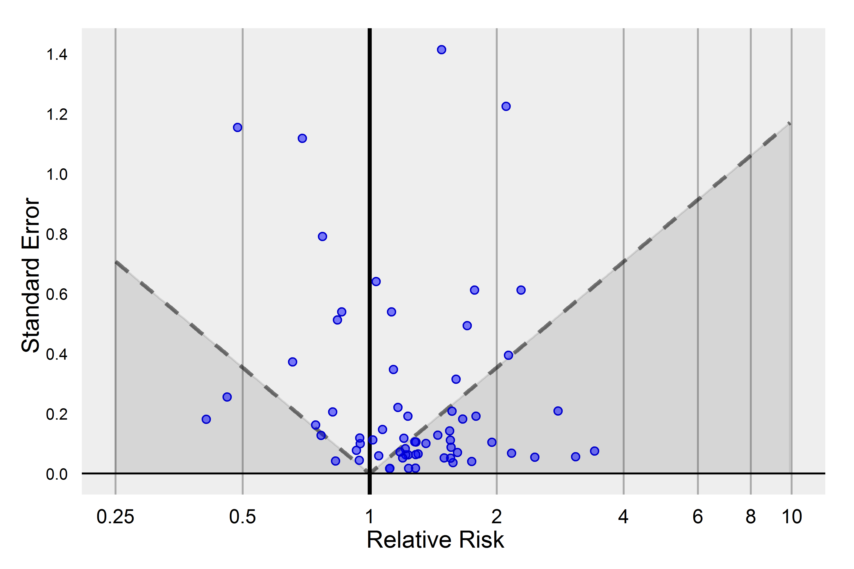
p-value calibration plot
CC: 2000314, CCAE, GI Bleed

Slide 44
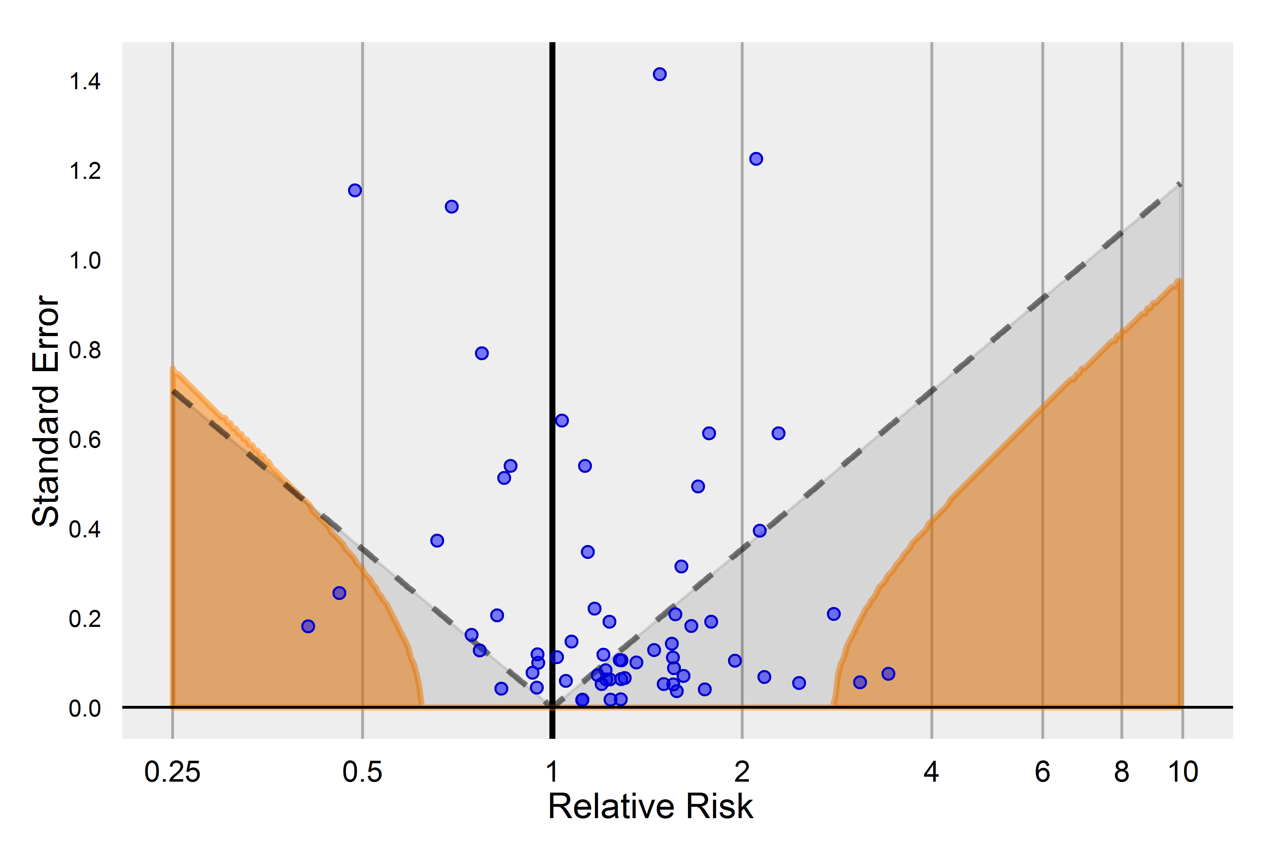
p-value calibration plot
CC: 2000314, CCAE, GI Bleed

Slide 45
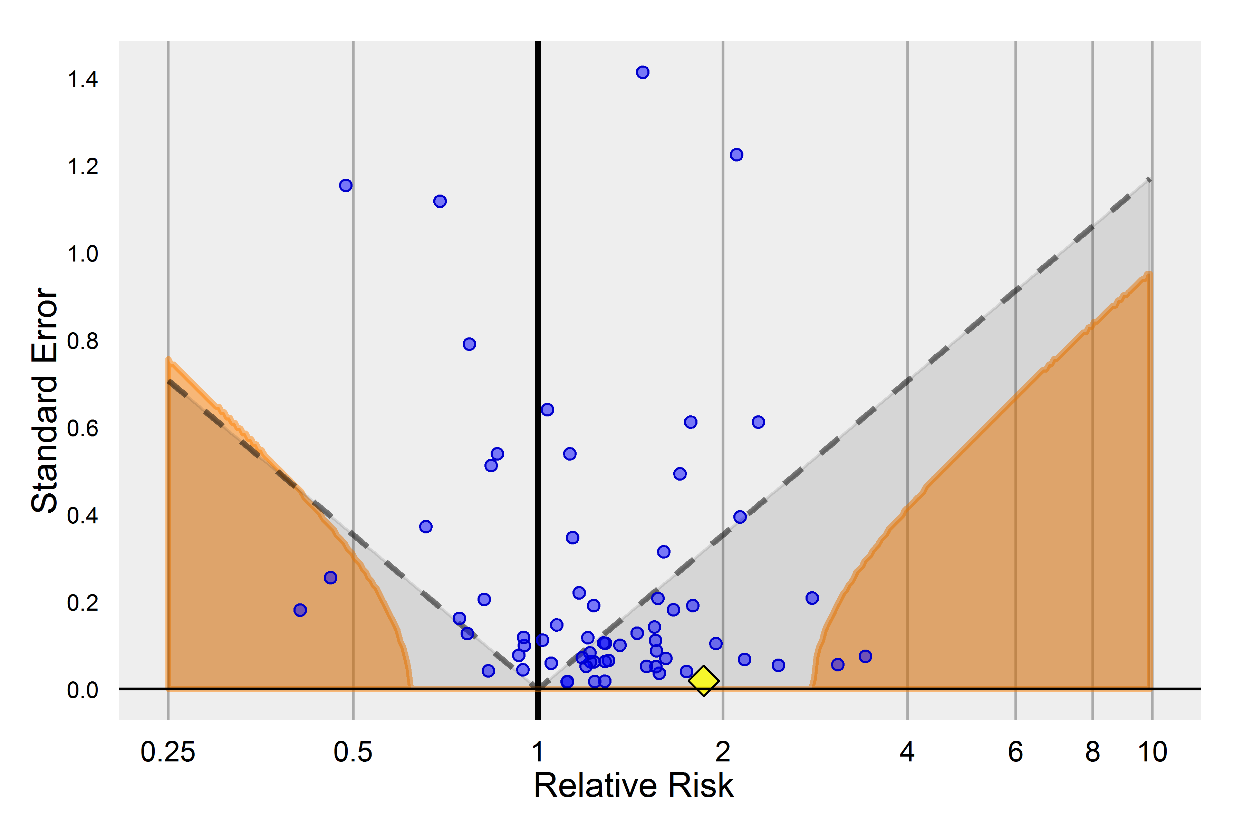
p-value calibration plot
CC: 2000314, CCAE, GI Bleed
p < .05 | 55%
Calibrated p < .05 | 6%
clopidogrel:
RR | 1.9 (1.8 – 1.9)
p |  | <.001
Calibrated p |  | .30
clopidogrel

Slide 46
p-value calibration plot
CC: 2000314, CCAE, GI Bleed
This analysis failed to reject the empirical null
… but we know clopidogrel causes GI bleeding (it’s a positive control)
clopidogrel

Slide 47
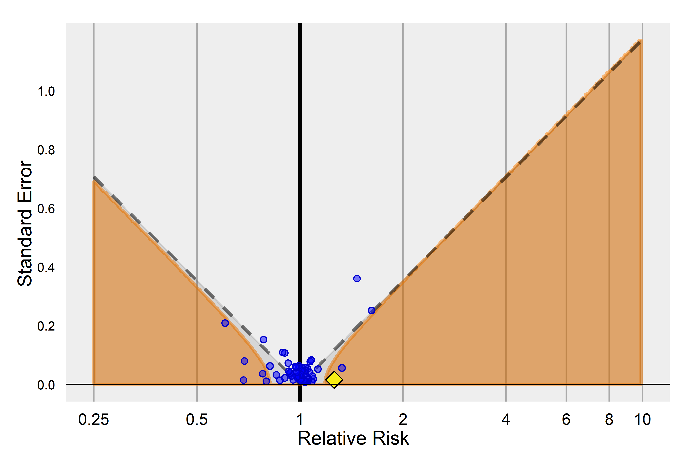
p-value calibration plot
Optimal method: SCCS:1931010, CCAE, GI Bleed
p < .05 |  |  | 33%
Calibrated p < .05 |  |  | 9%
clopidogrel:
RR | 1.3 (1.2 – 1.3)
p |  | <.001
Calibrated p |  | .01

Slide 48
Recap
Traditional p-values are based on a theoretical null distribution assuming an unbiased estimator, but that assumption rarely holds in our examples
One can estimate the empirical null distribution using negative controls
Many observational study results with traditional p < .05 fail to reject the empirical null: we cannot distinguish them from negative controls
Applying optimal methods, tailored to the outcome and database, can provide estimates that reject the null hypothesis for some of our positive controls
Using adjusted p-values will provide a more calibrated assessment of whether an observed estimate is different from 'no effect'

Slide 49
What have we learned so far?
Can you reject the null hypothesis of no association between the drug and outcome at a given significance level (ex: p<.05)?
New question: What is the probability that observed confidence interval contains the true effect size?
Is there an effect?
How big is the effect?

Slide 50
Estimating coverage probability
What if a study design could be applied across a large sample of drug-outcome pairs for which we know the true effect?
Coverage probability: the percentage of the test cases where the estimated confidence interval contains the true effect
(LB 95 CI <= true effect <= UB 95 CI)
Challenge: in real data, the ‘true effect size’ for negative controls can be assumed to be RR=1, but the RRs for positive controls are not known
In simulated data (OSIM2), we can inject signals with known effect sizes (RR=1.25, 1.50, 2, 4, 10) across a sample of drug-outcome scenarios and estimate the coverage probability

Slide 51
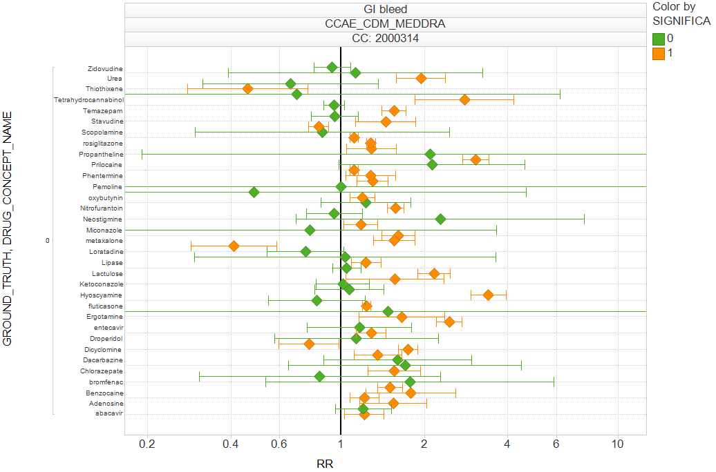
Applying case-control design to negative controls in real data
45% of the CIs of negative controls contain 1
(Expected: 95%)

Slide 52
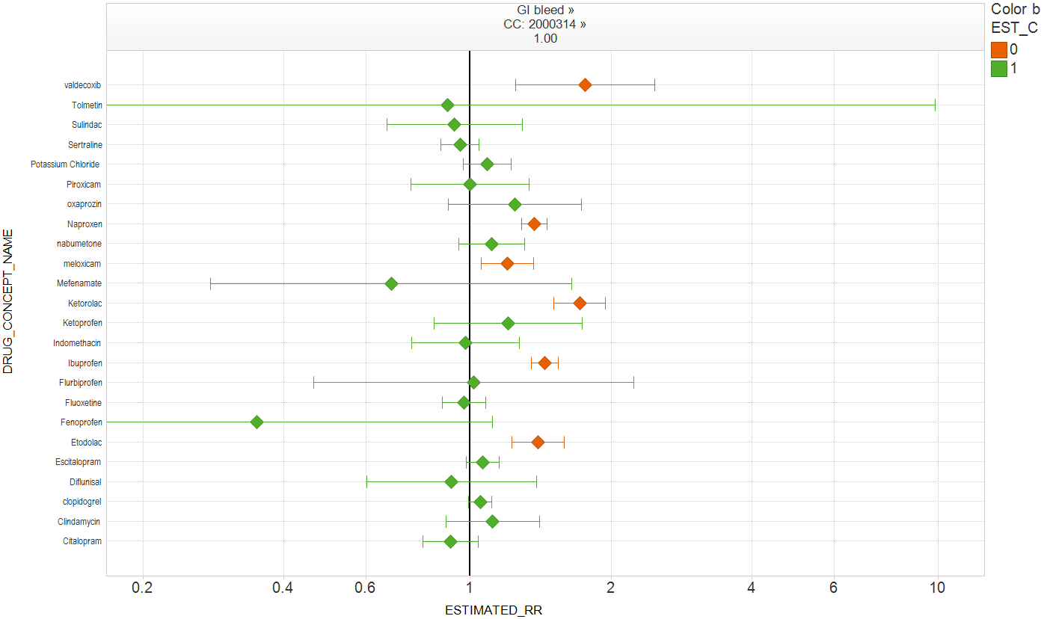
Applying case-control design in simulated data, RR=1.0
75% of the CIs of negative controls contain 1
(Expected: 95%)

Slide 53
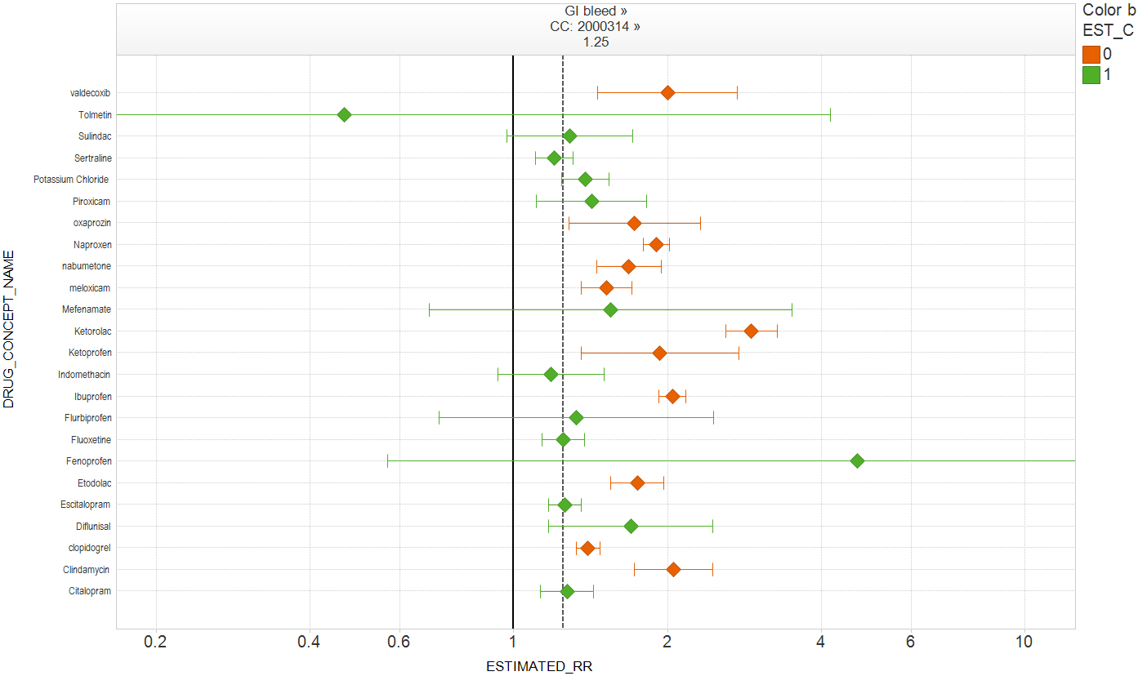
Applying case-control design to positive controls in simulated data, RR=1.25
54% coverage
(Expected: 95%)

Slide 54
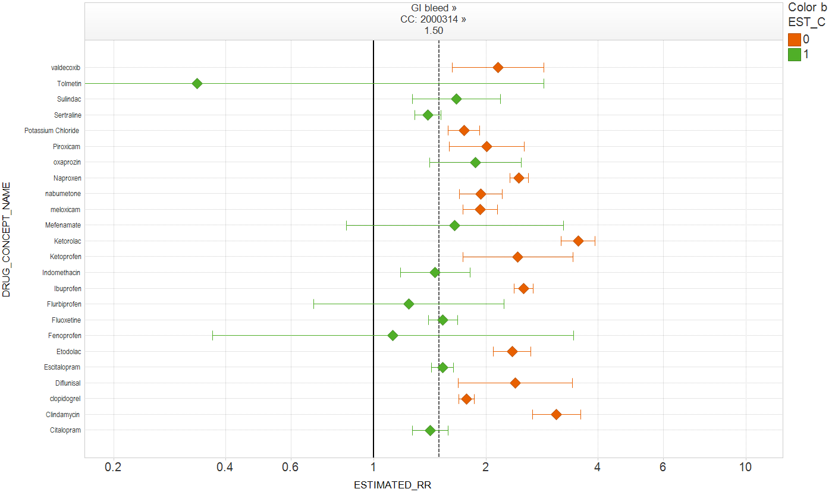
Applying case-control design to positive controls in simulated data, RR=1.50
46% coverage
(Expected: 95%)

Slide 55
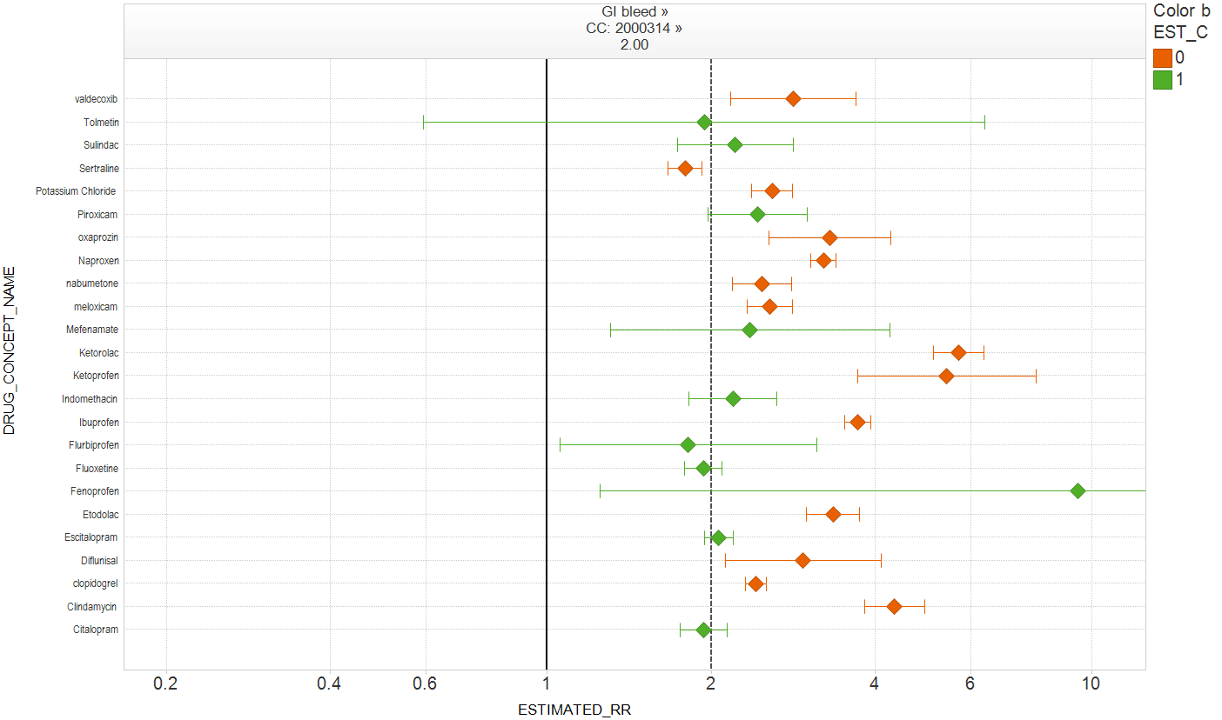
Applying case-control design to positive controls in simulated data, RR=2.00
42% coverage
(Expected: 95%)

Slide 56
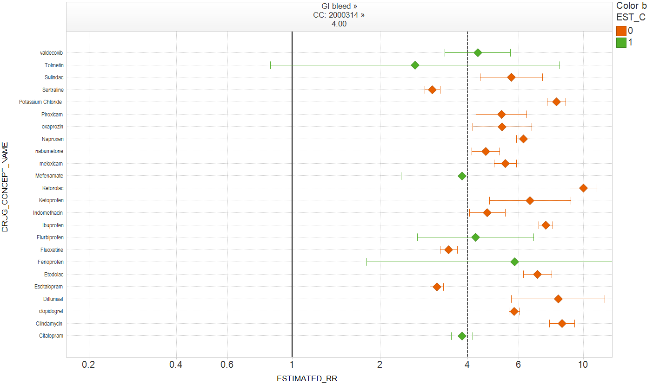
Applying case-control design to positive controls in simulated data, RR=4.00
25% coverage
(Expected: 95%)

Slide 57
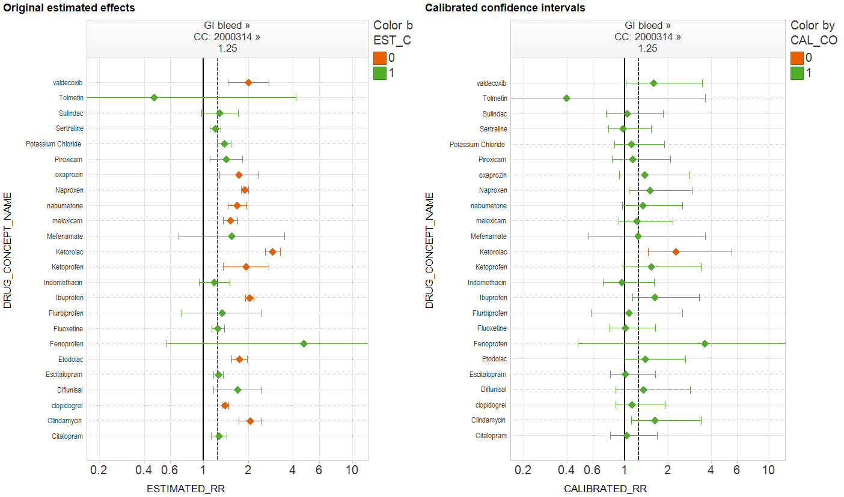
Applying case-control design and calibrating estimates of positive controls in simulated data, RR=1.25
Original coverage probability = 54%
Calibrated coverage probability = 96%

Slide 58
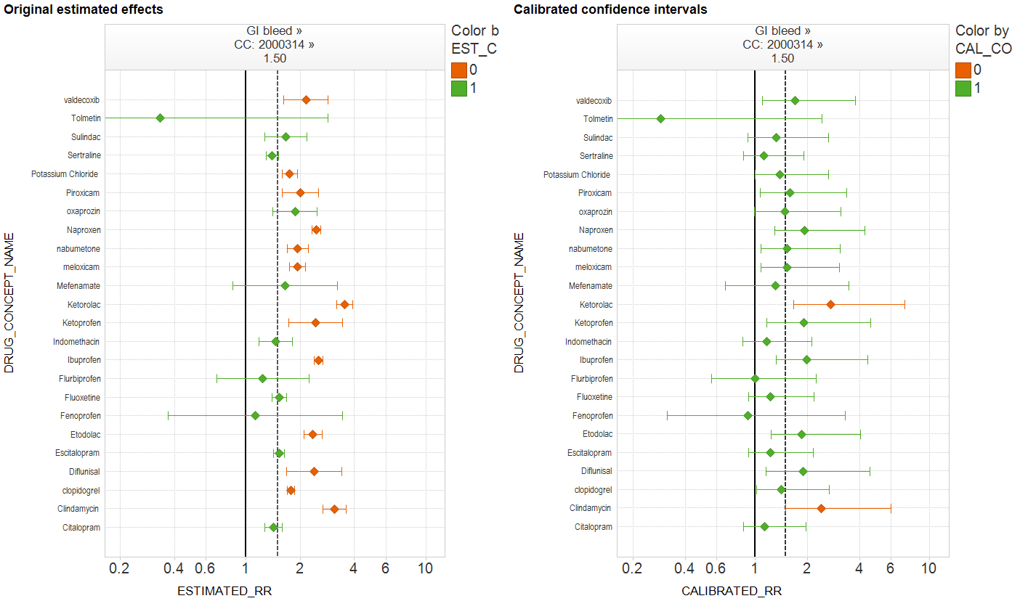
Applying case-control design and calibrating estimates of positive controls in simulated data, RR=1.50
Original coverage probability = 46%
Calibrated coverage probability = 92%

Slide 59
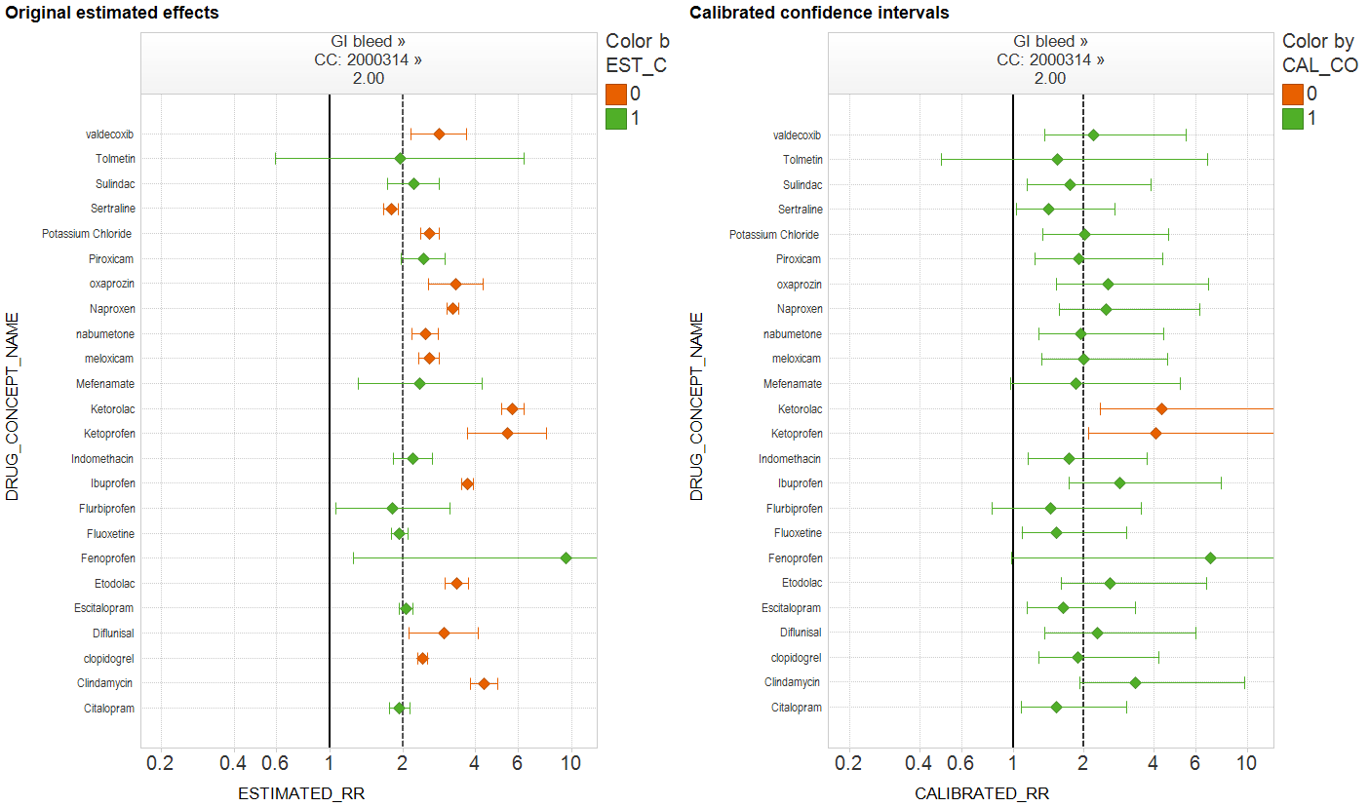
Applying case-control design and calibrating estimates of positive controls in simulated data, RR=2.00
Original coverage probability = 42%
Calibrated coverage probability = 92%

Slide 60
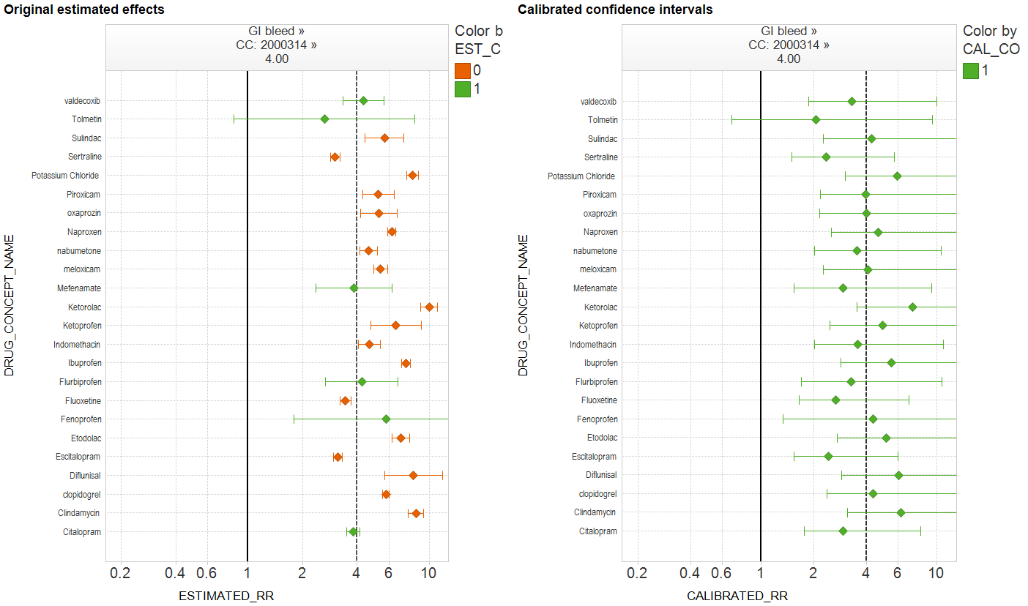
Applying case-control design and calibrating estimates of positive controls in simulated data, RR=4.00
Original coverage probability = 25%
Calibrated coverage probability = 100%

Slide 61

Coverage probability by effect size
Coverage probability
‘True RR’ – injected signal size

Slide 62
Recap
Traditional interpretation of 95% confidence interval, that the CI covers the true effect size 95% of the time, may be misleading in the context of observational database studies
  Coverage probability is much lower across all methods and all outcomes
  Results were consistent across real data and simulated data
Empirical adjustment of confidence intervals yields more robust coverage probabilities across most method-outcome scenarios
Further research for developing heuristics to adjust confidence intervals could yield more reliable interpretation, but empirical approach would require confidence that simulated data adequately reflects the real world data

Slide 63
Lessons for building a risk identification system
Strategies to improve performance:
  Partition results by outcome
  Tailor analysis to outcome
  Restrict to sufficient sample size
  Optimize analysis to the data source
OMOP’s experimental evidence suggests that following these strategies may yield predictive accuracy at or better than most clinical screening tools used in standard practice

Slide 64
Lessons for building a risk identification system
Where we are now:
  Given the diversity in performance and heterogeneity in estimates, we caution against generalizing these results to other outcomes or other data sources
  If you want to apply risk identification to different outcomes and/or different data sources, we suggest performing an empirical assessment to establish best practice and benchmark performance
Potential next step:
  conduct similar experiment for additional 19 outcomes identified by EUADR¹ as high-priority safety issues
  Once 23 HOIs complete, re-assess whether patterns emerge that would allow generalization to other outcomes
¹Trifiro et al, PDS 2009

Slide 65
Conclusions
Using the OMOP approach, a risk identification system can perform at AUC>0.80
Traditional p-values and confidence intervals require empirical calibration to account for bias in observational studies
Advancing the science of observational research requires an empirical and reproducible approach to methodology and systematic application

