Slide 1
Current Challenges for Measurement of Treatment Benefits
Sue Vallow
Sr. Dir., Patient Reported Outcomes, GSK

Slide 2
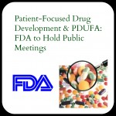





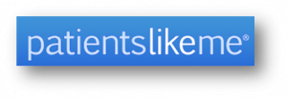
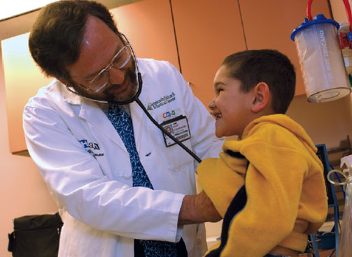

Interest in the Patient Perspective!
Patient Voice
Regulatory Agencies
Payers / HTAs
Accrediting Bodies
Public & Private Partnerships
Physicians/ Providers
Patient Advocacy
Notes:
Clearly, there’s so much interest in the patient’s perspective, from so many different stakeholder perspectives! In addition to patients, and patient groups themselvess…
Those of us in some form of health care already interested in the patient perspective
Regulatory agencies/ FDA, EMA : Regulatory Guidances, focusing on patients/ patient perpective: EMEA Reflection Paper on Health Related Quality of Life (2005); FDA PRO Guidance (2009); FDA Draft Guidance for Industry: Qualification Process for Drug Development Tools (2010); EMA DDT in draft (2012)
PDUFA V’s FDA Patient Focused Drug Development Initiative & FDA Performance Goals 2013 – 2017: increased focus on PROs, one of goals is to advance PRO/ Clinical Outcomes Assessment knowledge inside FDA
Government: Patient affordable care act/ PCORI: national priorities for research, taking into account …outcomes of care, the potential for new evidence to improve patient health, well-being, and the quality of care …as well as patient needs, outcomes, and preferences…in making informed health decisions….” Patient Centered Outcomes Research Initiative (PCORI)– expects patient involvement in research, and meaningful outcomes to be measured and communicated in meaningful way – to the patient
Payers (NICE, etc): especially outside the US emphasizing patient benefits for justfication of reimbursement
Physicians/ providers: Providers – there have been press releases that indicate that physicians are starting to see how they can use improvements in patient outcomes as a source of competitive advantage
Accrediting bodies, such as NQF: National Quality forum – the body that accedits institutions in the US – is looking at PROs as basis for measuring quality of performance of institutions
And of course, patients themselves – are becoming more and more informed and knowledgeable – with help of patient groups
Critical-Path Institutes’s PRO Consortium (public/private partnership) developing new PRO tools (formed 2008) for use as endpoints making regulatory claims

Slide 3




Environmental Influences: Connectivity, Technology, Social Media
Notes:
This, in the face of wider environment, where there are technology advances, and social media, where there is so much ifnromation shared,
-
Rapid advances in consumer electronics, telecommunications , technological sensors
Changing expectations as patients and health care providers becomes more techno-philic & saavy
Proliferation of smartphone apps for tracking health, compliance with meds, etc
Electronic medical records and use of iPads in clinical practice
Greater acceptance of telemedicine, and how that could be used in clinical trials

Slide 4
Use PROs to Demonstrate Patient Perspective on Treatment Benefits, for A Variety for Reasons & Stakeholders
Basis for indication – primary or co-primary endpoint – in certain symptomatic diseases
Differentiate and show value (e.g. as key secondary endpoint in labeling, can promote upon)
  Demonstrate clinical meaningfulness of primary endpoint, from patient’s perspective
Additional evidence of treatment benefits even if not in the label
  Support treatment benefits (e.g. publication, global value dossiers, HTA submissions)
Aid decision making in clinical practice
  COPD Assessment Test, Asthma Control Test (e.g. physician-patient communication)
4
Notes:
To me, the best way to measure these
So how can PROs be used? Not just for label claims….PROS can be used to demonstrate treatment benefits, for a number of reasons:
They can Support regulatory approval – be the basis for an indication
There 23 products approved by FDA using PROs as primary endpoints since 2012 (e.g. IBS, ADHD, epilepsy, erectile dysfunction, overactive bladder, RA, rhinitis, varicella, COPD)
Help Differentiate and add value (e.g. key secondary endpoint in labeling)
Demonstrate clinical meaningfulness of primary endpoint, from patient’s perspective, e.g. PRO used to demonstrate meaning of timed 25-foot walk (primary endpoint) in multiple sclerosis trials, and gained label claim
And, we May need to have claims if we’re not first to market and others have them – there are examples of this in the respiratory space
Support treatment benefits even if not in the label (e.g. publications, global value dossiers, HTA submissions)
Basis of utility calculations, for cost-effectiveness evaluations
(e.g. EQ-5D needed for NICE)
Peer-to-peer communications with payers, (e.g. HRQOL impacts of our drugs)
Help tell the story, more holistically, about treatment benefits
Use in Clinical Practice
COPD Assessment Test, Asthma Control Test (e.g. physician-patient communication)
The CAT development was led by GSK, and has been enormously successful as a tool for physicians The CAT has been successfully applied to facilitate communications between patients and physicians around the world to optimize patient treatment. It has been designated as part of the GOLD guidelines in COPD and incorporated into the EMA guidance for the development of medicinal products for the treatment of COPD.
Emphasize NOT just for label claims, so is important to have PRO strategies

Slide 5

Pharma Recognized the Value of Claims…
Many Have Been Successful!
INVEGA™ Approved by FDA With Personal and Social Performance In Label (12/20/06)
Incyte gained approval for JakafiTM – (Nov. 2011) the first approved medication for Myleofibrosis
INVEGA™ superior to placebo on both Positive and Negative Syndrome Scale (PANSS), and Personal and Social Performance (PSP) scale
USPI contains robust PRO labeling based on symptoms
Arcapta (indacaterol) approved by FDA July 2011 for COPD
Arcapta improved health-related quality of life compared to placebo, as measured with the St George’s Respiratory Questionnaire (SGRQ).
5
Notes:
Lots of companyies have recognized this – and have pursued label claims
Forbes– “Invega’s one possible advantage is that it’s the first ever schizophrenia drug to show improvement on a scale known as PSP, or Personal and Social Performance--a measure of personal and social functioning. The FDA will allow this to be included in the label. For J&J, this would be the drug’s upside and could be used by the manufacturer to promote the drug as better than the competition.”Forbes.com – December 20,2006
Majority of successful PRO claims are based on symptom improvement
Arcapta: Message – if have good data FDA can put it in
(SEALD not consulted and had a number of criticisms regarding the labeling
Novartis is using a lot in adversing; our respiratory colleagues have noted a shift even in the payer space – asking for such information on how products affect functioning, etc
Do we need to include it our studies going forward
Incyte Interesting case because: held up as a great example of how to collaborate with the FDA, and work with them very early in development
The PRO Guidance not strictly applied
Evidence of validity – many sources; modified instrument
Utilizaiton of ePRO key to success

Slide 6
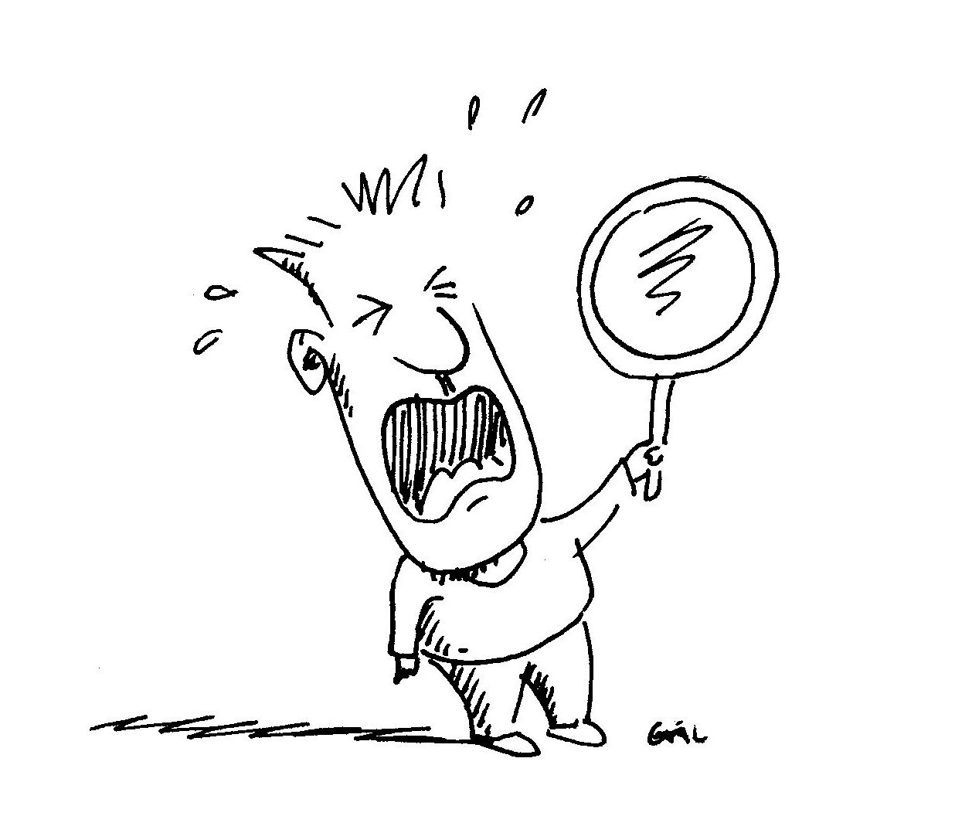

But Where to Start?

Slide 7

The Old Way of Developing Questionnaires for Measuring Patient Perspective….
What I think is…blah blah
But what I think is…blah blah
No, really they think …blah blah
  Developed without patient/respondent perspective
  Added to studies without a strategy, hypothesis or understanding concept being measured
Notes:
Going back in history…..Well, here’s what the old way was….

Slide 8
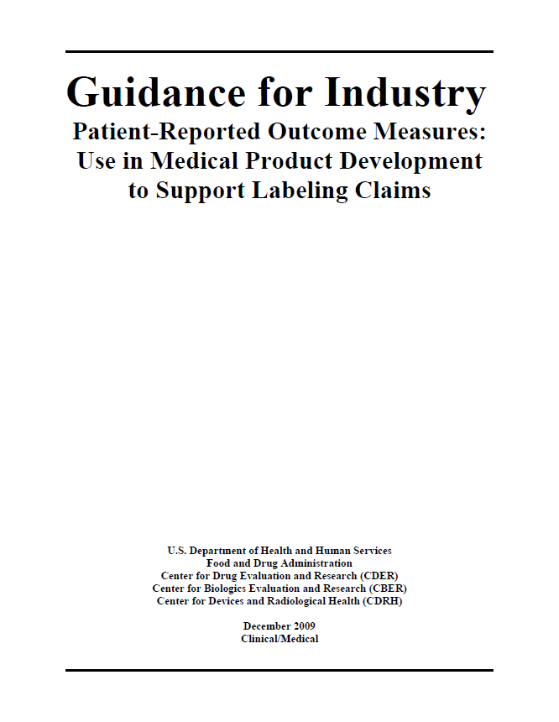
Current Standard for Measurement of the Patient Perspective: FDA PRO Guidance
8
FDA PRO Guidance 2009
Notes:
People may forget the development of the guidance was based upon best practices, but just adds to it, if going for a claim, and
Won’t go through what’s in here….
These are the Best practices that apply regardless of how we use the data
**mention about how PRO guidance standards would apply to new assessments going forward for clin Ros
Needs to be for FIT for PURPOSE (don’t ask me if something is “validated” – it needs to be ‘fit for purpose’)
EMA involvement

Slide 9
Key: Understand the Concept
Concept of Measurement: The specific measurement goal (i.e., the thing that is to be measured by a COA)
Underlying concepts of a direct assessment of treatment benefit document how a patient feels or functions and can fall on a proximal-distal continuum…
9
Notes:
.

Slide 10
Understand the Concept of Measurement
Disease –defining concepts
Proximal disease impact concepts
Distal disease impact concepts
Distal impact on general life concepts
General psychological functioning
Satisfaction with health
Related
functioning
Core signs,
symptoms
or
decrements in
functioning
Overall impact
on HRQL
Related
signs and symptoms
General physical functioning
Productivity
Social functioning
Health status
Proximal concept to
treatment benefit
Distal concept to
treatment benefit
Notes:
Proximal: core disease-defining aspects of how patients feel and function.
Distal: impact of those core signs and symptoms on other aspects of how patients feel or function.
Proximal direct assessments are more likely to demonstrate treatment benefit and should be considered more appropriate for use as primary/secondary endpoints
Distal concepts could be influenced by multiple other factors and therefore challenging to interpret when documenting treatment benefit, particularly if the effect of the treatment on the core disease-defining concepts is unknown
MOST CLAIMS are on the left side,
Makes sense doesn’t it? Example question
- emphasis on symptoms, especially where patient’s voice has been silent!

Slide 11
Begin With the End in Mind
What is the claim we want to make?
  Is there a regulatory pathway, are there accepted endpoints?
  What is the best way to measure treatment benefit? If we want “Improvement in symptoms of X” or we’re measuring something only the patient can perceive (how they feel or function), then we need PRO
If seeking PRO-based claim, need supportive validation evidence for a PRO before End of Phase 2 meeting
  This means researching concepts, selecting or developing PROs, and obtaining input from regulatory agencies before phase II
  Need to pilot PRO in phase II
  It’s too late – to find out at end of phase II meeting that agency won’t accept measure
11
Adapted from L. Burke. The Role of PROs in US Drug Approval and Labeling Decisions. DIA Paris 10 May 2004
Notes:
For those us in Pharma….
What do we want to say at the end of the day, regardless of where using PRO info?
Start Early and work through Development – regardless of whether need to develop a PRO or not to support the claim… A lot of pieces to be put in place and end up with everything in PRO Evidence Package
APC
Strategy (claim, promotion, publication, HTA submission)
Endpoint model
Preparation of PRO evidence package

Slide 12
Clinical Outcomes Assessment Development within Drug Development
Pre-IND/Phase 1
Phase 2A
Phase 2B
Phase 3
NDA/BLA Submission
Define
Concept(s) &
Context of Use
Establish
Content
Validity
(e.g.,
Qualitative
Research, Mixed
Methods)
Establish other
measurement
properties
(e.g., Quantitative
Longitudinal
Research)
Pre-IND , SPA meetings
PRO/COA Evidence Package submitted as part of NDA/BLA
End of Phase II meetings
SEALD has advocated for PRO/ COA discussions as early as pre-IND!
12
Notes:
Also important is mappying best science to drug development programs, and communicating and organizing around that; getting stakeholders engaged
Laurie Burke presented this slide at PRO consortium meeting…Ideally, and in a lot of cases in more recent years, PRO work should start as early as phase I. This is a key time for PROs because we can really help with realizing the potential product’s differentiating features and how we could potentially measure it.
For example, what we may do would include understanding not just the important patient concepts and figuring out what we need to measure (with lit, qual) , what measures are available and if we need to develop new. But This also helps….understand unmet medical needs and opportunities for new drugs
It’s importatnt to have that in phase I, because we’ll want to test these concepts and measures in the learn phase of development – phase II>>will give us the preliminary evidence we need and to adjust as necessary before end of phase II.
We Need evidence of any instruments alidity and reliability before end of phase II – so that means initial discussions ,starting as early as pre-IND, to be sure we’re measuring the right concepts
greater focus and dedicated PRO research early in development, as it is so focused on obtaining an exquisite understanding patient needs and disease effects, can not only inform endpoint selection but could also help shape the clinical development plan and commercial strategy
Key timings for when to be involved and get FDA feedback: prior to phase II

Slide 13
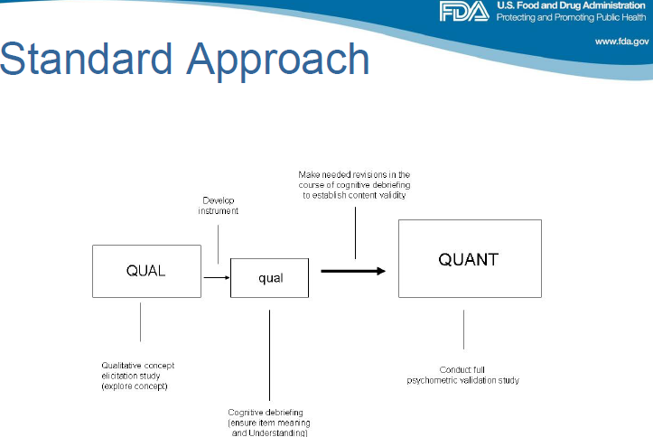
To Establish Content Validity….
When Developing New COA
Adapted from J. Stansbury’s “Mixed Methods to Enhance Content Validity..” C-Path’s Fourth Annual PRO Consortium. April 24, 2013;

Slide 14
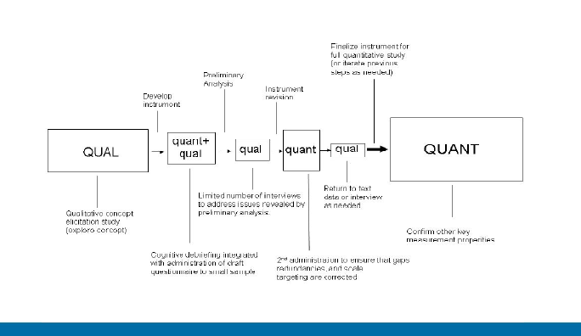
Additional Steps / Alternative Approach Proposed
C-Path Fourth Annual PRO Consortium. J. Stansbury, “Mixed Methods to Enhance Content Validity..” April 24, 2013
Notes:
Issue – more assessments, in face of squeezed drug dev timeline!

Slide 15
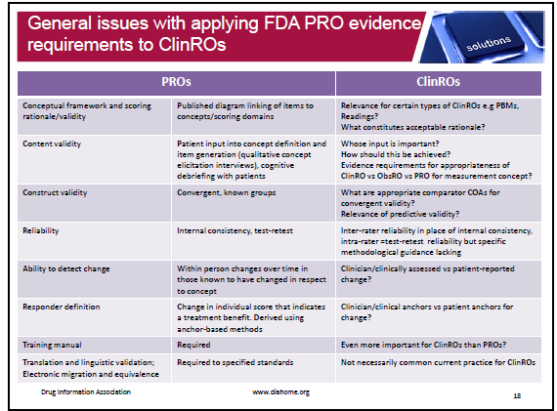
Application of FDA PRO Guidance to other Clinical Outcomes Assessments
Adapted from DIA Webinar Measurement in Clinical Trials, Flood E. 12-Sep-2013
Notes:
ISPOR Task force on this, being lead by John Powers….

Slide 16

ePROs: Enhance Ability to Achieve PRO Claims, Improve Data Quality & Support Regulatory Compliance
…FDA plans to review the protocol to determine what measures are taken to ensure that patients make entries according to the study design and not, for example, just before a clinic visit when their reports will be collected. (FDA PRO Guidance, page 13-14)
  ePROs support regulatory compliance by tracking audit trails and restricting access for modifications
  - Regulatory requirements apply with regards to record keeping, maintenance and access apply, as per 21 CFR 11
Time- stamping data is CRITICAL when the concept being measured may change frequently (e.g. symptoms) – important especially in Pain, Immunology & Oncology. ONLY EPRO TECHNOLOGIES CAN TIME-STAMP

Slide 17

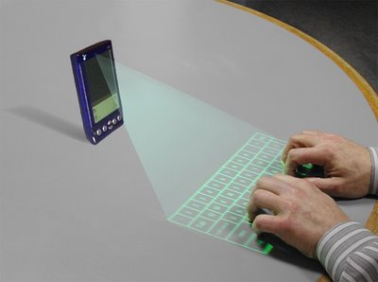
So Where to Go from Here? Some challenges for PROs
Where does social media fit in the development of PROs / Clinical Outcomes Assessments?
How to best integrate PROs with physiologic data to tell the story of clinical treatment benefits?
How to best use PROs early in drug development to inform plans, and benefits vs risks?
How and where can smartphone apps be used?
And of course, regulatory hurdles –
- Mobile Medical Device guidance
- Privacy issues with use of phones, etc?
- Even higher expectations?
Notes:
But where do we go from here? I would hope, as and that would be to harness interest in bringing in patient perspective thgouth innovative means such as;
Exit interviews, (Orencia – is an oldie but a goodie), early in a drug’s development
Use of existing and evolving electronic means of capturing patient perspective (what about the actual patient voice? Or simply touch?) and integrated with physiologic data
Application of social media advances, perhaps to help inform later work that would be more rigorous, or at at least to recruite and connect patients
Intergration of patient voice with patient data to capture patient perspective (e.g. with electronic health records, etc)

Slide 18
Summary
Advocate for the best science
Let’s not settle for same old thing
Let’s listen to the patient

Slide 19
Thank you

