Slide 1
Interpreting of Patient-Reported Outcomes
Joseph C. Cappelleri, PhD, MPH
Pfizer Inc
(e-mail: joseph.c.cappelleri@pfizer.com)
Presentation at the Meeting of the New Jersey Chapter of the American Statistical Association, Bridgewater, New Jersey, October 18, 2013

Slide 2
Disclaimer
The views expressed here do not reflect the views of Pfizer Inc

Slide 3
Outline:
Learning Objectives
Part 1: To understand the methods for interpretation of patient-reported outcomes for label and promotional claims
Part 2: To move beyond the 2009 FDA guidance – extended approaches

Slide 4
Part 1: Interpretation of Patient-Reported Outcomes for Label and Promotional Claims

Slide 5
Introduction
Key is to focus on prespecified patient-reported outcome (PRO)
Important to report all prespecified PROs (not just those that are “significant”)
Also important to report all PROs, prespecified or not

Slide 6
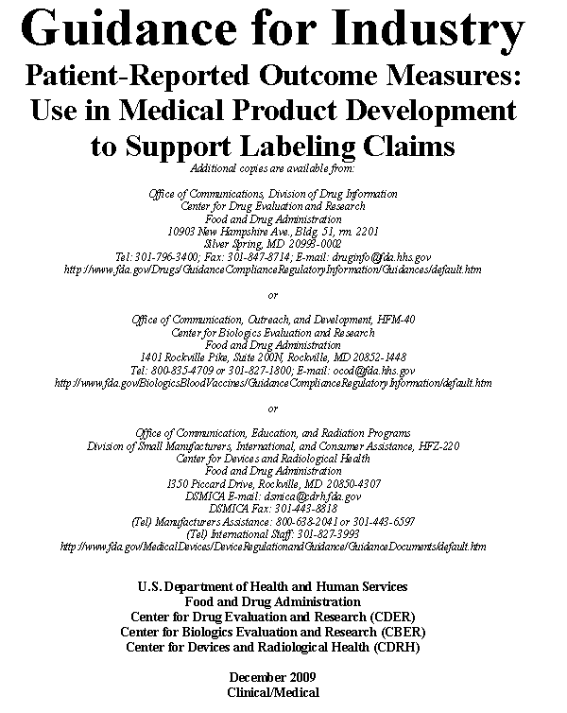

Slide 7
Interpretation of PROs
Not considered a measurement property
Interpretation of PRO endpoints follows similar considerations as for all other endpoint types used to evaluate treatment benefit of a medical product
This presentation assumes adequate evidence of instrument development and validation on the PRO measure of interest

Slide 8
PRO Guidance - Interpretation of Data

Slide 9
What is Different About PROs?

Slide 10
  1. Known relevant change standards
for physiological measures
• blood pressure
    serum creatinine level
2. Developed familiarity with
physiological measures
• professional training
• experience gained by observing
  changes among many patients
  3. Unknown relevant change
  standards for PRO measures
    research tools
    little training or patient experiences

Slide 11
Interpretation Is More Than p<0.05
Need to achieve statistically significant differences between the active treatment and placebo arms for clinical trials, but it’s just not enough
Need a way to determine if statistically significant differences are meaningful and important to clinical trial participants
Can’t rely on p<0.05 to demonstrate an interpretable difference —Many PRO scales are new to label readers and familiarity with what types of changes are important requires experience over time
11

Slide 12
How do you determine the Responder Definition for a PRO instrument?

Slide 13
Key to Interpretation:
Responder Definition
Defined as the trial-specific important difference standard or threshold applied at the individual level of analysis
This represents the individual patient PRO score change over a predetermined time period that should be interpreted as a treatment benefit

Slide 14
Responder Definition
The responder definition is determined empirically and may vary by target population or other clinical trial design characteristics
FDA reviewers will evaluate a PRO instrument’s responder definition in the context of each specific clinical trial

Slide 15
Anchor-Based Methods
Anchor-based methods explore the associations between the targeted concept of the PRO instrument and the concept measured by the anchors
To be useful, the anchors chosen should be easier to interpret than the PRO measure itself and should bear an appreciable correlation with it

Slide 16
Example of Responder Definition:
Pain Intensity Numerical Rating Scale (PI-NRS)
Farrar JT et al. Pain 2001; 94:149-158
11-point pain scale: 0 = no pain to 10 = worst pain
  Baseline score = mean of 7 diary entries prior to drug
  Endpoint score = mean of last 7 diary entries
  Interest centers on change score
  Primary endpoint in pregabalin program
10 chronic pain studies with 2724 subjects
  Placebo-controlled trials of pregabalin
  Several conditions (e.g., fibromyalgia and osteoarthritis)

Slide 17
Example of Responder Definition: Pain Intensity Numerical Rating Scale (PI-NRS)
Patient Global Impression of Change (anchor)
  Clinical improvement of interest
  Best change score for distinguishing ‘much improved’ or better on PGIC
Since the start of the study, my overall status is:
  Very much improved
  Much improved
  Minimally improved
  No change
  Minimally worse
  Much worse
  Very much worse

Slide 18
Example of Responder Definition:
Pain Intensity Numerical Rating Scale (PI-NRS)
Receiver operating characteristic curve
Favorable: much or very much improved
Not favorable: otherwise
~30% reduction on PI-NRS
Sensitivity = 78% and specificity = 78%
Area under curve = 86%

Slide 19
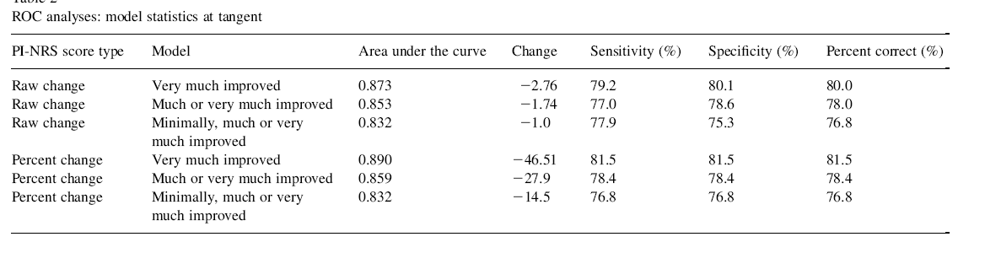
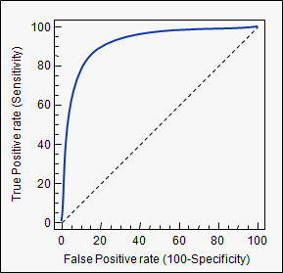

Slide 20
Types of Anchors
Clinical measure
  a 50% reduction in incontinence episodes might be proposed as the anchor for defining a responder
Clinician-reported outcome
  Clinician global rating of change (CGIC) in mental health conditions
Patient global ratings
  Patient global rating of change
  Patient global rating of concept

Slide 21
Cumulative Distribution Function

Slide 22
Cumulative Distribution Function
An alternative or supplement to responder analysis
Display a continuous plot of the percent change (or absolute change) from baseline on the horizontal axis and the cumulative percent of patients experiencing up to that change on the vertical axis
Such a cumulative distribution of response curve – one for each treatment group – would allow a variety of response thresholds to be examined simultaneously and collectively, encompassing all available data

Slide 23
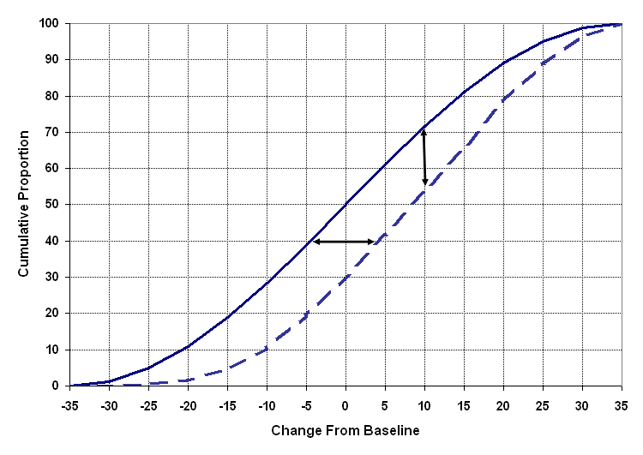
Illustrative Cumulative Distribution Function: Experimental Treatment (solid line) better than Control Treatment (dash line) -- Negative changes indicate improvement

Slide 24
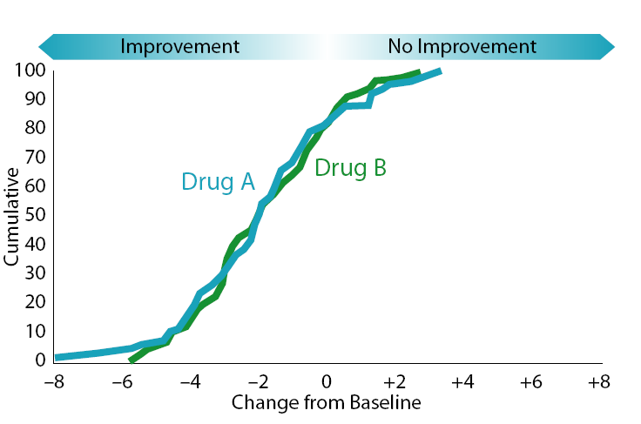
CDF results that do not demonstrate the comparative efficacy of Drug A or Drug B

Slide 25
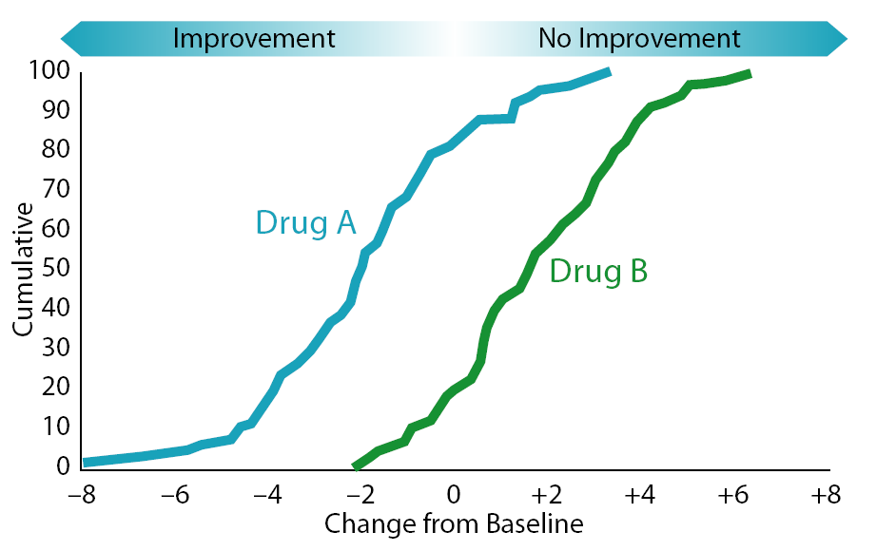
Better result for demonstrating the efficacy of Drug A over Drug B

Slide 26
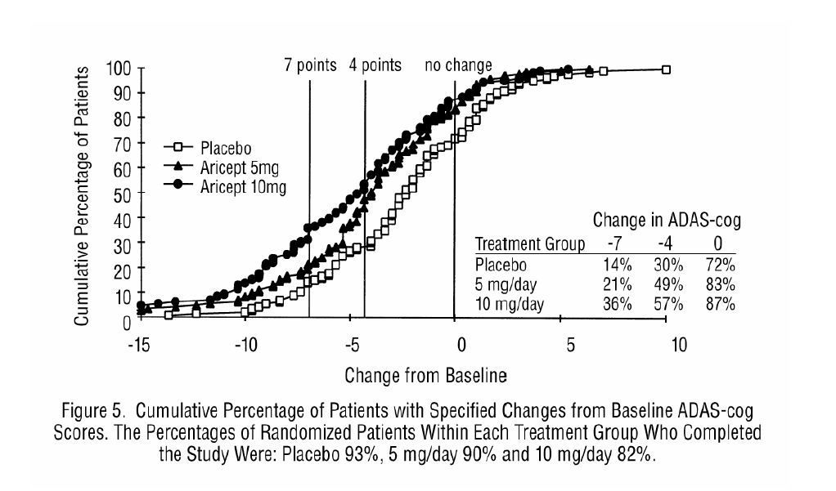
Aricept® label from 10/13/2006

Slide 27
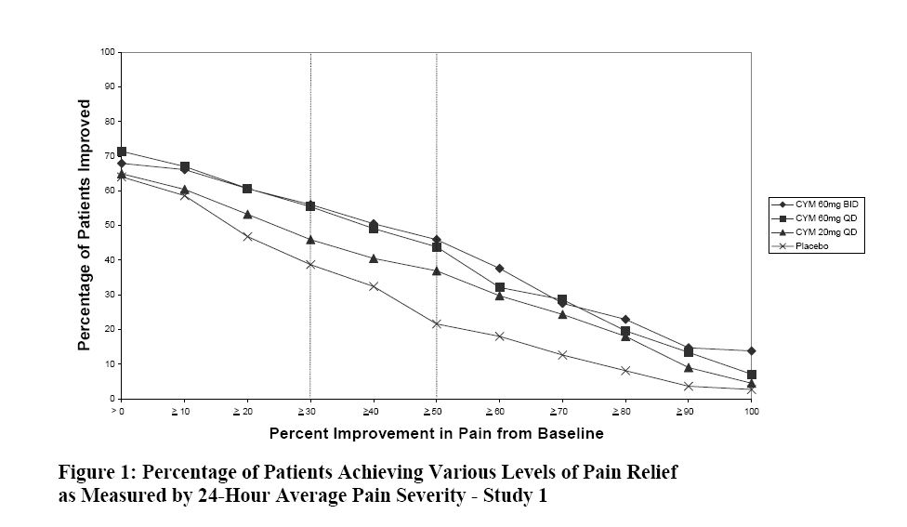
Cymbalta® label from 11/19/2009 (x-axis reversed)

Slide 28
Part 2: Moving Beyond the FDA Guidance – Extended Approaches

Slide 29
Moving Beyond the 2009 PRO Guidance:
Cumulative Proportions and Responder Analysis

Slide 30
Cumulative Proportion of Responders Analysis
Variation of cumulative distribution function analysis and considers only subjects with improvement scores
Cumulative proportion of patients who achieved a specific response rate (percentage) or better as improvement from baseline
Such descriptive (cumulative) response profiles can be numerically enriched using area under the curve

Slide 31
Example:
Cumulative Proportion of Responders Analysis
Farrar et al. Journal of Pain and Symptom Management 2006; 31:369-377
Randomized, double-blind trial of patients with postherpetic neuralgia treated with pregabalin over an eight-week period
Outcome: 11-point pain intensity rating scale (0 = no pain to 10 = worst possible pain)

Slide 32
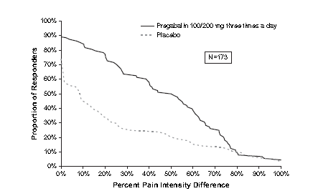
Example:
Cumulative Proportion of Responders Analysis (CPRA)
The proportions of patients with at least 30% decreases in mean pain scores were greater with pregabalin than with placebo (63% vs. 25%,
P = 0.001)

Slide 33
Moving Beyond the 2009 PRO Guidance:
Reference-group Interpretation:
Variation of Anchor-based Approach

Slide 34
Reference-Group Interpretation
Compare trial-based values with values from a reference (anchor) group
Reference values can come from a general population or healthy population

Slide 35
Example of Reference-Group Interpretation:
Self-Esteem And Relationship (SEAR) Questionnaire
Consider 93 men with erectile dysfunction who were measured before and after treatment with sildenafil
Add independent study of men with no clinical diagnosis of ED in past year (control sample)
Relationship with a partner
94 control subjects received no treatment
SEAR assessments completed at a single visit

Slide 36
Example of Reference-Group Interpretation:
SEAR Questionnaire
Clinical and Statistical Significance
Traditional Statistical Test
Significant Not Significant
Cell I
Clinically Equivalent,
Statistically Different
Cell II
Clinically Equivalent,
Not Statistically Different
Significant
Clinical
Equivalency
Test
Cell III
Not Clinically Equivalent,
Statistically Different
Cell IV
Not Clinically Equivalent,
Not Statistically Different
Not
Significant
Dysfunctional population vs. functional population (type of anchor-based method)
Classification of tests using statistical significance and clinical equivalence

Slide 37
Clinical Significance Adding Control Group
Example of Reference-Group Interpretation:
SEAR Questionnaire
Confidence intervals were used to determine equivalence (or lack thereof) within a prespecified range
  0.5 SD of domain score in control group
  Rogers et al. Psychological Bulletin 1993; 113:553-565
  Cappelleri et al. Journal of Sexual Medicine 2006; 3:274-282
ED group before treatment vs. control sample
ED group after treatment vs. control sample

Slide 38
Descriptive Statistics*
Example of Reference-Group Interpretation:
SEAR Questionnaire
Sildenafil Trial
(n=93)
SEAR Component
Control Sample
(n=94)
Pretreatment:
Baseline
Post-treatment:
End of Treatment
1. Sexual Relationship
74 (24)
42 (21.7)
78 (21)
2. Confidence
82 (22)
55 (25.5)
81 (21)
a) Self-Esteem
84 (23)
52 (26.9)
81 (22)
b) Overall Relationship
80 (25)
62 (29.9)
80 (24)
3. Overall score
78 (22)
48 (21.6)
79 (20)
*Data are mean (SD)

Slide 39
Example of Reference-Group Interpretation:
SEAR Questionnaire
Sexual Relationship Satisfaction
40
90% CI
95% CI
Note: Same conclusion, similar results for other domains
37.4
38.4
35
30
31.9
31.9
25
26.4
25.4
20
15
Mean and Confidence Interval
11.95
10
5
90% CI
95% CI
1.6
2.7
Equivalency
Interval
0
-5
-3.8
-3.8
-10
-9.2
-10.3
-11.95
-15
Control Mean (n=94) minus
Pretreatment Mean (n=93):
Statistically Different and
Not Clinically Equivalent
Control Mean (n=94) minus
Posttreatment Mean (n=93):
Clinically Equivalent and
Not Statistically Different

Slide 40
Example of Reference-Group Interpretation:
Medical Outcomes Study (MOS) Sleep Scale
Baseline MOS Sleep Scale scores taken from two double-blind placebo-controlled clinical trials (with pregabalin) for patients with fibromyalgia
  Cappelleri et al. Sleep Medicine 2009; 10:766-770
These scores were compared using a one-sample Z test with scores (assumed fixed) obtained from a nationally representative sample in the United States
  Hays et al. Sleep Medicine 2005; 6:41-44
Patients MOS Sleep Scale scores were statistically (P<0.001) and substantially poorer than general population normative values in the United States

Slide 41
Example of Reference-Group Interpretation:
MOS Sleep Scale
MOS Sleep Scale | LIFT Study |  |  | RELIEF Study |  |  | United States Normative Values
 | n | Mean±SD | 95% CI | n | Mean±SD | 95% CI
Sleep Disturbance | 744 | 67.8±23.4 | 66.1, 69.5 | 740 | 60.0±24.9 | 58.2, 61.8 | 24.5
Snoring | 726 | 40.6±35.9 | 38.0, 43.2 | 717 | 36.7±34.6 | 34.2, 39.2 | 28.3
Awaken Short of Breath or with Headache | 744 | 37.6±31.1 | 35.4, 39.8 | 743 | 32.3±32.0 | 30.0, 34.6 | 9.5
Quantity of Sleep (hours) | 747 | 5.4±1.6 | 5.3, 5.5 | 744 | 5.6±1.6 | 5.5, 5.7 | 6.8
Optimal Sleep (% with 7 or 8 hours ) | 747 | 15.1±1.3 | 12.5, 17.7 | 744 | 21.1±1.5 | 18.1, 24.0 | 54
Sleep Adequacy | 745 | 20.6±22.0 | 19.0, 22.2 | 744 | 23.7±23.2 | 22.0, 25.4 | 60.5
Somnolence | 743 | 50.3±24.1 | 48.6, 52.0 | 740 | 42.1±23.1 | 40.4, 43.8 | 21.9
Sleep Problem Index II | 741 | 65.0±16.3 | 63.8, 66.2 | 736 | 58.3±17.7 | 57.0, 59.6 | 25.8

Slide 42
Moving Beyond the 2009 PRO Guidance:
Content-based Interpretation to Enhance Interpretation of PROs:
Variation of Anchor-based Approach

Slide 43
Content-based Interpretation
Uses a representative (anchor) item on multi-item PRO, along with its response categories, internal to the measure itself
Item response theory
Logistic models with binary or ordinal outcomes
Observed proportions

Slide 44
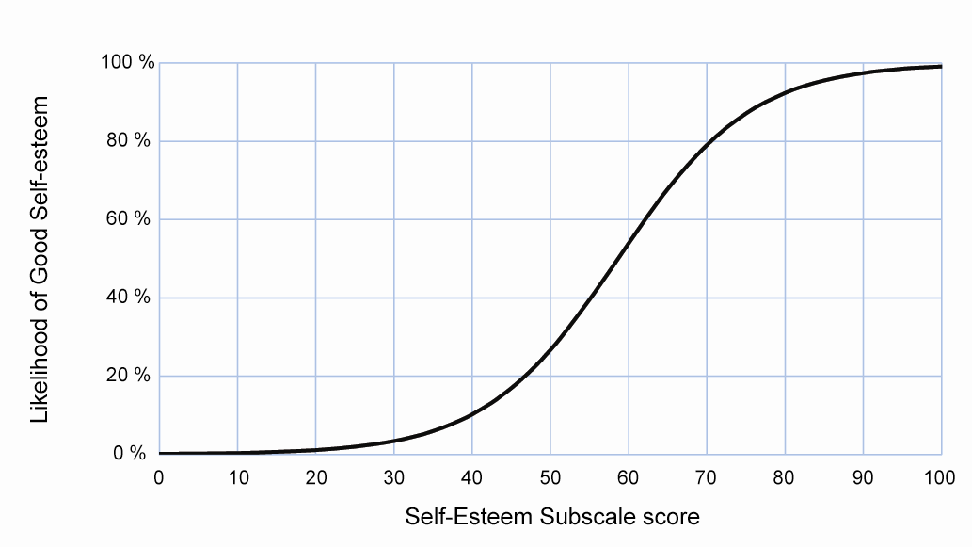
Example of Content-based Interpretation: Self-Esteem on SEAR
Cappelleri JC, Bell SS, Siegel RL. Interpretation of a self-esteem subscale for erectile
dysfunction by cumulative logit model. Drug Information Journal 2007; 41:723-732.
A non-treatment cross-sectional study with 98 men with erectile dysfunction and 94 controls.
The ordinal response item “I had good self-esteem” over the past 4 weeks (1=almost never/never, 2=a few times,
3=sometimes, 4=most times, 5=almost always/always): “Good Self-esteem” was either Category 4 or 5.

Slide 45
Example of Content-based Interpretation:
Enhanced interpretation of instrument scales using the Rasch model (Thompson et al. Drug Information Journal 2007; 41:541-550)

Slide 46
Moving Beyond the 2009 PRO Guidance:
Distribution-based Methods to Enhance Interpretation of PROs

Slide 47
Distribution-based Methods
Adjunct to, not substitute for, anchor-based methods
Informs on meaning of change in PROs but not whether change is clinically significant to patients
Mean change to standard deviation (SD)
  Signal-to-noise ratio
  Effect size and standardized response mean
  Small, moderate, large effects
Standard error of measurement (reliability-adjusted SD)
Probability of relative benefit

Slide 48
Distribution-based Methods
Effect size = magnitude of effect relative to variability
  0.2 SD, ‘small’; 0.5 SD, ‘medium’; 0.8 SD, ‘large’
Within group: before vs. after therapy
Between groups: treatments A vs. B
Both types: responders vs. non-responders

Slide 49
Distribution-based Methods
Within group
  Effect = average difference score on PRO
  Variability = baseline standard deviation (SD)
  Or variability = SD of individual changes
Between groups
  Effect = average change between groups at follow-up
  Variability = pooled between-group SD at baseline
  Or variability = pooled between-group SD at follow-up
  Or variability = pooled SD of individual changes

Slide 50
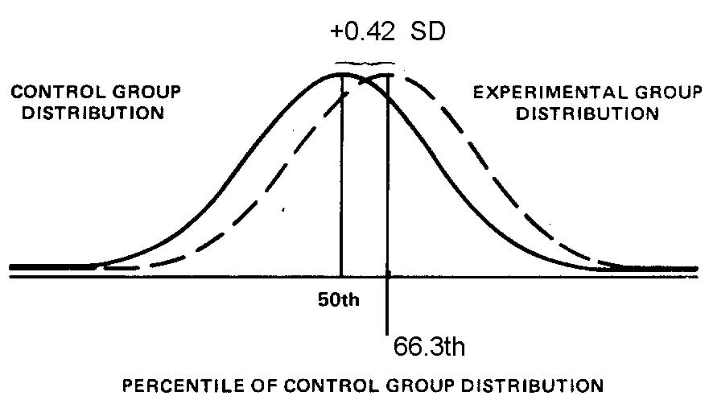
Effect Size Interpretation:
Graphical Depiction
For an effect size of 0.42, the score of the average individual
in the treated group would have exceeded that of 66.3% of
controls [Pr (X < x) = Pr (X < 0.42) = 0.66 from standard
normal table]

Slide 51
Example: Effect Size
Althof et al. Urology 2003; 61:888-892
Cappelleri et al. International Journal of Impotence Research 2004; 16:30-38
Treatment responsiveness of the SEAR questionnaire in erectile dysfunction
  Sexual relationship satisfaction, confidence
  Self-esteem, overall relationship satisfaction, overall
  Each component can range from 0 to 100 (best)
  Interest in change scores to gauge magnitude
93 men with ED in a 10-week open-label trial
  50-mg sildenafil (adjustable 25 mg or 100 mg)

Slide 52
Example: Effect Size
Effect size for all subjects
Effect size = Mean difference score SD at baseline

Slide 53
Example: Effect Size
SEAR Baseline End Effect
Component Mean ± SD Mean ± SD Difference Size__
Sexual Relationship
42 ± 22
78 ± 21
36 ± 23
1.6
Confidence
55 ± 26
81 ± 21
26 ± 26
1.0
Self-esteem
52 ± 27
81 ± 22
29 ± 28
1.1
Overall Relationship
62 ± 30
80 ± 24
18 ± 32
0.6
Overall
48 ± 22
79 ± 20
31 ± 22
1.4
Notes: i) Effect sizes of 0.2, 0.50, and 0.80 have been generally regarded, respectively, as “small,” “medium,” and “large”
ii) For all scores, P=0.0001 on the paired data (final – baseline) using a paired t-test
iii) Similar results reported in two double-blind placebo controlled trials of sildenafil (Althof et al. J Gen Intern Med 2006;1069-1074)

Slide 54
Example: Probability of Relative Benefit
Cappelleri et al. BJU International 2008; 101:861-866.
Two 12-week, double-blind, placebo-controlled, flexible-dose sildenafil trials on Self-Esteem and Relationship (SEAR) questionnaire for men with erectile dysfunction
Difference (sildenafil versus placebo) in SEAR from baseline to week 12 was evaluated with a Wilcoxon rank-sum test using ridit analysis

Slide 55
Example: Probability of Relative Benefit
All p values < 0.001
Across all items, average probability was 0.67 (standard deviation of 0.04)

Slide 56
Moving Beyond the
2009 PRO Guidance:
Mediation Analysis

Slide 57
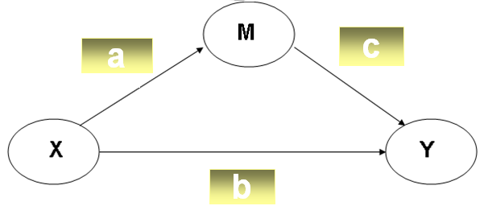
Mediation Models
Seeks to identify or confirm the mechanism that underlies an observed relationship between a predictor (X) and an outcome (Y) via the inclusion of an intermediate or mediator variable (M)
For example: X = treatment (vs. control), M = pain,
Y = sleep disturbance
Note: Direct effect = b, indirect effect = a*c,
total effect = b + a*c

Slide 58
Example:
Russell et al. Sleep Medicine 2009; 10:604-610
Reduced Sleep Disturbance
Decreased Pain
Indirect Effect
(27%; p=0.01)
Direct Effect
(73%; p<0.01)
Pregabalin
450 mg/day
(vs Placebo)
Total Effect = 12.7 reduction (improvement)

Slide 59
Mediation Modeling Depiction
The total effect of an independent variable on a dependent variable can be divided into direct effects and indirect effects through one or more mediator variables
A statistical mediation model estimates the relative contributions of direct and indirect effects of an independent variable on a dependent variable
Mediator variable
c
a
Indirect
effect
Independent
variable
Dependent
variable
b
Direct
(all other effects)

Slide 60
Mediation Modeling Equations
Let X = independent variable, Y = dependent variable and
M = mediator variable
Total effect of X on Y is measured by d in the simple regression equation: Y = intercept1 + d * X
Consider the two simultaneous regression equations:
    Y = intercept2 + b * X + c * M
    M = intercept3 + a * X
Complete mediation is the case in which the variable X no longer affects Y so the direct path coefficient b is zero
Cross-product of a and c (a*c) refers to the indirect effect of X on Y
No mediation occurs when the total effect of X on Y exists entirely through the direct effect, so that b is non-zero and a*c is zero
Partial mediation is the case in which the direct path (b) and indirect path (a*c) are both non-zero

Slide 61
Recent Special Issue on PROs:
Statistical Methods in Medical Research
(Published online 19 February 2013)
Bell M, Fairclough D. Practical and statistical issues in missing data for longitudinal patient reported outcomes
Cappelleri JC, Bushmakin AG. Interpretation of patient-reported outcomes
Izem R, Kammerman LA, Komo S. Statistical challenges in drug approval trials that use patient-reported outcomes
Julious SA, Walters SJ. Estimating effect sizes for health related quality of life outcomes
Massof RW. A general theoretical framework for interpreting patient-reported outcomes estimated from ordinally scaled item responses

Slide 62
Some Noteworthy Books on PROs
Cappelleri JC, Zou KH, Bushmakin AG, Alvir JMJ, Alemayehu D, Symonds T. Patient-Reported Outcomes: Measurement, Implementation and Interpretation. In press. Boca Raton, Florida: Chapman & Hall/CRC; December 2013.
de Vet HCW, Terwee CB, Mokkink LB, Knol DL. 2011. Measurement in Medicine: A Practical Guide. New York, NY: Cambridge University Press.
Fayers FM, Machin D. Quality of Life: The Assessment, Analysis and Interpretation of Patient-reported Outcomes. 2nd ed. Chichester, England: John Wiley & Sons Ltd.; 2007.
Fairclough DL. Design and Analysis of Quality of Life Studies in Clinical Trials. 2nd ed. Boca Raton, Florida: Chapman & Hall/CRC; 2010.
Streiner DL, Norman GR. Health Measurement Scales: A Practical Guide to Their Development and Use. 4th ed. New York, NY: Oxford University Press; 2008.

Slide 63
Summary:
Learning Objectives
Part 1: To understand the methods for interpretation of patient-reported outcomes for label and promotional claims
    Responder analysis
    Anchor-based approaches
    Cumulative distribution function
    Examples
Part 2: To move beyond the 2009 FDA guidance – extended approaches
    Cumulative proportion and responder analysis
    Reference-group interpretation
    Content-based interpretation
    Distribution-based methods
    Mediation Models
    Examples

